Slide 1


Transdisciplinary Assessment and Treatment of Language-based Learning Disabilities:
The Theoretical Importance of Sensory Processing
Tim Conway, Ph.D.
The Morris Center, Inc.
University of Florida
Gainesville, Florida
twc@morriscenters.com
Lorie Richards, Ph.D., OTR/L
University of Florida
Gainesville, Florida
www.TheMorrisCenter.com

Slide 2
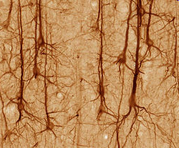
Notes:
Ultimately – everything I’m talking about today comes down to this – the neurons in a human brain and their response to the environment.

Slide 3
Neurons - How the Brain Works
How many neurons In the brain?
  ~ 100 Billion
How many connections exist in the neural networks formed in the brain?
  ~ 100 Trillion
How many “connections” from one neuron?
  ~ 40,000
The brain is specifically designed for learning and behaviors. It is ready and willing to create neural networks.
Learning to drive?
Driving to Ft. Lauderdale…..

Slide 4
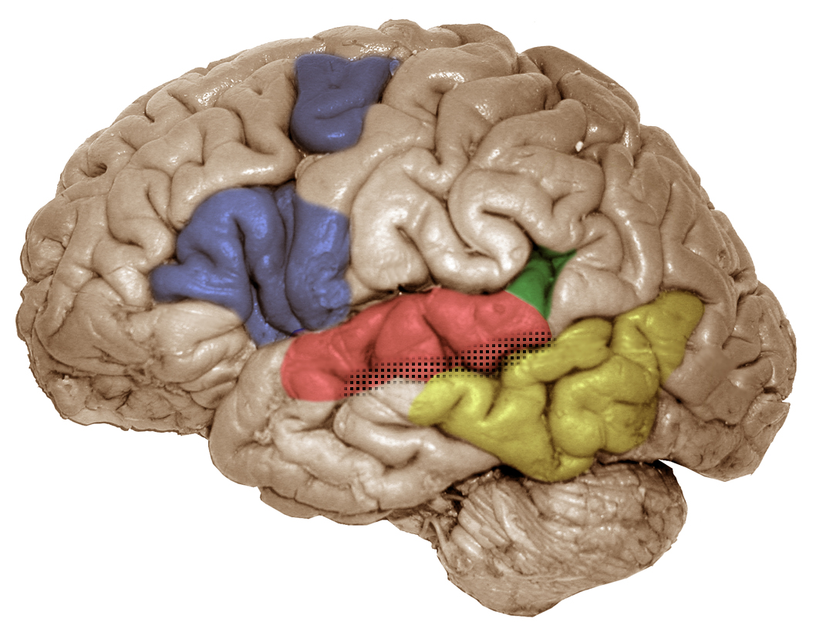
pIFG/dPM (left)
articulatory-based
speech codes
Area Spt (left)
auditory-motor interface
STG (bilateral)
acoustic-phonetic
speech codes
STS phoneme
representations
pMTG (left)
sound-meaning interface
Hickok & Poeppel (2000), Trends in Cognitive Sciences
Hickok & Poeppel (2004), Cognition
Notes:
We have models that tell us how certain areas of the brain have more activity for one type of sensory or cognitive information processing than another. This would lead us to believe that there are particular processing “centers” in the brain; however, we have other studies that show us the brain is not so strictly divided into functional zones or “centers”.

Slide 5
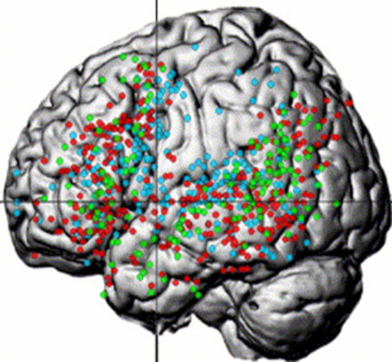
UNIQUE AND OVERLAPPING NETWORKS
SENTENCE/SYNTACTIC, SEMANTIC, PHONOLOGICAL
VIGNEAU et al., 2006
Notes:
For example, from a meta-analysis of fMRI studies we see that these centers are more accurately viewed as broad, distributed NETWORKS of activity within the brain.

Slide 6
How does the brain develop these distributed networks of sensory and cognitive abilities?
Notes:
But, how does the brain develop these distributed networks of sensory and cognitive abilities?

Slide 7
UNIVERSAL SPEECH PERCEPTION: 0-6 MONTHS
SENSORY LEARNING
STATISTICAL LEARNING (DISTRIBUTIONAL FREQUENCIES)
LANGUAGE-SPECIFIC PERCEPTION FOR VOWELS
INFANTS DISCRIMINATE PHONETIC CONTRASTS OF ALL LANGUAGES
Perception
Production
0
1
2
3
4
5
6
Time (months)
INFANTS PRODUCE NON-SPEECH SOUNDS
INFANTS PRODUCE
VOWEL-LIKE SOUNDS
UNIVERSAL SPEECH PRODUCTION: 0-6 MONTHS
(Kuhl, 2004)
Notes:
Use to reiterate the importance of the phonological system and how it lays foundation for future language development. Ability to perceive sounds as different from one another and to appreciate phonotactic patterns
(e.g. Statistical learning –distribution: babies learn phonotactic patterns (rules that govern the sequences of phonemes that can be used to compose words) by 9 months. In other words, they are able to discriminate between phonetic sequences that occur frequently (e.g. /st/) from those that do not occur frequently (e.g. /zb/ -note that this permissible in English) or at all.
Statistical learning transitional probabilities – being sensitive to the sequential probabilities between adjacent syllables (e.g. consider phrase “pretty baby” the probability that “ty” will follow “pre” is higher than the probability that “bay” will follow “ty”). Babies can discover that “pretty” is a potential word even before understanding it’s meaning)

Slide 8
UNIVERSAL SPEECH PERCEPTION: 6-12 MONTHS
Sensory Learning
Language-specific speech perception
RECOGNITION OF LANGUAGE-SPECIFIC SOUND PRODUCTION
LANGUAGE-SPECIFIC PERCEPTION FOR VOWELS
DETECTION OF TYPICAL STRESS PATTERNS IN WORDS
STATISTICAL LEARNING (DISTRIBUTIONAL FREQUENCIES)
INCREASE IN NATIVE-LANGUAGE CONSONANT PERCEPTION
STATISTICAL LEARNING (TRANSITIONAL PROBABILITIES)
DECLINE IN FOREIGN-LANGUAGE CONSONANT PERCEPTION
PERCEPTION
PRODUCTION
6
7
8
9
10
11
12
TIME (MONTHS)
FIRST WORDS PRODUCTION
CANONICAL BABBLING
LANGUAGE SPECIFIC SPEECH PRODUCTION
Sensory-Motor Learning
Language Specific Speech Production
(Kuhl, 2004)
Notes:
Babbling –baby’s way of playing with sound to help integrate the phoneme with sensory-motor learning to create a phonemic map.

Slide 9
Multisensory = any senses?
To promote language development, does it matter what sensory systems or how the sensory systems are engaged/experienced?

Slide 10
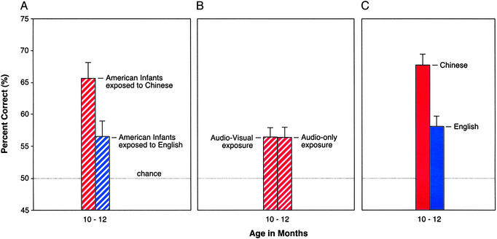
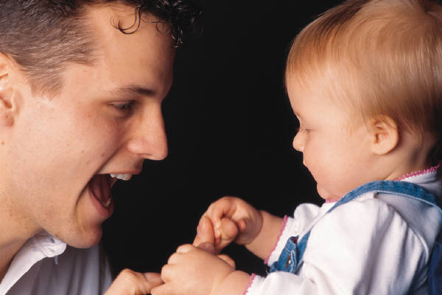

Sensory Systems & Speech Perception
Live intervention
Machine intervention
Live monolingual
(Kuhl et al., 2003)
Notes:
Fig. 2.
Experiment 1. Effects of live foreign-language intervention in infancy. Mandarin Chinese speech discrimination tests conducted on infants after exposure to Mandarin Chinese (red stripes) or American English (blue stripes) show significant learning for the Mandarin-exposed infants when compared with the English controls.
Experiment 2. Mandarin Chinese foreign-language exposure in the absence of a live person (AV or A) shows no learning.
Results of the same Mandarin speech discrimination tests on monolingual Mandarin-learning (red) and English-learning (blue) infants.
Foreign-language experience in infancy: effects of short-term exposure and social interaction on phonetic learning.
Kuhl PK, Tsao FM, Liu HM. Proc Natl Acad Sci U S A. 2003 Jul 22;100(15):9096-101. Epub 2003 Jul 14.

Slide 11
Sensory Systems & Language
Why did live / invivo experience with a parent improve 2nd language discrimination when TV and Headphone experience didn’t?
What sensory systems are engaged by live experience and NOT by recorded experiences?
What do you do when you teach a baby a new word and he/she has trouble saying all the word’s sounds, e.g. “ba” versus ball?

Slide 12
Early Language Development
Brain is tuned to parents’ language
What systems do newborn’s integrate for speech?
    Oral-facial movements – visual
    Speech sounds – phonology
    Speech/babble – oral motor tactile kinesthetic
    Social-emotional – (non verbal tones & gestures) – pragmatics
Newborns speech perception is affected by multisensory experiences during language development.

Slide 13
Sensory Systems & Language Development
Is an adult’s well-developed speech perception affected by multisensory experiences?
http://www.youtube.com/watch?v=eQoYKuNcCpU&feature=fvwrel
Spell pseudo words

Slide 14
How does the brain develop these distributed networks of sensory and cognitive abilities?
Sensory and motor systems that fire together wire together to form functional neural networks in a typically developing brain.
Which sensory systems are firing during development of speech perception?
Notes:
But, how does the brain develop these distributed networks of sensory and cognitive abilities?

Slide 15
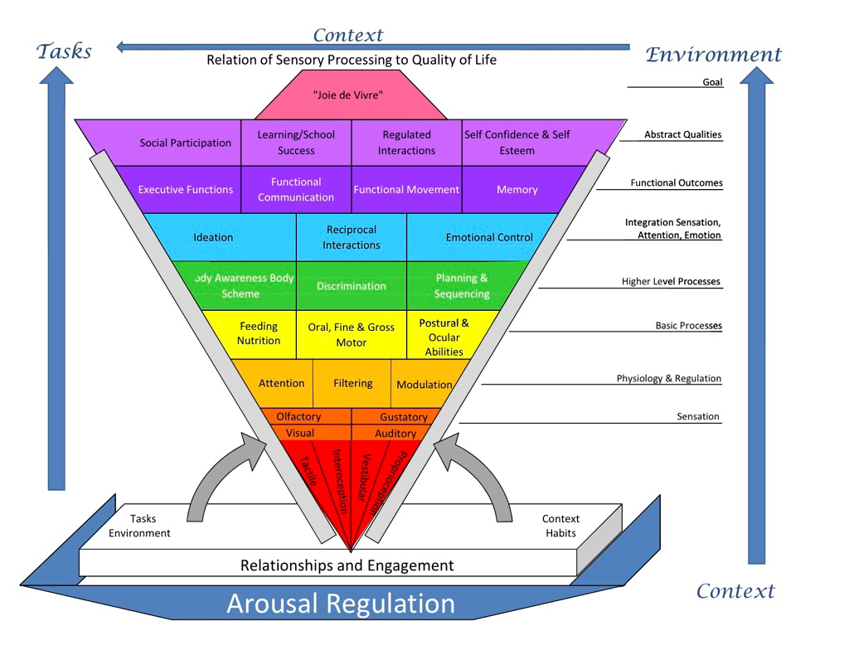
(Miller, 2011)
Notes:
It’s the sensory and cognitive experiences that drive “experience dependent” neural plasticity which helps the brain forms networks for developing skills and abilities.
Figure is from Miller’s handout @ SPD conference – her talk on 10/20/11.

Slide 16
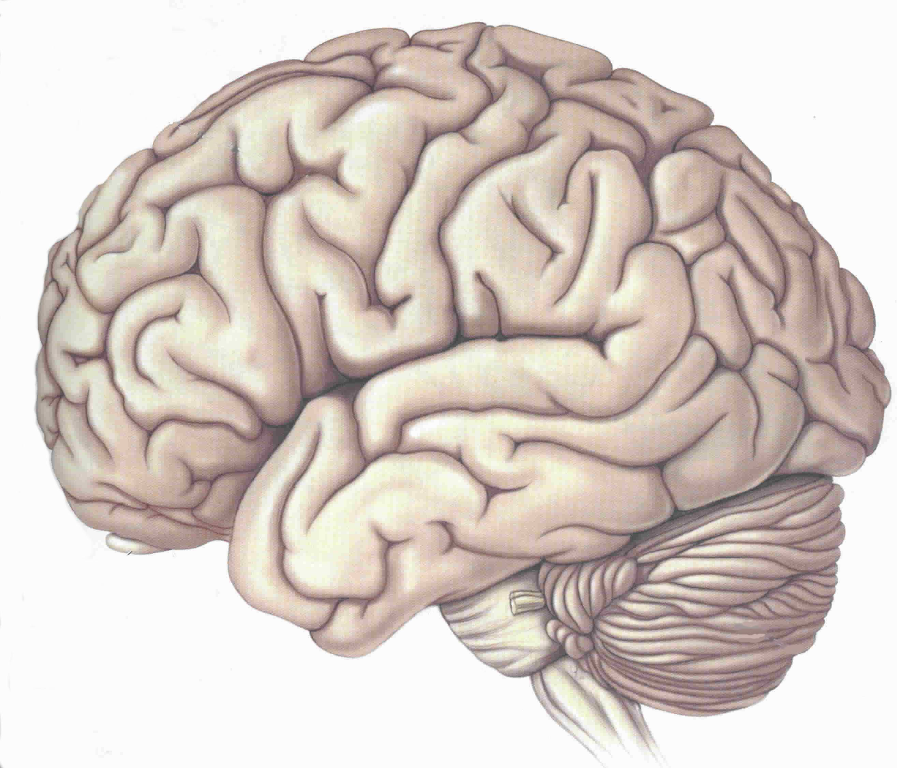
Typical LANGUAGE Networks
VISUAL-LANGUAGE
ASSOCIATION AREA
VISUAL /
VERBAL
AREA
SPEECH
PRODUCTION
AREA
AUDITORY
PROCESSING
AREA
LEFT HEMISPHERE
Notes:
Networks form for language skills

Slide 17
Typical READING Areas
WORD ANALYSIS
WORD ANALYSIS
AUTOMATIC
(SIGHT WORD)
LEFT HEMISPHERE
Notes:
Other networks form for reading skills

Slide 18
“CHANGES IN SYNAPSES?”
At what chronological age do neurons lose the ability to make new connections (synapses) or networks?
Can neural networks make new connections even after documented brain injury?

Slide 19
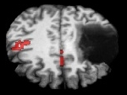
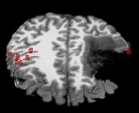
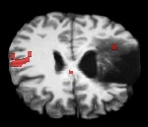
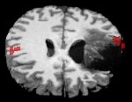
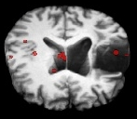
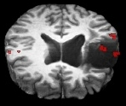
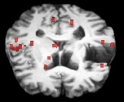
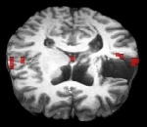
Following a stroke, can partially damaged brain areas be re-activated by neurorehabilitation?
YES! New activity and improved behaviors occur in some patients.
Pre-Treatment
Post-Treatment
Top
R
L
R
L
Back
Back
Bottom
(Chang, et al. 2006)
Front
Front

Slide 20
Principles Of Neural Plasticity
Neurons that fire together - wire together
  - Multiple, salient sensorimotor inputs that wire together can strengthen neural networks
Optimal arousal and attention
Consistent input/learning experiences
Learning experiences drive neural plasticity:
    SALIENCE – specificity of instruction/experience
    FREQUENCY - hour(s) per day
    INTENSITY - days per week
      practice, practice, practice
(Heilman and Alexander, 2003; Kleim and Jones, 2008)

Slide 21
Variability in Neural Plasticity?
Why don’t neural networks all form the same for each person’s brain?
Why do some brains work “differently” than others?

Slide 22
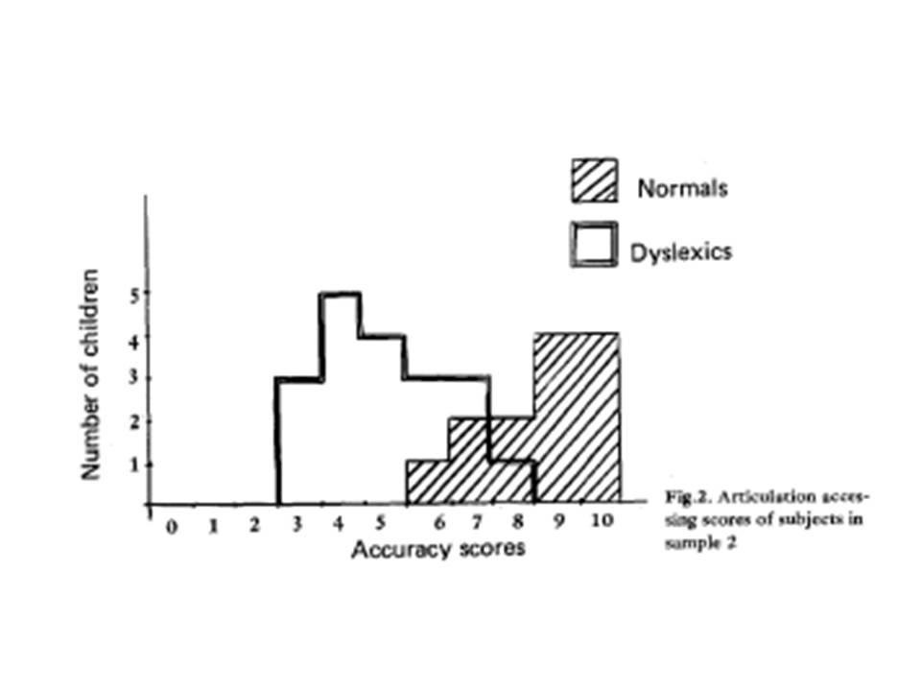
Visual, auditory & oral sensory systems –
Are they integrated well in dyslexia?
Articulation Accessing scores of subjs in sample 2
Montgomery, 1981
Notes:
Discuss - Montgomery & Developmental Dyslexia oral awareness deficits
Abstract:
15 dyslexic and 19 normal readers of the same reading age (8 yrs) but of different CA (10 and 8 yrs) were given an articulation accessing and a phoneme segmentation task. For the former task, Ss had to indicate which of several schematic drawings corresponded to the position of their tongue, teeth, and lips for a given phoneme. Results show that the dyslexic Ss experienced great difficulty with this task, although they were equal to the normal Ss on a simple phoneme segmentation task. Results were replicated with 2 further samples of 19 dyslexic and 15 normal Ss. It is hypothesized that awareness of articulation processes is an important factor in explanations of dyslexia. (17 ref) (PsycINFO Database Record (c) 2010 APA, all rights reserved)

Slide 23
WHAT DYSLEXIA IS NOT
DYSLEXIA…
.. is NOT A VISUAL PROBLEM
.. is NOT A LACK OF INTELLIGENCE
.. is NOT DUE TO LACK OF EFFORT
.. is NOT A DEVELOPMENTAL LAG
.. is NOT UNCOMMON: 5–17.5 % OF POPULATION
.. is NOT RESPONSIVE TO STANDARD READING
INSTRUCTION

Slide 24
DYS = trouble LEXIA = words
Dyslexia is…
Neurologic in origin – genetic
Lifelong – but environment may alter course
Reading comprehension > word reading skills
Dyslexia may include accompanying challenges
  ADHD 50-70%
  Behavioral problems
  Sensory motor difficulty
  = More challenging to remediate

Slide 25

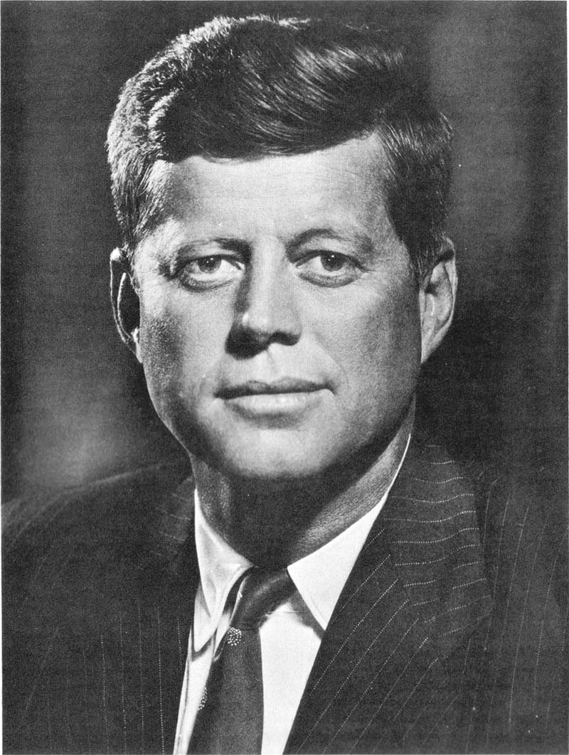

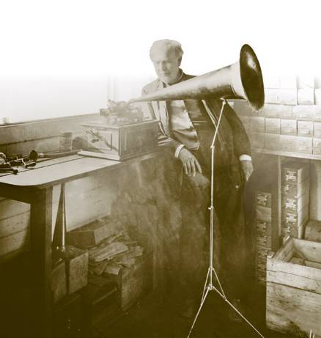

THE PICTURE OF DYSLEXIA
(ALL STRENGTHS DO NOT OCCUR FOR EVERYONE)
(Alexander & Conway, 2007)
STRENGTHS
LEADERSHIP SKILLS
THINKING “OUT OF THE BOX”
CHURCHILL
THOMAS EDISON
JFK
TED TURNER
POLITICAL
&
MILITARY
PATTON
BUSINESS
SCIENTISTS &
INVENTORS

Slide 26
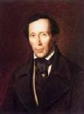

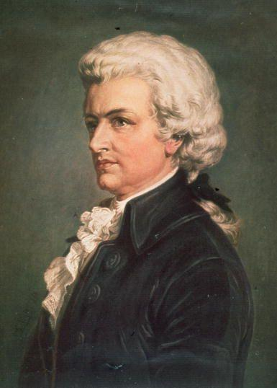

THE PICTURE OF DYSLEXIA
(ALL STRENGTHS DO NOT OCCUR FOR EVERYONE)
(Alexander & Conway, 2006)
STRENGTHS
CREATIVITY
WRITERS
ARTISTS
MUSICIANS
ACTORS/DIRECTORS
H.C. ANDERSEN
Da VINCI
MOZART
SPEILBERG / FORD

Slide 27
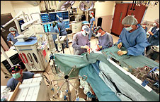

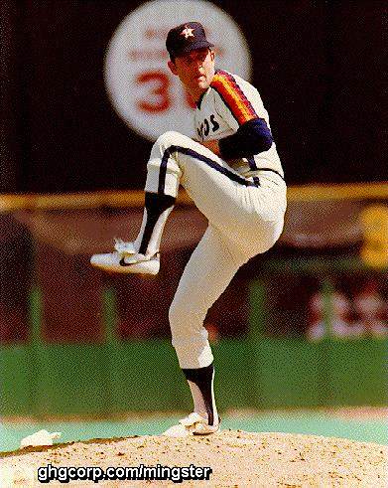
THE PICTURE OF DYSLEXIA
(ALL STRENGTHS DO NOT OCCUR FOR EVERYONE)
(Alexander & Conway, 2006)
STRENGTHS
VISUOSPATIAL / MOTOR SKILLS
SURGEONS
ATHLETES
NEUROSURGERY
MUHAMMAD ALI
NOLAN RYAN

Slide 28
THE PICTURE OF DYSLEXIA
(ALL SYMPTOMS DO NOT OCCUR WITH EVERYONE)
(Alexander & Conway, 2006)
ORAL LANGUAGE
CHALLENGES
LISTENING
SPEAKING
Phonological Awareness
Word Finding
Multi-syllable Words
Auditory Memory
(word sequences, phone numbers,
remembering directions)
Sequencing Ideas
Foreign Language
Foreign Language

Slide 29
THE PICTURE OF DYSLEXIA
(ALL SYMPTOMS DO NOT OCCUR WITH EVERYONE)
(Alexander & Conway, 2006)
WRITTEN LANGUAGE CHALLENGES
READING
SPELLING & WRITING
Mechanics
Comprehension
Mechanics
Expressing Ideas
Speed
Speed

Slide 30
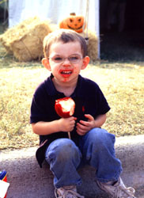
THE PICTURE OF DYSLEXIA
(ALL SYMPTOMS DO NOT OCCUR WITH EVERYONE)
(Alexander & Conway, 2006)
ACCOMPANYING SENSORIMOTOR CHALLENGES
Messy Eating
Oral Motor
Writing/knots
Fingers
Lose Place
Words Swim
Eyes
Tired
Left/Right
Spatial Awareness
Up/Down

Slide 31

THE PICTURE OF DYSLEXIA
(ALL SYMPTOMS DO NOT OCCUR WITH EVERYONE)
(Alexander & Conway, 2006)
ACCOMPANYING CHALLENGES (BEHAVIORAL)
Attention & Executive Function
Anxiety
Brain / Behavior
Disorders
OCD
Oppositional
Behavior
Depression
Parents with similar challenges

Slide 32
Dyslexia – really, what is it?

Slide 33
3 – LEGGED
STOOL
COMPREHENSION
FLUENCY
AUDITORY /
SOUNDING OUT
VISUAL /
SIGHT WORDS
LANGUAGE /
VOCABULARY
GRAMMAR

Slide 34
If Phonology Is So Important, Then When Does It Begin Developing?
At what age do children begin to learn the sounds of their native language?

Slide 35
Developmental Building Blocks for Language
METALINGUISTICS
9 YEARS
WRITING
SPELLING
5 YEAR S
READING
SYNTAX
18 MONTHS
(FORM)
SEMANTICS
9 MONTHS
(MEANING)
PHONOLOGY
(FORM)
PRAGMATICS
(FUNCTION)
1 MONTH
Notes:
Sensorimotor, phonology and language skills are developing immediately post-birth and continue so for quite some time. Phonology is a core system that develops from oral language from birth. Oral language is the primary mechanism for development of phonological processing UNTIL formal instruction in the English alphabet begins around age 4-5 years (younger in some regions/countries and older in others).

Slide 36
pIFG/dPM (left)
articulatory-based
speech codes
Area Spt (left)
auditory-motor interface
STG (bilateral)
acoustic-phonetic
speech codes
STS phoneme
representations
pMTG (left)
sound-meaning interface
Hickok & Poeppel (2000), Trends in Cognitive Sciences
Hickok & Poeppel (2004), Cognition
Notes:
We have models that tell us how certain areas of the brain have more activity for one type of sensory or cognitive information processing than another. This would lead us to believe that there are particular processing “centers” in the brain; however, we have other studies that show us the brain is not so strictly divided into functional zones or “centers”.

Slide 37
UNIQUE AND OVERLAPPING NETWORKS
SENTENCE/SYNTACTIC, SEMANTIC, PHONOLOGICAL
VIGNEAU et al., 2006
Notes:
For example, from a meta-analysis of fMRI studies we see that these centers are more accurately viewed as broad, distributed NETWORKS of activity within the brain.

Slide 38
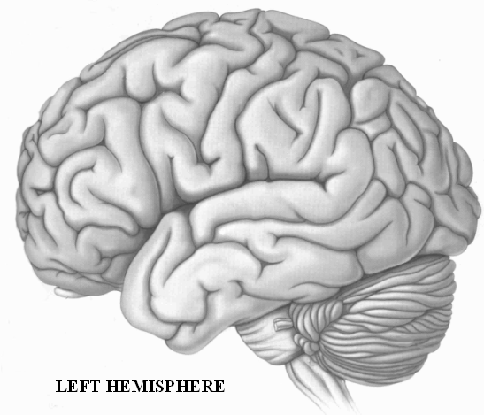
“OUT OF LINE NEURONS” (ECTOPIAS)
FRONT
BACK
Notes:
Out of line ectopias lead to inefficient neural “wiring” in some language and sensorimotor regions of the brain. Inefficient wiring may predispose children the development of language and sensorimotor deficits, e.g. dyslexia and/or sensory processing disorder.

Slide 39
Typical READING Areas
WORD ANALYSIS
WORD ANALYSIS
AUTOMATIC
(SIGHT WORD)
LEFT HEMISPHERE
Notes:
Other networks form for reading skills

Slide 40
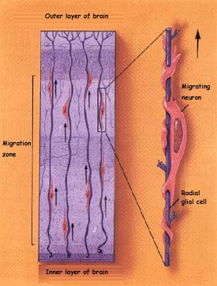
Neuronal migration goes awry in developmental dyslexia?
NEURONAL MIGRATION
X
www.thebrain.mcgill.ca
Notes:
All 100 billion neurons have to migrate to their traget destination in the cortex, but some do not migrate to the proper regions or layers of the brain.

Slide 41
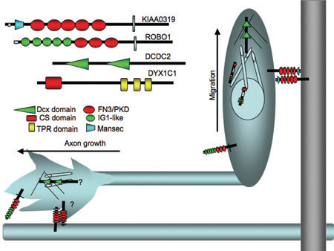
NEURONAL MIGRATION
*transmembrane adhesion molecules and receptors
*downstream targets: change cytoskeletal processes & neuron motility
(Galaburda, et al., 2006)
Galaburda, 2006
Notes:
However, the causes of the malformations in the dyslexic brain remained unclear until four candidate dyslexia susceptibility genes were reported—DYX1C1, KIAA0319, DCDC2 and ROBO1—which are involved in neuronal migration and other developmental processes.
Figure 1 Protein domains and possible functions.
KIAA0319 and ROBO1 serve as transmembrane adhesion molecules and receptors that guide axons to appropriate targets. DCDC2, and perhaps DYX1C1, are proposed to act as downstream targets that then serve to modulate changes in cytoskeletal dynamic processes involved in the motility of developing neurons. Critical future studies must now address whether there are links between the functions of these proteins in migration and axonal path finding.

Slide 42
Neuronal Ectopia
(Ramus, 2004)
Notes:
Neurons and glia have escaped into the molecular layer of the cortex, through a breach in the external glial limiting membrane, to form an ectopia. Scientists believe that ectopias occur in the developing brain of the fetus before its sixth month, since most neurons find their adult positions by that time.

Slide 43
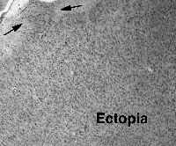

Slide 44
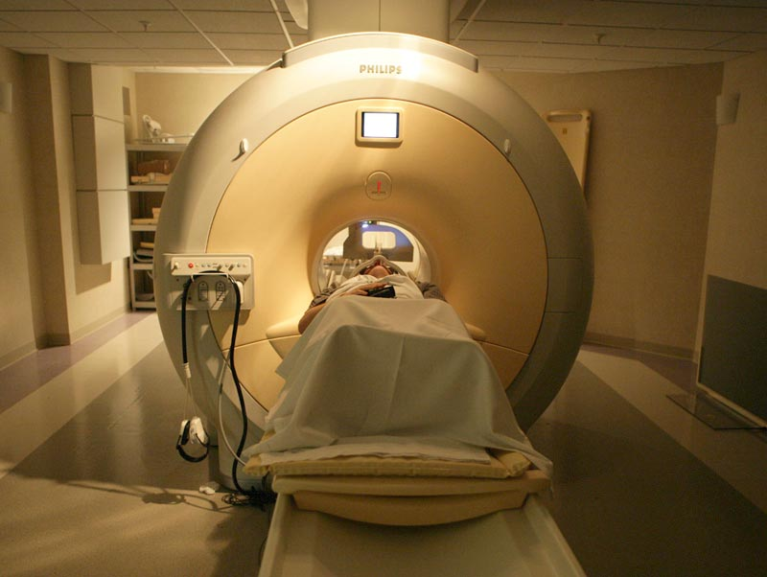
What effects on brain function might ectopias have? Functional MRI (fMRI)
same machine as clinical MRI
additional measure of blood oxygenation levels in brain
shows brain’s active areas when doing some behavior/task

Slide 45
BRAIN ACTIVITY DURING READING
STRONG
ACTIVITY
PATTERN
weak activity
pattern
“SIGNATURE” DYSLEXIC BRAIN
Simos, et al 2002
Notes:
Prototypical comparison of dyslexic and non dyslexic MSI study. The activated areas are, from left to right in the lower right panel, the angular gyrus, Wernicke’s area, and superior temporal gyrus (heavily involved in phonology). Aactivation in occipital area (not depicted) and activation of secondary association area (basal temporal- in yellow) and the simultaneous activation of red, representing a neural network supporting word recognition – a difference is obvious in the language hemisphere in the normal reader and the non-language hemisphere in the poor reader.

Slide 46
TREATMENT CHANGES the BRAIN’S ACTIVITY
right
left
right
left
Treatment = Increased activity in left hemisphere
Decreased activity in right hemisphere
(Simos, et al., 2002)
Notes:
I ask audience why this happened or who did it- instruction, teacher- brain has to learn that words are part of the language system- instruction is needed, whether by parents or a teacher or some other adult; the human brain is not specialized for reading, as the specialization only occurs in response to environmental intervention/educational experience.

Slide 47
Biology
(RAMUS, 2004)
Cognition
Behavior
Notes:
Strong evidence that there are neuronal influences on body functions (cognition) and academic functions (behavior). So, where does Occupational Therapy fit in with all of this?

Slide 48
PHONOLOGY
(Alexander, 2006)
(PERCEPTION & PRODUCTION)
EXECUTIVE FUNCTION / INTENTION
WORKING MEMORY
HOLD / MANIPULATE
PROSODIC
(WORD LEVEL)
PHONEMIC
REPRESENTATION
ORAL MOTOR
SOMATOSENSORY
ACOUSTIC
VISUAL
ATTENTION / AROUSAL
Notes:
Breaking phonology into it component parts helps highlight the critical sensori-motor skills that are core to language development.

Slide 49
(Alexander, 2006)

Slide 50
Theory
Developmental Dyslexia: A Motor-articulatory Feedback Hypothesis (Heilman, Voeller, Alexander, 1996)
  “The inability to associate the position of their articulators with speech sounds may impair the development of phonological awareness and the ability to convert graphemes to phonemes. Unawareness of their articulators may be related to programming or feedback deficits.”

Slide 51
Interdisciplinary Team for
Assessment & Treatment
Disciplines:
  Neuropsychology
  Psychiatry
  Nursing/Nurse Practitioner
  Clinical Psychology
  Occupational Therapy
  Speech-Language Pathology
  Education
Notes:
The team of professionals who work together at The Morris Center, Inc.

Slide 52
Multidisciplinary vs Interdisciplinary
Multidisciplinary – more than one discipline individually evaluates and treats
  Each discipline retains its methodologies and assumptions, without change or development from other disciplines
  Cooperation may be mutual and cumulative, but is not interactive
Interdisciplinary – several disciplines evaluate and treat together
  Each discipline is trained in some tenets of the other disciplines
  Shared theoretical models that integrate perspectives from several disciplines
  Blends the practices and assumptions of each discipline involved
Notes:
The Morris Center only uses an Interdisciplinary model of operations.

Slide 53
Case Study
High school student
History of dyslexia since elementary school
Parent is a school teacher
Years of school-based academic intervention and specialized tutoring at franchised centers…
Starting athlete with scholarship potential, but he has body function and academic deficits in…

Slide 54
Case Study - Assessment Findings
Deficits in:
  Attention
    ADHD-Inattentive
  Language
    Phonological
    Reading
    Writing
    Spelling
    Written comprehension
    Expression
  Sensory Processing Disorder
    Visual vigilance
    Visual tracking
    Vestibular
    Visual perceptual
    “Low Registration” on Sensory Profile
    Poor balance with eyes closed
    Poor supine flexion

Slide 55
Case Study: Interdisciplinary Treatments
Psychology:
  Individual therapy
  Therapy with mother
Speech-Language:
  Phonological Awareness (LiPS Program®)
  Mental Imagery
  (Visualizing & Verbalizing®)
  Written Composition
  (Visual-Kinesthetic Sentence Structure)
OT w/ SI focus
  Sensory modulation & processing - esp. vestibular
  Oculomotor skills
  Joint stability
  Visual perceptual skills
  Balance
  Movement perception
  Sequencing

Slide 56
Case Study:
Interdisciplinary Treatment of Dyslexia
Treatment Schedule:
Daily
4-6 hours treatment per day
  ~1 hour of OT-SI
  ~3-5 hours language
5 days per week
~12 weeks
Treatment Hours:
Phonological/Cognitive: ~150
(neurodevelopmental LiPS®)
Semantic/Memory (V/V®): ~50
Syntax/Cognitive (VKSS): ~50
Physical Medicine (OT-SI): ~45.
Notes:
TMC uses a unique neurodevelopmental approach with the LiPS program, which is described in part in our 1991 paper on the treatment of a group of children with severe dyslexia (Annals of Dyslexia) in our 1999/2000 papers (with Joe Torgesen) on prevention and treatment of dyslexia. VKSS is an “in-house” program developed at TMC to extend both VV and LiPS skills into VKSS’s hands-on development of written language and grammar skills.

Slide 57
Sensory Processing Disorder (SPD)
“…difficulty taking in and interpreting sensory information so that an appropriate response can be generated.” (Bialer & Miller, 2011, pg 20)

Slide 58
Treatment of SPD
“So, to be able to design and implement helpful treatment activities for kids with sensory challenges, it is important on a behavioral level to have some understanding about how sensory input either supports or challenges a child.” (Bialer & Miller, 2011, pg.20)

Slide 59
Body Functions:
Visual-Motor Integration (VMI)
IQ=101
Standard score
Notes:
Motor – 75 to 89 Standard score (14 points of improvement; ~1SD)

Slide 60
Body Functions:
Test of Visual Processing Skills-3
IQ=101
Scaled score

Slide 61
Body Functions:
Comprehensive Test of Phonological Processing (CTOPP)
Standard score

Slide 62
Improved Body Functions
Sensory Processing – “Low registration” was improved with OT-SI, medication and arousal strategies for use at home and school.
Processing/ Modulation of Vestibular Information - R & L LE balance without vision = 4 and 7 secs, improved to 21 and 18 secs; impaired supine flexion improved to 90 seconds while counting (without holding shoulders); depressed post rotary nystagmus was improved
Oculomotor Skills - losing his place during reading and poor visual endurance (blinked excessively during visual tasks/testing), both visual tracking and endurance were improved and excessive blinking was markedly decreased
Visual Perception -TVPS=83 SS (below average) to TVPS=110 (high average)
Graphomotor Skills - VMI Motor Coordination = 75 SS improved to 89
Oral Motor Skills - trouble with his oral-motor “feeling” was improved

Slide 63
Academic Functions:
WECHSLER INDIVIDUAL ACHIEVEMENT TEST (WIAT-II)
Standard score
Notes:
Very large gains in all academic areas and these improved skills helped him go home and pass his high school proficiency tests, get a regular high school diploma and he completed his first year of college.

Slide 64
Conclusions and Future Directions
Participant01 Demonstrated:
Improved Body Functions,
Improved Academic Functions
Improved School Performance
  passed high school proficiency tests (including written exam)
  earned a standard high school diploma
Follow-up report: He has completed his first year of college

Slide 65
Future Directions:
More “Single-Subject Research Design” and RCT studies need to be published to document the specific impact of OT-SI treatment on body functions and academic functions for children with LD’s.
OT is an essential part of an interdisciplinary assessment and treatment for children and young adults with LD’s, but more empirical data is needed.

Slide 66
Future Perspectives: InterdisciplinaryTreatment
Complimentary Interventions
(adapted from Doreit & Miller, 2011)
Language
Sensory processing/integration
Interpersonal relationships
Social engagement
Auditory processing
Cognitive behavioral strategies
Regulating mood/affect
Executive functioning
Academic performance
Parent & client education/training

Slide 67
Thank You
Questions & Comments
Tim Conway, Ph.D.
The Morris Center, Inc.
Gainesville, Florida
twc@morriscenters.com
www.TheMorrisCenter.com

Slide 68
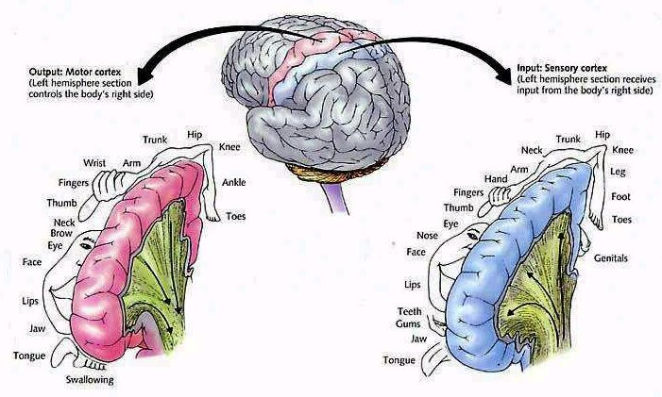

Slide 69
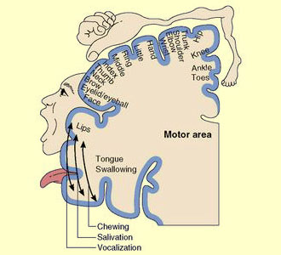

Slide 70
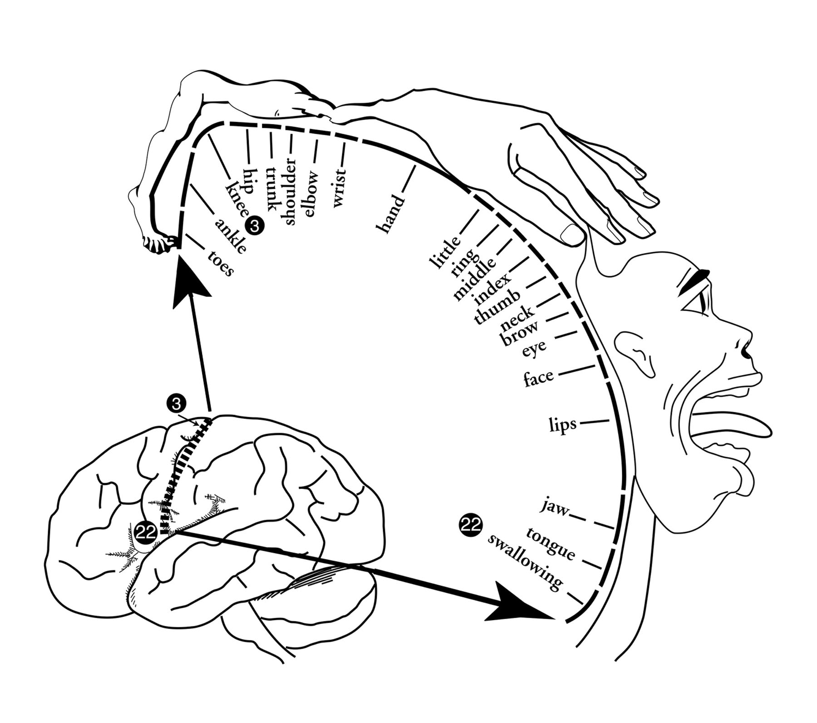

Slide 71
Human Sensory Systems
Visual
Gustatory
Olfactory
Auditory
Tactile
Also:
Vestibular – movement of the head in relation to gravity
Proprioception – pressure in the muscles and joints
Interoception – awareness of body organs, hunger, thirst…

Slide 72
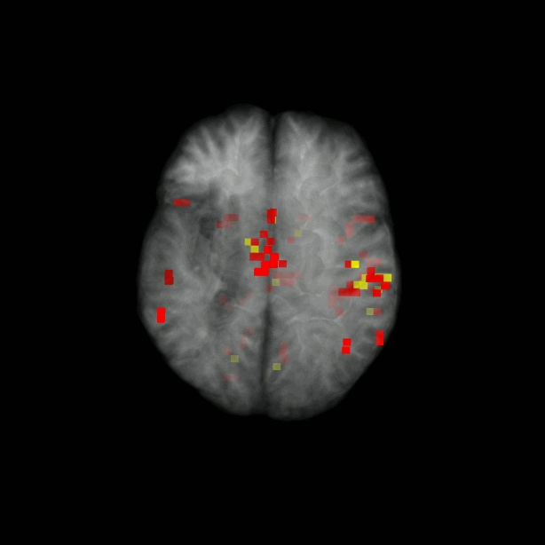
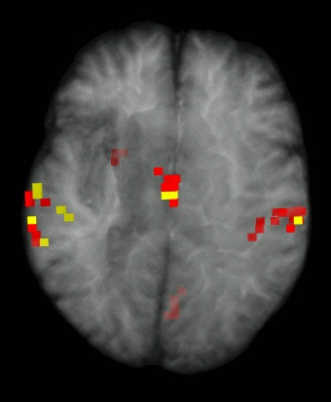
Pre-treatment 3D
Post-treatment 3D
L
R
L
R
Back
Back

Slide 73
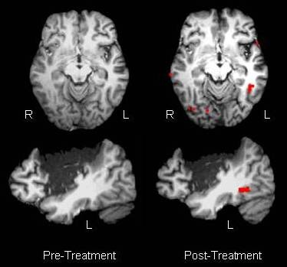
Reading Pseudo words
Front

