Slide 1
Multimodal Treatment of Adults with Post-stroke Phonological Alexia: Behavioral and fMRI Outcomes
T. Conway^{a,b,c}, D. Szeles^{a,b}, F. Bowden^{b}, S. Uhazie^{b,c}, J. Gilbertª, C. Hammª, P. Prilutskyª, B. Crosson^{a,b}, &
L. Gonzalez-Rothi^{a,b,c,d}
ªVA RR&D Brain Rehabilitation Research Center, Malcom Randall VA Medical Center, Gainesville, Florida
^{b}University of Florida, Department Clinical and Health Psychology, Gainesville, Florida
^{c}University of Florida, Department of Speech, Language and Hearing Sciences, Gainesville, Florida
^{d}University of Florida, Department of Neurology, Gainesville, Florida
Acknowledged support:
VA RR&D Center of Excellence (#B3149-C), Career Development (C2743V & B6699W), and Career Scientist awards (B5083L & B6364L).

Slide 2
Abstract
A dual-route model of reading characterizes post-stroke phonological alexia as impaired indirect route reading skills (difficulty with grapheme-to-phoneme conversion). While indirect route reading is aided by phonological processing, few alexia studies retrain phonological processing before attempting to retrain indirect route reading. Conversely in developmental dyslexia, a multimodal treatment markedly improved phonological processing and then indirect route reading. Preliminary attempts with a version of this multimodal treatment to improve phonological alexia produced positive results for some participants and pilot evidence of neural reorganization on fMRI. Thus, we aimed to produce consistent outcomes by treating ten adults with homogeneous post-stroke phonological alexia and measuring changes in neural plasticity (fMRI) during overt reading. We employed a mixed-effects, single-subject research design. All participants demonstrated consistent progress through treatment stages (indicating improved phonological processing and indirect route reading with novel treatment pseudowords) and showed inconsistent outcomes on multiple-probes and pre- versus post-treatment standardized assessments.

Slide 3
Phonological Alexia
an impaired ability to read by sounding words out (poor accuracy in converting alphabet letters into speech sounds and blending the sounds into a word).

Slide 4
Dual Route Model of Reading (Coltheart, 1985)
PRINT
Visual Word
Recognition
Grapheme-Phoneme
Conversion System
Semantics
Spoken Word Production
SPEECH
SPEECH

Slide 5
Prior Studies
Prior alexia studies trained grapheme-to-phoneme conversion skills, alphabetic phonics or reading, instead of training phonological awareness prior to retraining indirect route reading via
mnemonics,
visual associations,
semantic associations,
repeated text reading and
direct grapheme-to-phoneme memorization drills.
However, they failed at or did not attempt training phonological processing prior to training its application to indirect route reading (DePartz, 1986; Kendall et al., 1998; Kiran et al., 2001; Lacey et al., 2010; Mitchum & Berndt, 1991; Nickels, 1992; Wilson, 1994).

Slide 6
These studies reported some improvement in reading, but residual difficulties commonly persisted post-treatment.
These difficulties included limited generalization to untrained words and/or poor maintenance of treatment gains after treatment stopped.

Slide 7
Thus, it is unknown if training phonological processing prior to training indirect route reading could rehabilitate persistent phonological awareness and indirect route reading difficulties in phonological alexia, and lead to generalization and/or long-term gains.

Slide 8
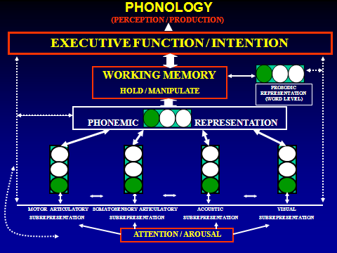
(Alexander and Slinger-Constant, 2004)

Slide 9
(Alexander and Slinger-Constant, 2004)

Slide 10
Does a new version of MMiT consistently improve phonological processing and phonological reading skills for a group of adults with chronic aphasia and phonological alexia?
Hypothesis: Hierarchically training multimodal features of phonemes and their application to training phonological awareness, phoneme to grapheme associations and phonological reading provides a vicariative mechanism for improving phonological processing and reading skills.
Prediction: Improved phonological awareness and reading skills accompanied by increased perilesional activity in IFG , SMG, STG or in their non-dominant hemisphere homologues

Slide 11
Methods

Slide 12
Participants

Slide 13
Participants
N=9
monolingual English speaking
mean age 53 years 6 months (43-62)
8 males
mean education 14 years (12-16)
left-hemisphere stroke
mean duration post onset 53 months (10.6-146)
WAB AQ =71.9 (42.6 - 93.2)
BNT=26 (1-51; SD = 19.1)

Slide 14
Participants
left hemisphere stroke
aphasia
Impaired, but measurable phonological processing
impaired pseudoword and real word reading
auditory comprehension sufficient to complete the treatment protocol

Slide 15
Participants
T1 MRI showed left hemisphere infarction.

Slide 16
PAS01

Slide 17
PAS02

Slide 18
PAS03

Slide 19
PAS04

Slide 20
PAS05

Slide 21
PAS07

Slide 22
JPAS01

Slide 23
JPAS02

Slide 24
JPAS03

Slide 25
Methods Behavioral Treatment

Slide 26
Multimodal Treatment (MMiT)
Single-subject mixed effects (multiple-probe & ABA)
Multiple probes (baseline, treatment, post, 3-month)
Word reading, Pseudoword Reading, Pseudoword Repetition, Orthographic Irregular Word Spelling
Standardized testing (pre-treatment, post-, 3-month)
1:1 treatment, 2-4 hrs/day, 4-5 days/week, ~12-weeks, ~120 hours
Modified version of Lindamood Phoneme Sequencing Program (LiPSTM) (Lindamood & Lindamood, 1998)

Slide 27
Treatment Stages
I. Multimodal Associations - phoneme perception, production and association training (24 consonants and 15 vowels)
II. Phonological Awareness Training
First with mouth pictures, then with colored blocks
III. Phonological Reading and Spelling
First with mouth pictures, then with alphabet letters

Slide 30
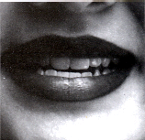
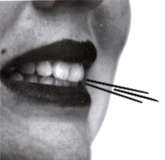
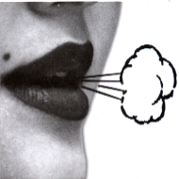
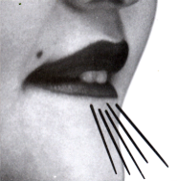
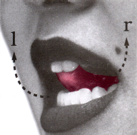
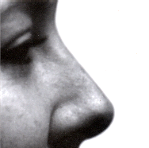
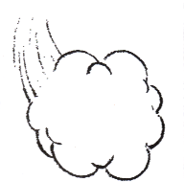
OO
F
EE
TH
SH

Slide 31
MMiT
Pseudowords and words were used during treatment Stage II and Stage III.
During treatment, all words systematically increased from one to five phonemes in length (single syllable) when 80% accuracy occurred across 2-3 sessions.
All words systematically increased from one to five syllables in length(multisyllable) when 80% accuracy occurred aross 2-3 sessions.

Slide 32
Methods fMRI paradigm

Slide 33
fMRI of Overt Pseudoword Reading
fMRI of overt pseudoword reading & pre-treatment, post-, & 3-months follow-up
Single-subject deconvolution analysis (Ward, 1996) in AFNI (Cox, 1996) of all responses followed by cluster analysis (Forman, 1995) with thresholds of cluster volume >100 microliters & r-squared value > 0.20
a priori ROI’s = bilateral STG, SMG, and IFG

Slide 34
Results Behavioral Data

Slide 44
Results fMRI Data

Slide 45
fMRI Task Performance - Reading Pseudowords

Slide 46
S01

Slide 47
S02

Slide 48
S03

Slide 49
S04

Slide 50
S05

Slide 51
S07

Slide 52
JPAS01

Slide 53
JPAS02

Slide 54
JPAS03

Slide 55
S01 pre–post

Slide 56
S01 pre – 3 month

Slide 57
JPAS01 Pre-Post

Slide 58
JPAS01 pre-3month

Slide 59
PAS07 pre-post

Slide 60
Discussion

Slide 61
Discussion
Improved phonological processing skills and maintenance of gains at 3-months post-treatment for adults with post-stroke phonological alexia are outcomes that are consistent with earlier versions of this treatment method (Conway, et al., 1998; Kendall et al., 2003, 2006).

Slide 62
Discussion
Approximately two-thirds of the participants demonstrated treatment improvement and maintenance, with amount of treatment progress appearing directly related to gains on outcome measures. Notably, maintenance of gains on untrained words and additional post-treatment improvements are uncharacteristic effects for alexia studies.

Slide 63
Discussion
Preliminary analyses of fMRI data are consistent with reports of post-treatment relateralization of language function to non-dominant cortices (Adair, et al., 2000), as well as increased activity in dominant, residual perilesional cortices (Crosson, et al., 2005).

Slide 64
Discussion
Consistent evidence of decreased right-hemisphere activity during post-treatment pseudoword reading and consistent or increased reading accuracy during fMRI implies increased efficiency in R-STG networks.
Variable patterns of post-treatment change in neural activity (right and/or left hemispheres), coupled with improved behavioral task performance, may indicate vicariative and/or restitutive mechanisms supporting rehabilitation of language and reading functions (Rothi, 1995).

Slide 65
Discussion
Future data collection and additional analyses will evaluate the impact of the location and size of lesion on treatment outcomes and changes in neural activity.
Also, determination of pre-treatment activity patterns and their relationship to treatment success and changes in neural activity patterns will provide essential information about prospective selection of participants who are most likely to benefit from this treatment approach. Not all participants benefited from this multimodal treatment.

Slide 66
Thank You

