Slide 1


Promoting Speech, Language, Literacy, & Auditory Working Memory
Tim Conway, Ph.D.
The Morris Center
The Einstein School
University of Florida
Neuro-development of Words – NOW®! Gainesville, Florida
FLASHA Conference
May 28, 2015

Slide 2
Sensory Inputs that Support the Development of Speech, Language, Literacy and Auditory Working Memory

Slide 3
What Do Children Learn First….?
Spoken Language Skills
or
Written Language Skills (reading and spelling)?

Slide 4
At what age do children begin to learn the speech sounds of their native language?
Do children hear words first or say words first?
Does Speech Perception Develop Before Speech Production or vice versa?

Slide 5
UNIVERSAL SPEECH PERCEPTION: 0-6 MONTHS
SENSORY LEARNING
STATISTICAL LEARNING (DISTRIBUTIONAL FREQUENCIES)
LANGUAGE-SPECIFIC PERCEPTION FOR VOWELS
INFANTS DISCRIMINATE PHONETIC CONTRASTS OF ALL LANGUAGES
Perception
Production
0
1
2
3
4
5
6
Time (months)
INFANTS PRODUCE NON-SPEECH SOUNDS
INFANTS PRODUCE
VOWEL-LIKE SOUNDS
UNIVERSAL SPEECH PRODUCTION: 0-6 MONTHS
(Kuhl, 2004)
Notes:
Use to reiterate the importance of the phonological system and how it lays foundation for future language development. Ability to perceive sounds as different from one another and to appreciate phonotactic patterns
(e.g. Statistical learning –distribution: babies learn phonotactic patterns (rules that govern the sequences of phonemes that can be used to compose words) by 9 months. In other words, they are able to discriminate between phonetic sequences that occur frequently (e.g. /st/) from those that do not occur frequently (e.g. /zb/ -note that this permissible in English) or at all.
Statistical learning transitional probabilities – being sensitive to the sequential probabilities between adjacent syllables (e.g. consider phrase “pretty baby” the probability that “ty” will follow “pre” is higher than the probability that “bay” will follow “ty”). Babies can discover that “pretty” is a potential word even before understanding it’s meaning)

Slide 6
UNIVERSAL SPEECH PERCEPTION: 6-12 MONTHS
Sensory Learning
Language-specific speech perception
RECOGNITION OF LANGUAGE-SPECIFIC SOUND PRODUCTION
LANGUAGE-SPECIFIC PERCEPTION FOR VOWELS
DETECTION OF TYPICAL STRESS PATTERNS IN WORDS
STATISTICAL LEARNING (DISTRIBUTIONAL FREQUENCIES)
INCREASE IN NATIVE-LANGUAGE CONSONANT PERCEPTION
STATISTICAL LEARNING (TRANSITIONAL PROBABILITIES)
DECLINE IN FOREIGN-LANGUAGE CONSONANT PERCEPTION
PERCEPTION
PRODUCTION
6
7
8
9
10
11
12
TIME (MONTHS)
FIRST WORDS PRODUCTION
CANONICAL BABBLING
LANGUAGE SPECIFIC SPEECH PRODUCTION
Sensory-Motor Learning
Language Specific Speech Production
(Kuhl, 2004)
Notes:
Babbling –baby’s way of playing with sound to help integrate the phoneme with sensory-motor learning to create a phonemic map.

Slide 7
Contrast Aids Perception:
- reasoning by comparison, learning statistical probabilities via experience/practice, and auditory working memory are key elements of the development of Speech and Language skills

Slide 8
What Sensory Systems help a Baby’s Brain Learn or Develop Speech & Language Skills?
Notes:
General notes:
Neuro-developmental models
Define evidence-based support of a program versus research-based support versus clinical experiential support – all promoting SLP’s delivery of Evidence-Based Practice (the focus of FLASHA/ASHA
Are there dyslexia subtypes that are research-based subtypes?

Slide 9


How do parents speak to babies?
“ball”

Slide 10
If a child is having trouble learning to say a word, how do we help them say it correctly?
Do we shout it LOUDER in their ear?
Do we say it slower?

Slide 11
Where do babies look when parents are speaking to them – face to face?

Slide 12
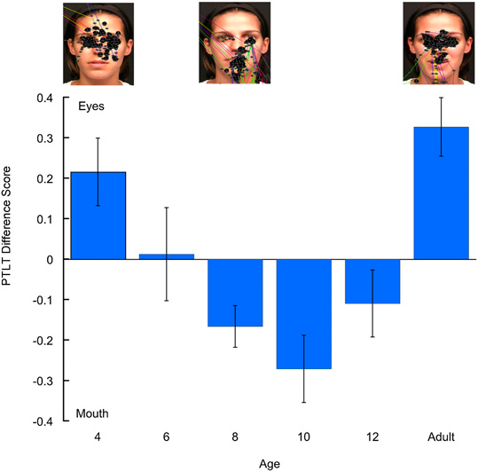
Infants’ visual fixation during speech perception – an example
Notes:
Fig. 1. PTLT difference scores as a function of age in response to the English monologue. Error bars represent SEMs. The screen shots above the graph are representative scan patterns of the talker’s face in a 4- and an 8-mo-old infant and in an adult (each black dot represents a single visual fixation).
ABSTRACT: The mechanisms underlying the acquisition of speech-production ability in human infancy are not well understood. We tracked 4–12-mo-old English-learning infants’ and adults’ eye gaze while
they watched and listened to a female reciting a monologue either in their native (English) or nonnative (Spanish) language. We found that infants shifted their attention from the eyes to the
mouth between 4 and 8 mo of age regardless of language and then began a shift back to the eyes at 12 mo in response to native but not nonnative speech. We posit that the first shift enables
infants to gain access to redundant audiovisual speech cues that enable them to learn their native speech forms and that the second shift reflects growing native-language expertise that frees
them to shift attention to the eyes to gain access to social cues. On this account, 12-mo-old infants do not shift attention to the eyes when exposed to nonnative speech because increasing native-
language expertise and perceptual narrowing make it more difficult to process nonnative speech and require them to continue to access redundant audiovisual cues. Overall, the current findings
demonstrate that the development of speech production capacity relies on changes in selective audiovisual attention and that this depends critically on early experience.

Slide 13
Speech Perception:
Do children learn their native language by ear, eye and/or mouth?
the “McGurk Effect”
(sample video)
Notes:
General notes:
Neuro-developmental models
Define evidence-based support of a program versus research-based support versus clinical experiential support – all promoting SLP’s delivery of Evidence-Based Practice (the focus of FLASHA/ASHA
Are there dyslexia subtypes that are research-based subtypes?

Slide 14
At what age is a child’s brain “tuned” to parents’ native language?
  At approximately 10 months of age the auditory cortex begins to specialize for a native language
  (Kuhl, 2004)
Notes:
General notes:
Neuro-developmental models
Define evidence-based support of a program versus research-based support versus clinical experiential support – all promoting SLP’s delivery of Evidence-Based Practice (the focus of FLASHA/ASHA
Are there dyslexia subtypes that are research-based subtypes?

Slide 15
EARLY NEURO-DEVELOPMENT of SPEECH
Babies integrate sensory and motor inputs from what senses?
    MOTOR - ORAL-FACIAL MOVEMENTS
    AUDITORY - SPEECH SOUNDS (Phonology)
    VISION (of oral-facial movements; own mouth if a mirror is available)
    SOCIAL–EMOTIONAL (Pragmatics)

Slide 16
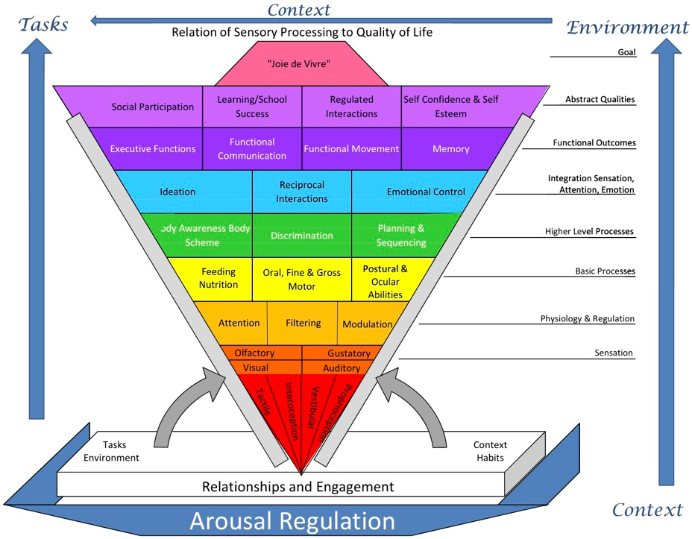
(Miller, 2011)
Notes:
It’s the sensory and cognitive experiences that drive “experience dependent” neural plasticity which helps the brain forms networks for developing skills and abilities.
Figure is from Miller’s handout @ SPD conference – her talk on 10/20/11.

Slide 17
NEURO-DEVELOPMENTAL MODELS OF PHONOLOGICAL AWARENESS AND READING

Slide 18
PHONOLOGY
(Alexander & Slinger, 2004)
(PERCEPTION & PRODUCTION)
EXECUTIVE FUNCTION / INTENTION
WORKING MEMORY (HOLD / MANIPULATE)
PROSODIC
(WORD LEVEL)
PHONEMIC
REPRESENTATION
ORAL MOTOR
SOMATOSENSORY
ACOUSTIC
VISUAL
ATTENTION / AROUSAL

Slide 19
Developmental Building Blocks for Language
(modified from Alexander & Heilman , 2006)
METALINGUISTICS
9 YEARS
WRITING
SPELLING
5 YEARS
READING
Expressive Language
SYNTAX
Receptive Language
18 MONTHS
(FORM)
9 MONTHS
SEMANTICS
(MEANING)
1 MONTH
PHONOLOGY
(FORM)
PRAGMATICS
(FUNCTION)
Notes:
Sensorimotor, phonology and language skills are developing immediately post-birth and should continue so for quite some time, if all the systems are working well together.

Slide 20
What Skills = Solid Foundation for Reading? Developmental “Language Building Blocks”
C O M P R E H E N S I O N
SYNTAX
R E A D I N G F L U E N C Y
SOUND OUT WORDS (phonology/decoding)
SIGHT WORDS
(Visual Memory)
SIGHT WORDS
(visual memory)
VOCABULARY
(semantic knowledge)
VOCABULARY
(Semantic Knowledge)
Notes:
Sensorimotor, phonology and language skills are developing immediately post-birth and continue so for quite some time. Phonology is a core system that develops from oral language from birth. Oral language is the primary mechanism for development of phonological processing UNTIL formal instruction in the English alphabet begins around age 4-5 years (younger in some regions/countries and older in others).

Slide 21
ORGANIZATION & ACTIVITY: PHONOLOGICAL AWARENESS AND READING IN THE BRAIN

Slide 22
BRAIN ACTIVITY DURING READING
STRONG
ACTIVITY
PATTERN
weak activity
pattern
“SIGNATURE” DYSLEXIC BRAIN (Shaywitz, 2003)
Simos, Fletcher, Bergman, et al 2002
Notes:
Prototypical comparison of dyslexic and non dyslexic MSI study. The activated areas are, from left to right in the lower right panel, the angular gyrus, Wernicke’s area, and superior temporal gyrus (heavily involved in phonology. Activate after initial sensory activation in occipital area (not depicted) and activation of secondary association area (basal temporal- in yellow) and the simultaneous activation of red, representing a neural network supporting word rec- difference is obvious- in the language hemisphere in the normal reader and the nonlanguage hem in the poor reader

Slide 23
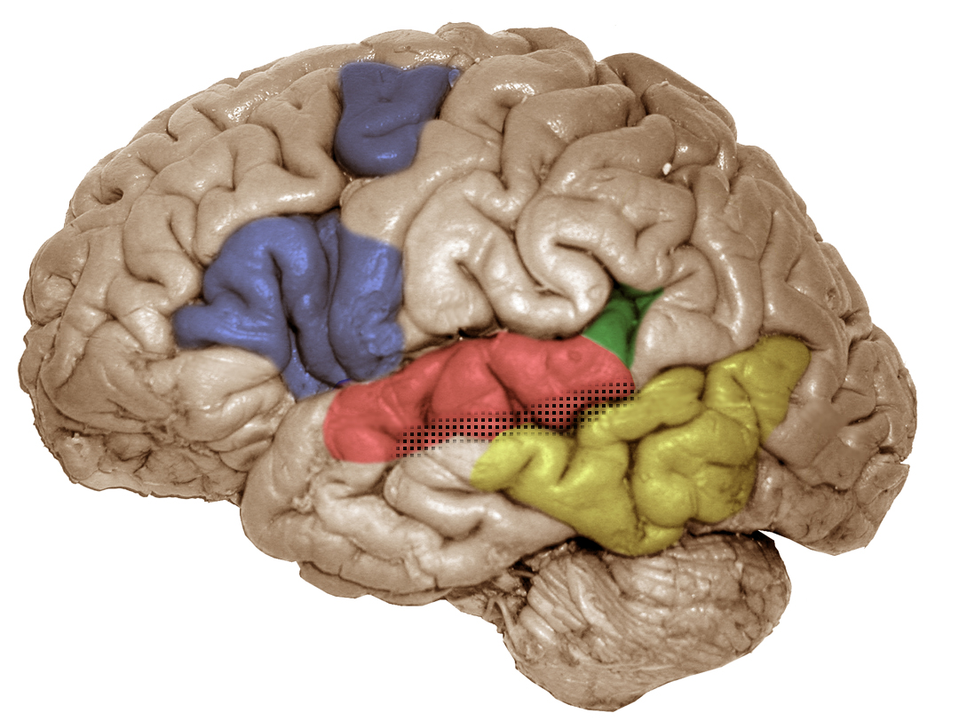
FUNCTIONAL BRAIN REGIONS
pIFG/dPM (left)
articulatory-based
speech codes
Area Spt (left)
auditory-motor interface
STG (bilateral)
acoustic-phonetic
speech codes
STS phoneme
representations
pMTG (left)
sound-meaning interface
HICKOK & POEPPEL (2000, 2004)

Slide 24
Education should change Brain Connections & Wiring, aka “Synapses”
At what age in your life do your neurons lose the ability to make new connections (synapses) or new wiring (networks)?
Can neural networks make new connections even after documented brain injury?

Slide 25
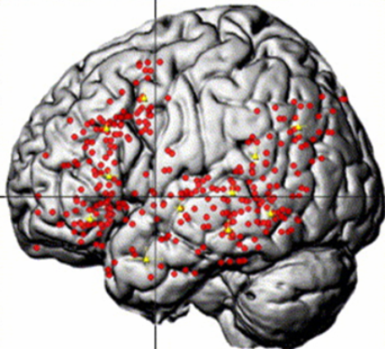
SEMANTIC activity
VIGNEAU et al., 2006

Slide 26
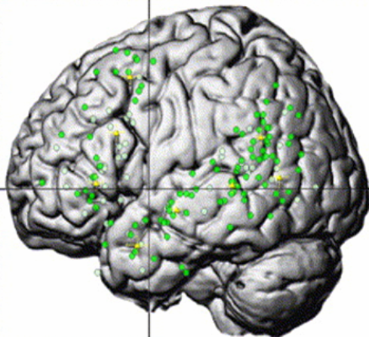
SENTENCE/SYNTACTIC Activity
VIGNEAU et al., 2006

Slide 27
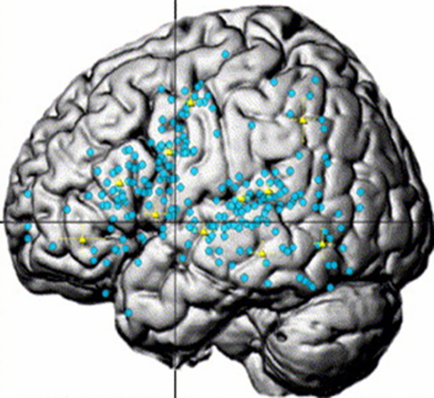
PHONOLOGICAL activity
VIGNEAU et al., 2006

Slide 28
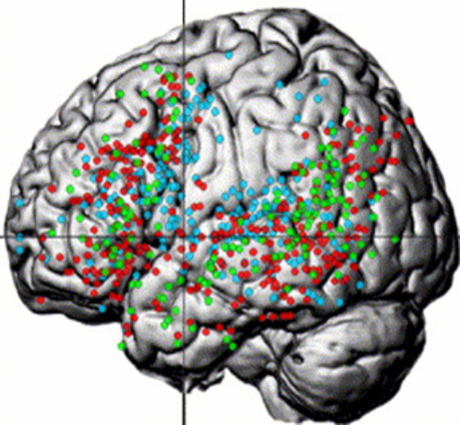
UNIQUE and OVERLAPPING NETWORKS
SENTENCE/SYNTACTIC, SEMANTIC, PHONOLOGICAL
(VIGNEAU et al., 2006)

Slide 29
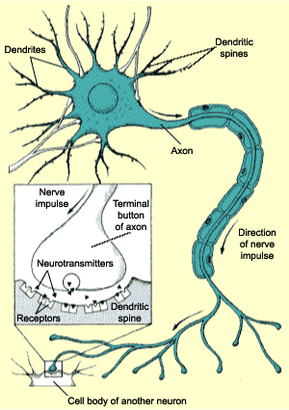
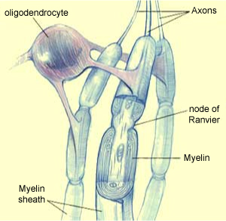
NEURONS
– follow a developmental journey
www.thebrain.mcgill.ca

Slide 30
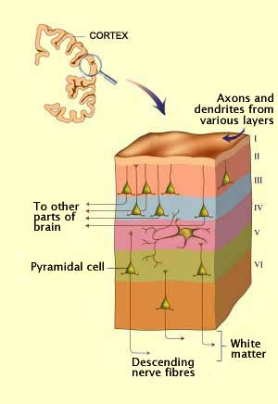
A journey forms specific brain layers
www.thebrain.mcgill.ca

Slide 31
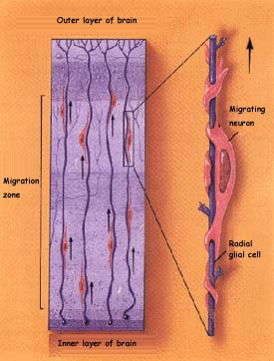
Maybe neuronal migration goes awry in developmental dyslexia?
NEURONAL MIGRATION (journey)
X
www.thebrain.mcgill.ca
Notes:
All 100 billion neurons have to migrate to their target destination in the cortex, but some do not migrate to the proper regions or layers of the brain. This leaves the brain with less efficient wiring, meaning that it will take more intensive, more frequent and more explicit or concrete instruction to help rewire these areas or networks in the brain. So, where do these ectopias occur and which networks in the brain are they most likely to affect? Language, sensory and motor skills (speech and fine motor). So, from this knowledge of the less efficient wiring and brain regions/networks models of what skills need to be working together to develop these networks for phonological processing and reading are developed. These models look like the following:

Slide 32
Fact or Myth about Dyslexia?
Dyslexia is genetic and tends to run in families.
  It is hereditary and has been linked to 6-9 different genes that may contribute to the development of dyslexia.

Slide 33
Dyslexia
Dyslexia is a genetic, neurobiological learning difficulty and is commonly believed to include visual, language, sensory, motor, behavioral, and attention difficulties. However, many common beliefs are myths, not supported by research data. Importantly, research on both the prevention and the remediation of the phonological and decoding deficits common to dyslexia shows robust success for children and for adults.

Slide 34
What is Dyslexia?
Definition:
  Difficulty with words (dys = difficulty; lex = words)
  Difficulty in learning to read despite adequate intelligence, educational opportunities and cannot be due to an impairment in a primary sensory system (e.g. blindness).
  Can affect other language skills besides reading, i.e. spelling, speech, language expression and language comprehension.

Slide 35
Fact or Myth about Dyslexia?
Dyslexia is not very common?
  Current estimates are nearly 20% of children have dyslexia.
  That’s a prevalence of 1 out of every 5 children
  Among those diagnosed with a learning disability, 80% of these children have a specific learning disability in reading.

Slide 36
Fact or Myth about Dyslexia?
Individuals with Dyslexia see words backwards
  Child looks at the word WAS and says “saw”
  Does the child look at THE and say “eht” ?
    Why not?

Slide 37
Fact or Myth about Dyslexia?
Dyslexia is a visual problem that can be fixed with eye exercises?
  Eye training has not been shown to improve decoding skills in children with dyslexia (2009).
    AMERICAN ACADEMY OF PEDIATRICS
    AMERICAN ACADEMY OF OPHTHALMOLOGY
    AMERICAN ASSOCIATION FOR PEDIATRIC OPHTHALMOLOGY AND STRABISMUS
    AMERICAN ASSOCIATION OF CERTIFIED ORTHOPTISTS

Slide 38
Fact or Myth about Dyslexia?
Dyslexia is a developmental lag and if we just retain or hold a child back one year then reading will “click”, because the child will have matured and caught up to his/her peers.
  Retention does not produce better reading skills in children with dyslexia
  Another year of the same educational methods – yields the same results it did the first time – POOR.
  Matching children with and without dyslexia for total reading experience, stills shows that the children with dyslexia are making more errors when reading.

Slide 39
DYS = trouble LEXIA = words
Dyslexia is…
Neurologic in origin – genetic
Lifelong – but environment may alter course
Reading comprehension > word reading skills
Dyslexia may include accompanying challenges
  ADHD 50-70%
  Behavioral problems
  Sensory motor difficulty
  = More challenging to remediate

Slide 40
GROWTH IN “PHONICS” ABILITY OF CHILDREN WHO BEGIN FIRST GRADE IN THE BOTTOM 20%ile IN PHONEME AWARENESS AND LETTER KNOWLEDGE
6
5.9
5
Average
Low PA
4
Low
Ave. PA
READING GRADE LEVEL
3
2.3
2
1
K
1
2
3
4
5
GRADE LEVEL CORRESPONDING TO AGE
(Torgesen & Mathes, 2000)
`

Slide 41
GROWTH IN WORD READING ABILITY OF CHILDREN WHO BEGIN FIRST GRADE IN THE BOTTOM 20%ile IN PHONEME AWARENESS AND LETTER KNOWLEDGE (Torgesen & Mathes, 2000)
5.7
Low PA
5
Average
Low
4
Ave. PA
READING GRADE LEVEL
3.5
3
2
1
K
1 2 3 4 5
GRADE LEVEL CORRESPONDING TO AGE

Slide 42
GROWTH IN READING COMPREHENSION OF CHILDREN WHO BEGIN FIRST GRADE IN THE BOTTOM 20%ile IN PHONEME AWARENESS AND LETTER KNOWLEDGE (Torgesen & Mathes, 2000)
6.9
6
Average
Low
5
4
3.4
READING GRADE LEVEL
3
2
SAME VERBAL ABILITY – VERY DIFFERENT READING COMPREHENSION
1
Low PA
K
1
2
3
4
5
GRADE LEVEL CORRESPONDING TO AGE

Slide 43
THE EFFECTS OF WEAKNESSES IN ORAL LANGUAGE
ON READING GROWTH
(Hirsch, 1996)
16
15
14
13
12
11
10
9
8
7
6
5
High Oral Language in Kindergarten
Reading Age Level
5.2 years gap
Low Oral Language in Kindergarten
5 6 7 8 9 10 11 12 13 14 15 16
Chronological Age

Slide 44
Oral Language Difficulties in Dyslexia
(ALL SYMPTOMS DO NOT OCCUR WITH EVERYONE)
(Alexander & Conway, 2006)
ORAL LANGUAGE
CHALLENGES
LISTENING
SPEAKING
Phonological Awareness
Word Finding
Multi-syllable Words
Auditory Memory
(word sequences, phone numbers,
remembering directions)
Sequencing Ideas
Foreign Language
Foreign Language

Slide 45
Fact or Myth about Dyslexia?
If he/she would just “apply” him/herself and try harder, then they would learn more and be better at reading.
  Most children with learning difficulties have wanted to learn to read and have tried much harder than their peers – again and again – but with poor results.
    When an individual’s effort consistently produces a poor outcome, then sooner or later the individual’s effort will decrease or cease.

Slide 46
Fact or Myth about Dyslexia?
Dyslexia occurs more often in boys than in girls.
  The Connecticut Longitudinal Study showed that this belief was due to a referral bias.
    Boys more commonly act up when they cannot read and are their reading difficulties are more likely to be noticed
    Girls tend to withdrawal and hope that no one notices that they cannot read, so their reading difficulties are less likely to be noticed.

Slide 47
Fact or Myth about Dyslexia?
Individuals with Dyslexia have a brain that just “works differently” or “learns differently” than others who do not have dyslexia?
  Every healthy individual’s brain (without brain injury) has the same sensory inputs
    Visual
    Auditory
    Touch
    Taste
    Smell
    [OT’s note: Proprioception & Vestibular]

Slide 48
Effective Treatment Changes Brain Activity/Networks
- In Developmental Dyslexia
Pre-Treatment S-3
Pre-Treatment S-4
right
left
right
left
After Treatment S-3
After Treatment S-4
Treatment = Increased activity in left hemisphere
Decreased activity in right hemisphere
(Simos, et al., 2002)
Notes:
I ask audience why this happened or who did it- instruction, teacher- brain has to learn that words are part of the language system- instruction is needed, whether by parents or a teacher or some other adult; the human brain is not specialized for reading, as the specialization only occurs in response to environmental intervention/educational experience.

Slide 49
NEUROBIOLOGICAL MODEL OF DYSLEXIA

Slide 50
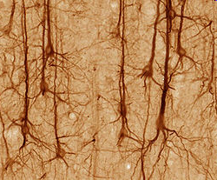
Notes:
Ultimately – everything I’m talking about today comes down to this – the neurons in a human brain and their response to the environment.

Slide 51
Neurons - How the Brain Works
How many neurons In the brain?
  ~ 100 Billion
How many connections exist in the neural networks formed in the brain?
  ~ 100 Trillion
How many “connections” from one neuron?
  ~ 40,000
The brain is specifically designed for learning and behaviors. It is ready and willing to create neural networks.
Learning to drive?
Driving to Daytona, FL…..

Slide 52
NEURONAL MIGRATION
Four “Dyslexia Susceptibility Genes”
(Galaburda, et al., 2006)
Galaburda, 2006

Slide 53
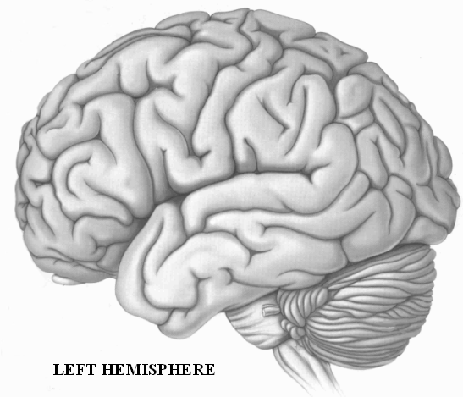
“OUT OF LINE NEURONS” ( ECTOPIAS )
FRONT
BACK

Slide 54
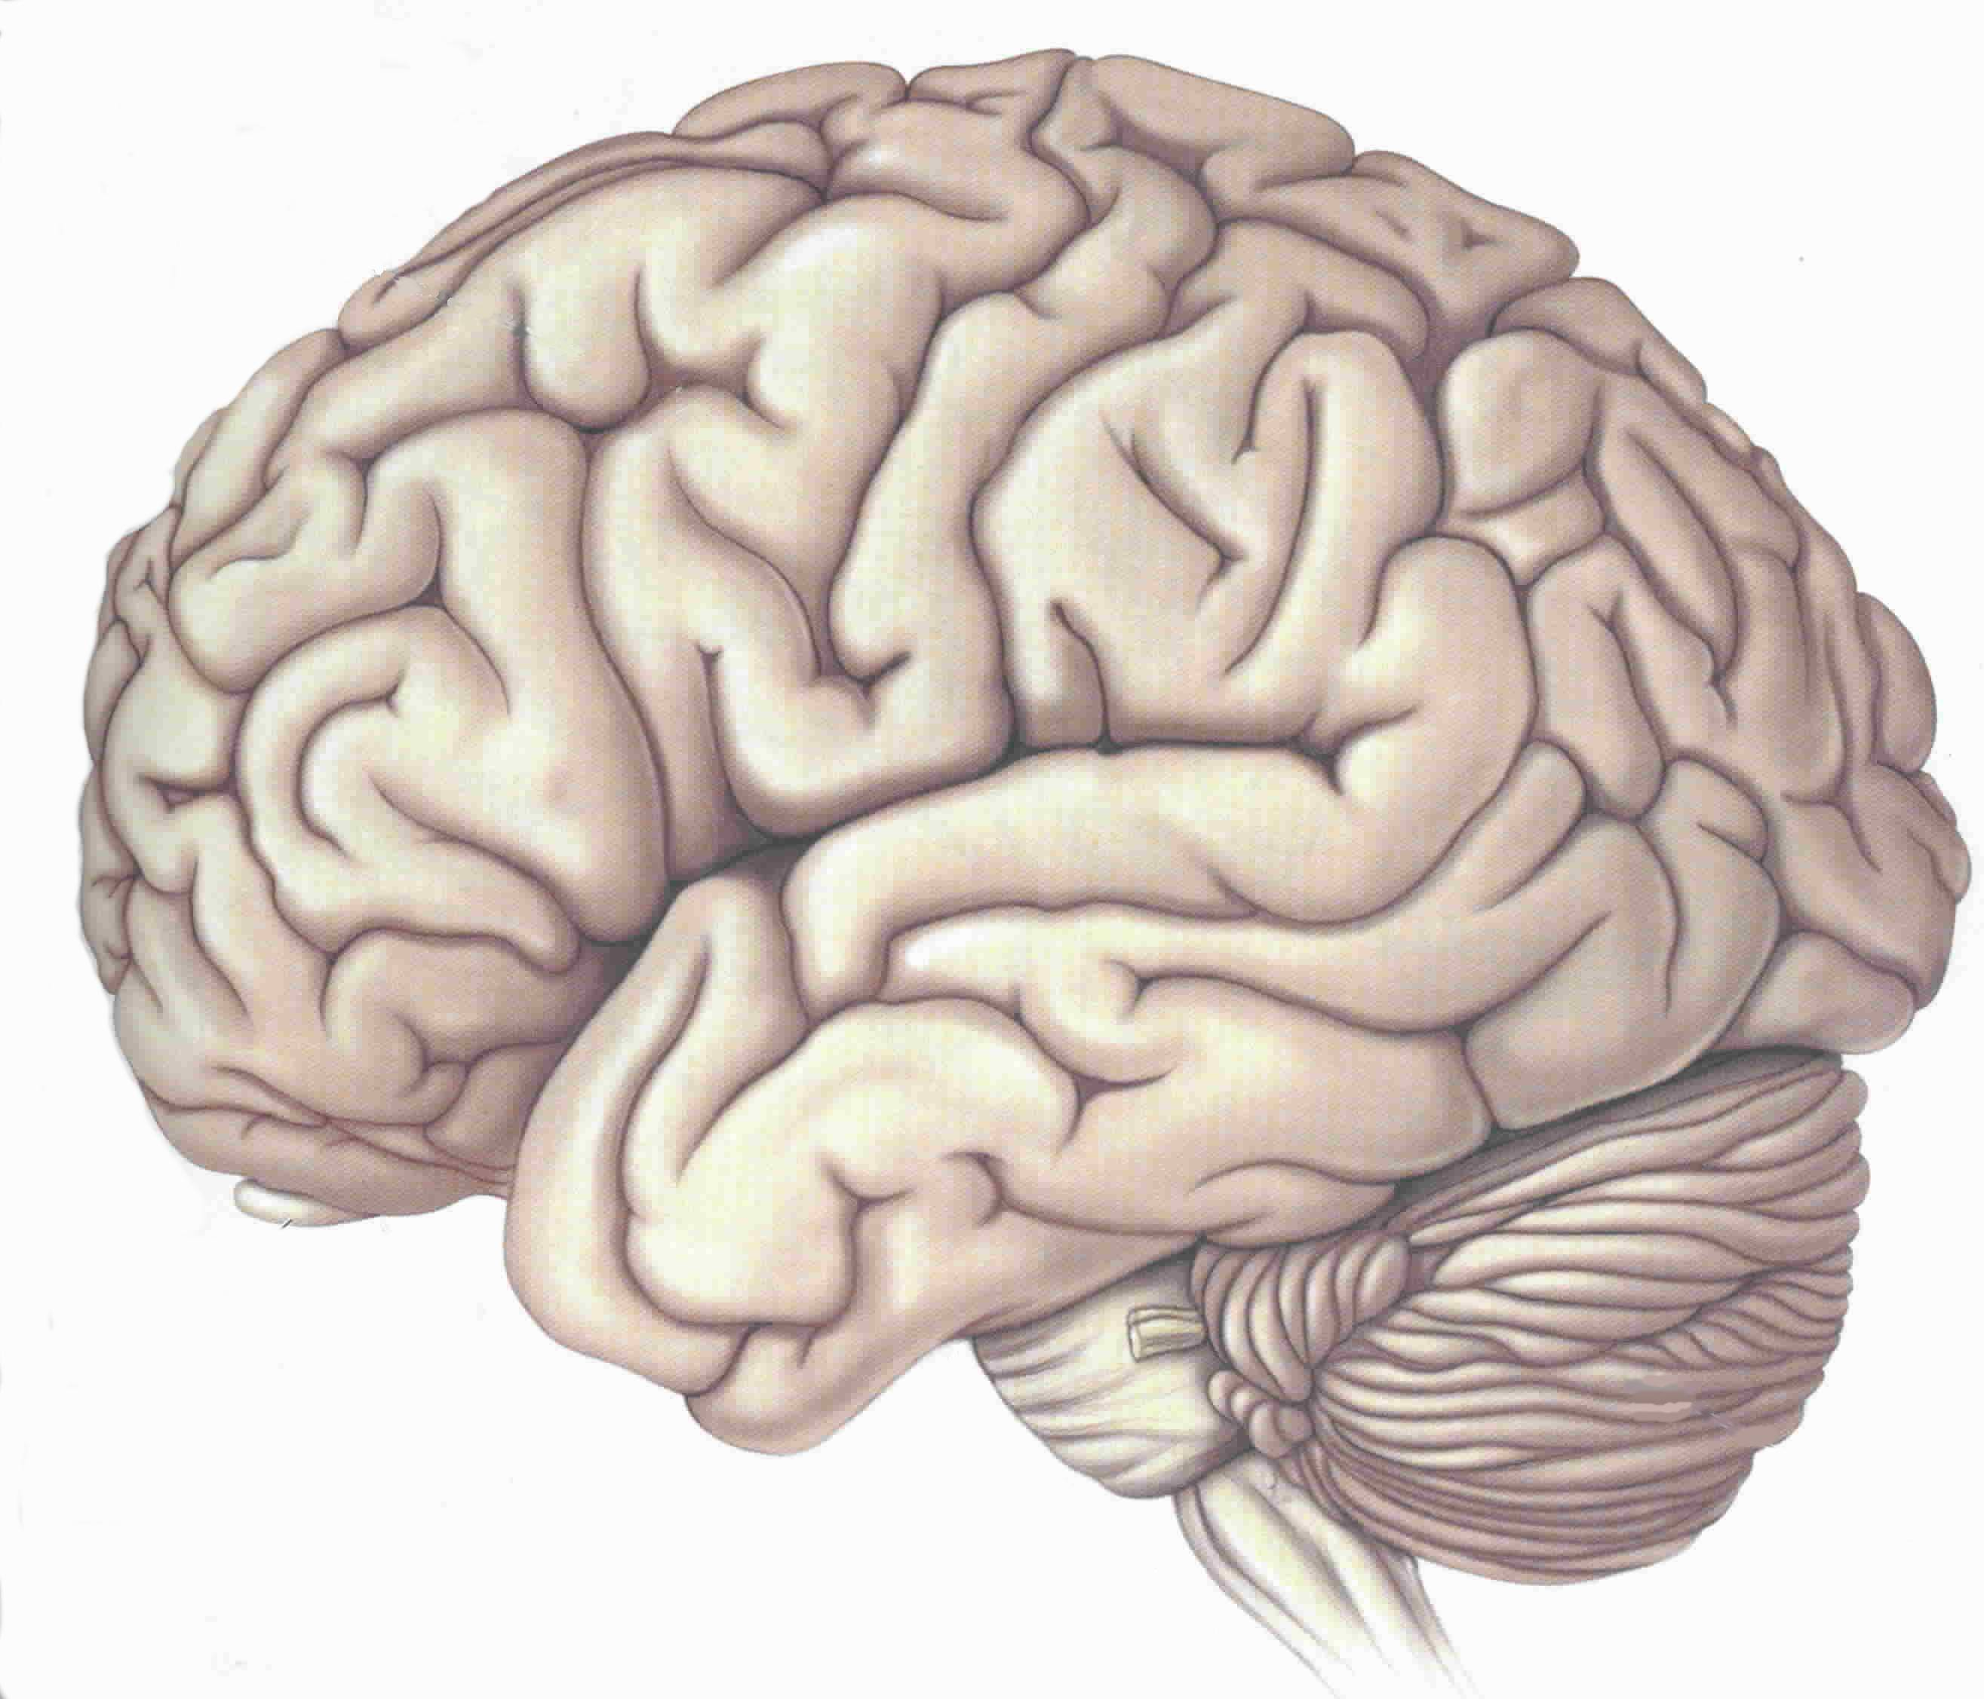
TYPICAL LANGUAGE AREAS
VISUAL-LANGUAGE
ASSOCIATION AREA
VISUAL /
VERBAL
AREA
SPEECH
PRODUCTION
AREA
AUDITORY
PROCESSING
AREA
LEFT HEMISPHERE

Slide 55
TYPICAL READING AREAS
WORD ANALYSIS
WORD ANALYSIS
AUTOMATIC
(SIGHT WORD)
LEFT HEMISPHERE

Slide 56
Microneurodysgenesis and Genetic Dyslexia
  Areas in the left side of the brain that are most likely to be affected:
    Broca's area/inferior frontal gyrus controlling articulation and word analysis
    Parieto-temporal area controlling word analysis
    Occipito-temporal area controlling the rapid, automatic fluent identification of words

Slide 57
(RAMUS, 2006)
Biology
Cognition
Behavior

Slide 58
Fact or Myth about Dyslexia?
Is dyslexia caused by weak phonological processing skills?
  FACT:
    This weakness is evident in speaking skills well before it appears in difficulties with reading/spelling skills.
      Poor rhyming words
      Trouble learning the letters of the alphabet (name and/or sound)
      Persistently mispronounces words even when given the correct pronunciation, e.g. says
  FACT:
    Over 88% of individual with dyslexia have phonological processing difficulties (Shaywitz, 2003)

Slide 59
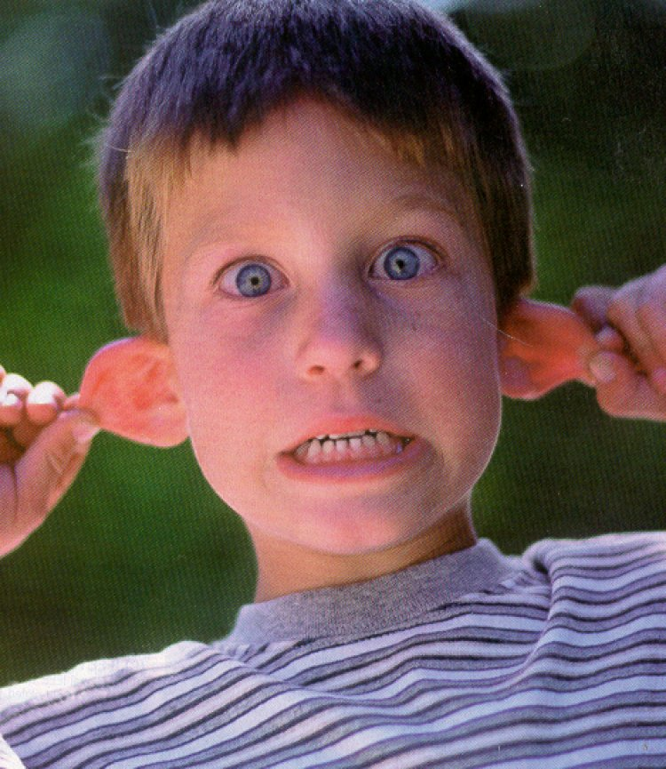
WHAT IS PHONOLOGICAL AWARENESS?

Slide 60
EXPERIENCING PHONOLOGICAL AWARENESS
In Reading…. GLESP
In Spelling… THROUG
In Speech… PACIFIC vs SPECIFIC

Slide 61
PHONOLOGICAL AWARENESS
THE ABILITY TO IDENTIFY, THINK ABOUT, AND
MANIPULATE THE INDIVIDUAL SOUNDS
(PHONEMES) IN WORDS
THE IMPLICATION OF A GROWING ABILITY TO
IDENTIFY INDIVIDUAL SOUNDS IN WORDS.
Torgesen, www.fcrr.org

Slide 62
Fact or Myth about Dyslexia?
Individuals with dyslexia may have trouble learning a foreign language?
  If someone struggles to learn the phonology (speech sounds) of their first language, might they also struggle to learn the phonology (speech sounds) of a 2nd language?
  YES, individuals with dyslexia commonly report having trouble learning a foreign language, including speaking, reading and/or writing in another language.

Slide 63
Fact or Myth about Dyslexia?
Dyslexia is a “gift” and makes you different from others who don’t have it – embrace your trouble with dyslexia.
  If there was no way to change the primary difficulties of dyslexia, then “accepting and embracing it” might be a very adaptive option.
  However, I have never met someone with dyslexia who chose to keep the difficulty, when given an opportunity to make reading significantly easier.

Slide 64
Fact or Myth about Dyslexia?
Individuals who have dyslexia commonly have other difficulties or disorders too?
  For example,
  ADHD (50-70% will have ADHD with Dyslexia)
  Sensory processing disorder
  Behavioral/emotional difficulties
  Language impairment

Slide 65
Fact or Myth about Dyslexia?
Because individuals with dyslexia have trouble reading, will they most likely have difficulty with reading comprehension too?
  Many individuals with dyslexia have adequate vocabulary knowledge and can infer or reason to compensate for their reading difficulty. Thus, their performance on standardized testing of comprehension skills may be grade levels higher than their performance on standardized tests of reading skills.

Slide 66
Written Language Difficulties in Dyslexia
(ALL SYMPTOMS DO NOT OCCUR WITH EVERYONE)
(Alexander & Conway, 2006)
WRITTEN LANGUAGE CHALLENGES
READING
SPELLING & WRITING
Mechanics
Comprehension
Mechanics
Expressing Ideas
Speed
Speed

Slide 67
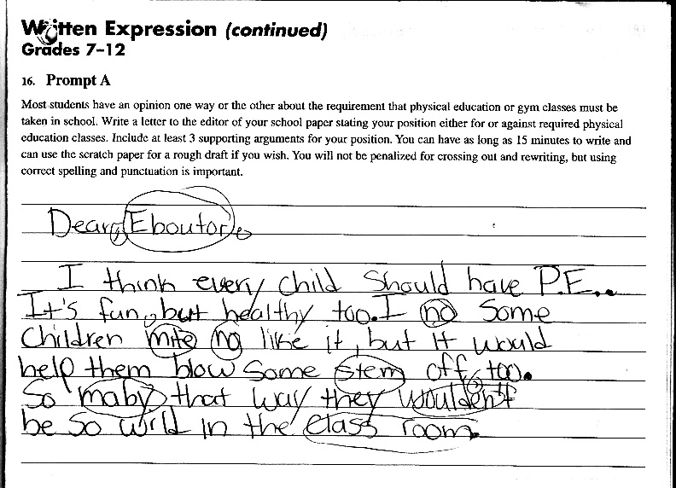
Written Expression Skills Before Treatment

Slide 68
What Develops First, Speaking or Reading & Writing Skills?
Spoken language
Does this same developmental progression happen in languages besides English?

Slide 69
Fact or Myth about Dyslexia?
Phonological processing does not develop until children are taught to read?

Slide 70
Fact or Myth about Dyslexia?
Dyslexia can be prevented

Slide 71
What Develops First, Speaking or Reading & Writing Skills?
If speech and spoken language develops first and phonological processing deficits are identifiable in speaking skills, then why do most educational interventions begin instruction with written language tasks, like reading and spelling?
Could intervention begin with speech and spoken language skills first?
Stay tuned…..more on this SATURDAY at talk #2 “Important Research on Preventing Reading Difficulties in Children”

Slide 72
Thank you for your time, interest and questions
Tim Conway, Ph.D. twc@morriscenters.com www.TheMorrisCenter.com www.NOWprograms.com www.EinsteinSchool.us

Slide 73
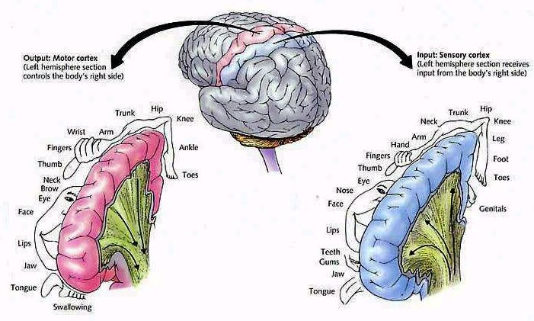

Slide 74
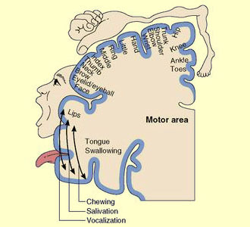

Slide 75
READING
(Alexander & Slinger, 2004)
DYSLEXIA
(PERCEPTION & PRODUCTION)
EXECUTIVE FUNCTION / INTENTION
SEMANTIC/
LEXICAL
PHONICS RULES
WORKING MEMORY (HOLD / MANIPULATE)
SYNTACTIC
ORTHOGRAPHIC
ARTICULATORY
PHONOLOGIC
PROSODIC
MORPHO-SYNTACTIC
ATTENTION / AROUSAL

Slide 77
Prevention of Developmental Dyslexia
Preventing Reading Failure in Young Children with Phonological Processing Disabilities: Group and Individual Responses to Instruction
Joseph K. Torgesen
Richard K. Wagner
Carol Rashotte
Elaine Rose
Patricia Lindamood
Tim Conway
Cyndi Garvan
(1999). Journal of Educational Psychology 91, 579-593.
*NICHD, National Center for Learning Disabilities, Donald D. Hammill Foundation

Slide 78
PREVENTION STUDY
MID KG – END 2ND GRADE
SCREENING - BOTTOM 12TH %ILE
FREQUENCY – 20 MINUTES / 4 DAYS / WEEK
INTENSITY – 1:1, 67 HRS.
TEACHERS & AIDES
4 METHODS:
PASP (Multisensory, “Bottom Up” current version is “NOW! Foundations for Speech, Language, Reading & Spelling®”program)
EP (Traditional explicit phonics)
RCS (Support of classroom teaching method)
NTC (No treatment control)
Torgesen et al, 1999 NICHD

Slide 79
Different Retention Rates:
Dyslexia Prevention Study
“Bottom-Up” vs “Top-Down”
NTC (NO TREATMENT CONTROL)
RCS (SUPPORT OF CLASSROOM TEACHING)
EP (TRADITIONAL EXPLICIT PHONICS)
NOW! Foundations program (MULTISENSORY, “BOTTOM UP”)
(PASP)*
*uses a more explicit, concrete, multisensory approach to train phonological awareness
(Torgesen et al, 1999)
Notes:
Why is it important to establish a “team” approach? Why distinguish skill vs. I.Q.?
The hierarchical process develops by establishing feeling (fingers behind back, wiggle… how do you know? –Not happy, sad, bored)
And a TEAM effort to develop SKILLS not increase IQ

Slide 80
Different Promotion Rates:
Dyslexia Prevention Study
“Bottom-Up” vs “Top-Down”
(PASP)
Notes:
Why is it important to establish a “team” approach? Why distinguish skill vs. I.Q.?
The hierarchical process develops by establishing feeling (fingers behind back, wiggle… how do you know? –Not happy, sad, bored)
And a TEAM effort to develop SKILLS not increase IQ

Slide 81
Preventing Dyslexia: After Treatment - Percent of children performing at least 1 S.D. BELOW their peers [ <85 ]
(Torgesen et al, 1999)
Percent
Groups
No Treatment Control
Regular Classroom Support
Explicit Phonics
Currently NOW! Foundations for Speech, Language, Reading and Spelling ®
Woodcock Reading Mastery Test- Revised (WRMT-R)

Slide 82
Preventing Dyslexia: After Treatment - Percent of children performing at least 1 S.D. ABOVE their peers [ > 100 ]
(Torgesen et al, 1999)
Percent
Groups
No Treatment Control
Regular Classroom Support
Explicit Phonics
Currently NOW! Foundations for Speech, Language, Reading and Spelling ®
Woodcock Reading Mastery Test- Revised (WRMT-R)

Slide 83
Different referral rates for Special Education
*p<.01
Torgesen et al, 1999

Slide 84
Prevention of Dyslexia?
“…the PASP treatment [currently NOW! Foundations program], as delivered in this study, was relatively ineffective in normalizing the phonetic reading skills of approximately 2.4% of children in the total population [180] from which our treatment sample (the bottom 10%) [of ~1,854 children] was selected.”
How many classroom teachers would be disappointed if only 97.6% of their students were reading in the “average” range or above?
(Torgesen, Wagner & Rashotte, 1997; Torgesen, et al., 1999)

Slide 85
PREVENTION STUDY OUTCOME
ONLY PASP (NOW! Foundations program) YIELDED SIGNIFICANT GAINS in PHONOLOGICAL AWARENESS & READING
END OF 2ND GRADE: PASP group was at 50TH %ILE in WORD READING SKILLS (ACCURACY AND FLUENCY).
OTHER Groups were no better than the no treatment control group
BEST PREDICTORS OF GROWTH IN READING:
ATTENTION / BEHAVIOR
HOME BACKGROUND
PHONOLOGICAL AWARENESS

Slide 86
What Develops First, Speaking or Reading & Writing Skills?
If spoken language develops first and phonological processing deficits are identifiable in speaking skills, then why do most educational treatments begin instruction with written language tasks, like reading and spelling?
Could treatment begin with spoken language skills first?
Stay tuned…..more on this tomorrow @ 2:15 pm.

Slide 87
Thank you for your time, interest and questions
Tim Conway, Ph.D. twc@morriscenters.com

Slide 88
Fact or Myth about Dyslexia?
Words “swim” on the page and this is the primary difficulty that makes it hard for individuals with dyslexia to read.

Slide 89
The acquired reading disorders - Alexia
Alexia = an acquired reading disorder
(see B. Coslett Chapter in Clinical Neuropsychology, 4th Ed)
  Phonological Alexia
    misread pseudowords or novel real words.
  Deep Alexia
    Same as phonological, but with semantic paraphasias, e.g. says “duck” when reading the word swan.
  Surface Alexia
    misread sight words or words that can not be sounded out, e.g. yacht.
  Pure Alexia
    Word and nonword reading are very slow and reads by spelling out the word or nonword aloud, e.g. naming each letter in left-to-right sequence, AKA "letter-by-letter reading”

Slide 90
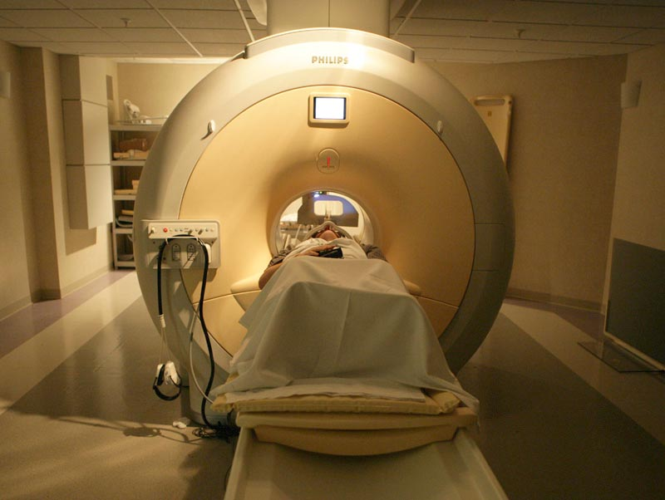
Functional MRI is done on the same machines on which clinical MRIs are done. However, in functional MRI, we measure blood oxygenation levels to determine what areas of the brain are active.

Slide 91
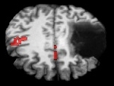
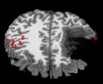
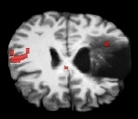
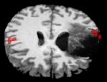
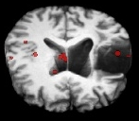
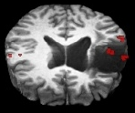
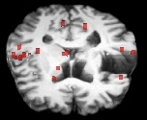
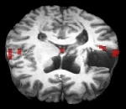
Pre-Treatment
Post-Treatment
We are interested in whether brain areas partially damaged by stroke can be re-activated during rehabilitation.
This appears possible in some patients, such as the one in these images.
Top
R
L
R
L
Back
Back
Bottom
Front
Front
(Chang, et al. 2006)

