Slide 1


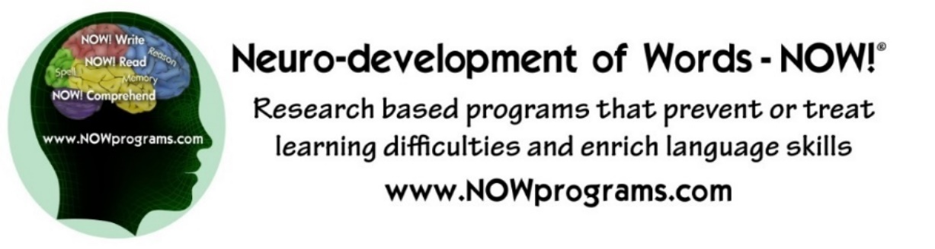
Developmental Dyslexia Diagnosis, Treatment and Prevention:
Advocating “evidence-based” practices
Tim Conway, Ph.D.
The Morris Center
The Morris Centre
The Einstein School – Gainesville, FL
University of Florida
Jacksonville University
Neuro-development of Words – NOW!®
ASHA Conference 2016

Slide 2
Financial Conflicts of Interest Disclosure
I own the following companies and financially benefit from any services or products purchased from these companies:
The Morris Center of Gainesville, FL
The Morris Center of Ocala, FL
The Morris Centre Trinidad and Tobago, West Indies
Neuro-development of Words, LLC
Non-Financial:
Co-Founder & President of The Einstein School of Gainesville, FL 501(c)3

Slide 3
Background
Professional Training – Clinical Neuropsychology research/training in pediatric, adult & geriatric; developmental disorders and acquired disorders, & neurorehabilitation models of intervention.
Types of Work/Research – Dyslexia Prevention/Early Intervention, Dyslexia Remedial Intervention (all ages), Post-Stroke Alexia Neurorehabilitation & fMRI
Venue/Business - Educational centers, Medical Clinics, Public Charter School, online Educational Technology Company, College/University Student Support programs, State Mental Hospital’s school

Slide 4
Background (continued)
Personal – Why at the age of 19 did I choose to focus on neuropsychological research on assessment and intervention of dyslexia/ADHD?
5-years old & brother 7-years old
Father of two children with ADHD/Dyslexia
  no ESE or LD due to early intervention
Dyslexia runs in my family
  I could have had reading disabilities myself except for my own very early early early intervention.

Slide 5
What is Phonological Awareness, Really?

Slide 6
EXPERIENCING PHONOLOGICAL AWARENESS
In Reading…. GLESP
In Spelling… THROUSK
In Speech… PACIFIC vs SPECIFIC

Slide 7
The Tale of a 6 year-old & 1st grade Retention Rec.
End of the year report from principal and teacher
  NO prior reports of difficulties meeting school’s goals
Recommend retention because child is “not yet ready for 2nd grade”, “needs more time to mature”
Why retention?
  Poor reading skills
Parent asks what will be done differently next year if grade repeated?
  Same curriculum, but she’ll be older and ready to learn more.
  Parent asks, what does research say about outcomes from retention?
  SILENCE across the table, but parent encouraged to “trust us. We have been educators for 25 years.”

Slide 8
What Caliber of Evidence did School Offer?
Evidence-based?
Research-based?
Consensus-based?
Anecdotal?
Parent’s response?
  No retention
  Specialized Evidence-based Intervention
  Returned in Grade 2 to same school
  Top reading group within a few months of school

Slide 9
Different Caliber/Quality of Evidence
  Evidence-based
    A specific program is scientifically studied/evaluated
    Competitive Grant Funded/Peer-reviewed Research
    Peer-reviewed Research Publication (well-respected journal)
  Research-based
    Program was not specifically tested/studied
    uses features from others’ research on dyslexia, language, learning….
    FEW to no high-caliber studies published in peer-reviewed journals
  Consensus-based
    “Popular program”; no research about its methods, but
    others say it works and are buying it too.
  Anecdotal
    no better than hearsay; a story that gets spread.

Slide 10
Why Did this Girl Need Specialized Instruction?
Something different about how her brain was processing information.
Brain wiring affects efficiency or inefficiency of learning –
NOT “how the brain learns”
“Experience-based Plasticity” leads to NEW wiring in the brain, improved processing and robust gains in functional skills.

Slide 11
Is Your Brain’s Wiring Working Efficiently?

Slide 12
Speech Perception:
Do children learn their native language by ear, eye, mouth…?
the “McGurk Effect”
(sample video)
Notes:
General notes:
Neuro-developmental models
Define evidence-based support of a program versus research-based support versus clinical experiential support – all promoting SLP’s delivery of Evidence-Based Practice (the focus of FLASHA/ASHA
Are there dyslexia subtypes that are research-based subtypes?

Slide 13
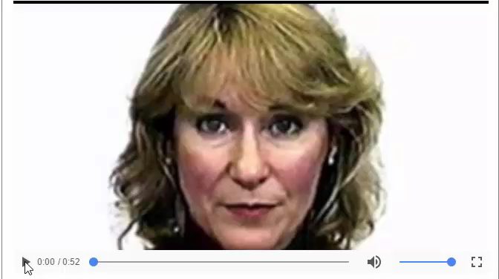
McGurk Effect
– Speech Processing is by Ear, Eye, Mouth,….?
Dr. Patricia Kuhl

Slide 14
Sensory Processing – What Sensory Inputs Aid Learning and Language Development?
The EIGHT Sensory Systems/Inputs

Slide 15
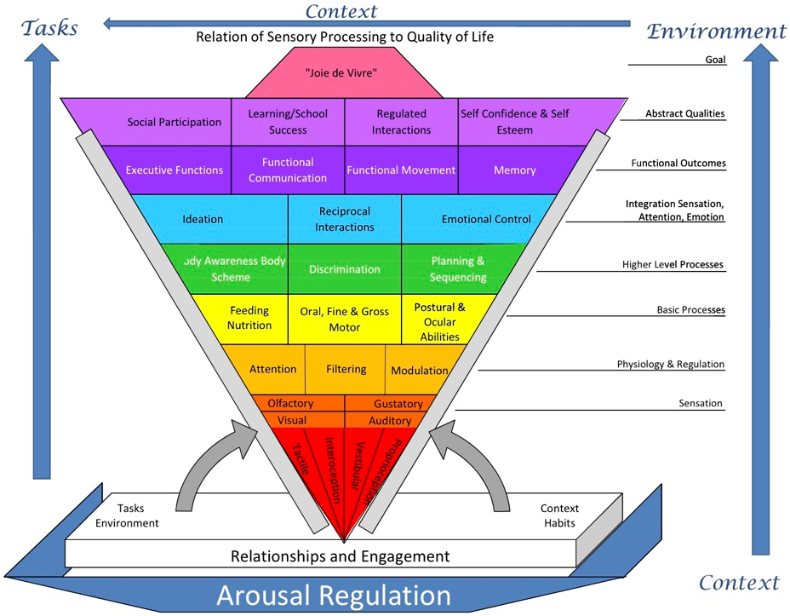
(Miller, 2011)
Notes:
It’s the sensory and cognitive experiences that drive “experience dependent” neural plasticity which helps the brain forms networks for developing skills and abilities.
Figure is from Miller’s handout @ SPD conference – her talk on 10/20/11.

Slide 16
(Miller, 2011)
Notes:
It’s the sensory and cognitive experiences that drive “experience dependent” neural plasticity which helps the brain forms networks for developing skills and abilities.
Figure is from Miller’s handout @ SPD conference – her talk on 10/20/11.

Slide 17
(Miller, 2011)
Notes:
It’s the sensory and cognitive experiences that drive “experience dependent” neural plasticity which helps the brain forms networks for developing skills and abilities.
Figure is from Miller’s handout @ SPD conference – her talk on 10/20/11.

Slide 18
What Sensory Inputs Aid Development of Phonological Awareness?

Slide 19
PHONOLOGY
(Alexander & Slinger, 2004)
(PERCEPTION & PRODUCTION)
EXECUTIVE FUNCTION / INTENTION
WORKING MEMORY (HOLD / MANIPULATE)
PROSODIC
(WORD LEVEL)
PHONEMIC
REPRESENTATION
ORAL MOTOR
SOMATOSENSORY
ACOUSTIC
VISUAL
ATTENTION / AROUSAL

Slide 20
Which Skills Develop FIRST –
Oral Language Skills?
Or
Written Language Skills?

Slide 21
Developmental Building Blocks for Language
(modified from Alexander & Heilman , 2006)
METALINGUISTICS
9 YEARS
WRITING
SPELLING
5 YEARS
READING
Expressive Language
SYNTAX
Receptive Language
18 MONTHS
(FORM)
9 MONTHS
SEMANTICS
(MEANING)
1 MONTH
PHONOLOGY
(FORM)
PRAGMATICS
(FUNCTION)
Notes:
Sensorimotor, phonology and language skills are developing immediately post-birth and should continue so for quite some time, if all the systems are working well together.

Slide 22
What the KEY Reading Skills Every Child Should Have Well-Developed for Academic Success?

Slide 23
What Skills = Solid Foundation for Reading? Developmental “Language Building Blocks”
C O M P R E H E N S I O N
SYNTAX
R E A D I N G F L U E N C Y
SOUND OUT WORDS (phonology/decoding)
SIGHT WORDS
(Visual Memory)
SIGHT WORDS
(visual memory)
VOCABULARY
(semantic knowledge)
VOCABULARY
(Semantic Knowledge)
Notes:
Sensorimotor, phonology and language skills are developing immediately post-birth and continue so for quite some time. Phonology is a core system that develops from oral language from birth. Oral language is the primary mechanism for development of phonological processing UNTIL formal instruction in the English alphabet begins around age 4-5 years (younger in some regions/countries and older in others).

Slide 24
What Happens if Students Do NOT Have Well-developed Phonological Awareness and Language Skills?

Slide 25
THE EFFECTS OF WEAKNESSES IN ORAL LANGUAGE
ON READING GROWTH
High Oral Language in Kindergarten
16
15
14
13
12
11
10
9
8
7
6
5
5.2 years gap
Reading Age Level
Low Oral Language in Kindergarten
5 6 7 8 9 10 11 12 13 14 15 16
Chronological Age
(Hirsch, 1996)

Slide 26
GROWTH IN “PHONICS” ABILITY OF CHILDREN WHO BEGIN FIRST GRADE IN THE BOTTOM 20%ile IN PHONEME AWARENESS AND LETTER KNOWLEDGE
6
5.9
5
Average
Low PA
4
Low
Ave. PA
READING GRADE LEVEL
3
2.3
2
1
K
1
2
3
4
5
GRADE LEVEL CORRESPONDING TO AGE
(Torgesen & Mathes, 2000)
`

Slide 27
GROWTH IN WORD READING ABILITY OF CHILDREN WHO BEGIN FIRST GRADE IN THE BOTTOM 20%ile IN PHONEME AWARENESS AND LETTER KNOWLEDGE
5.7
Low PA
5
Average
Low
4
Ave. PA
READING GRADE LEVEL
3.5
3
2
1
K
1 2 3 4 5
GRADE LEVEL CORRESPONDING TO AGE
(Torgesen & Mathes, 2000)

Slide 28
GROWTH IN READING COMPREHENSION OF CHILDREN WHO BEGIN FIRST GRADE IN THE BOTTOM 20%ile IN PHONEME AWARENESS AND LETTER KNOWLEDGE
6.9
6
Average
Low
5
4
3.4
READING GRADE LEVEL
3
2
SAME VERBAL ABILITY – VERY DIFFERENT READING COMPREHENSION
1
Low PA
K
1
2
3
4
5
GRADE LEVEL CORRESPONDING TO AGE
(Torgesen & Mathes, 2000)

Slide 29
How Do We Stop this Learning “Gap” ?
What is a Systematic Program of Dyslexia Research?
Striving for “evidence-based” data
Trying to insure best possible positive gains or outcomes
Aiming to help largest number of students improve functional skills
NOTE: Answering these questions BEFORE trial and error untested, unproven programs with students.

Slide 30
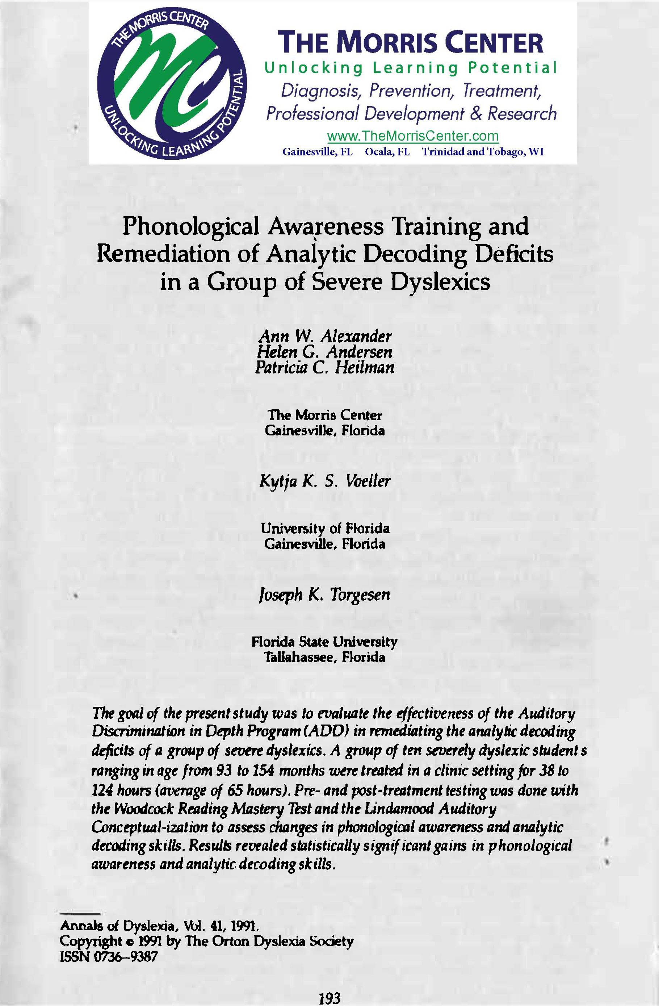

Slide 32
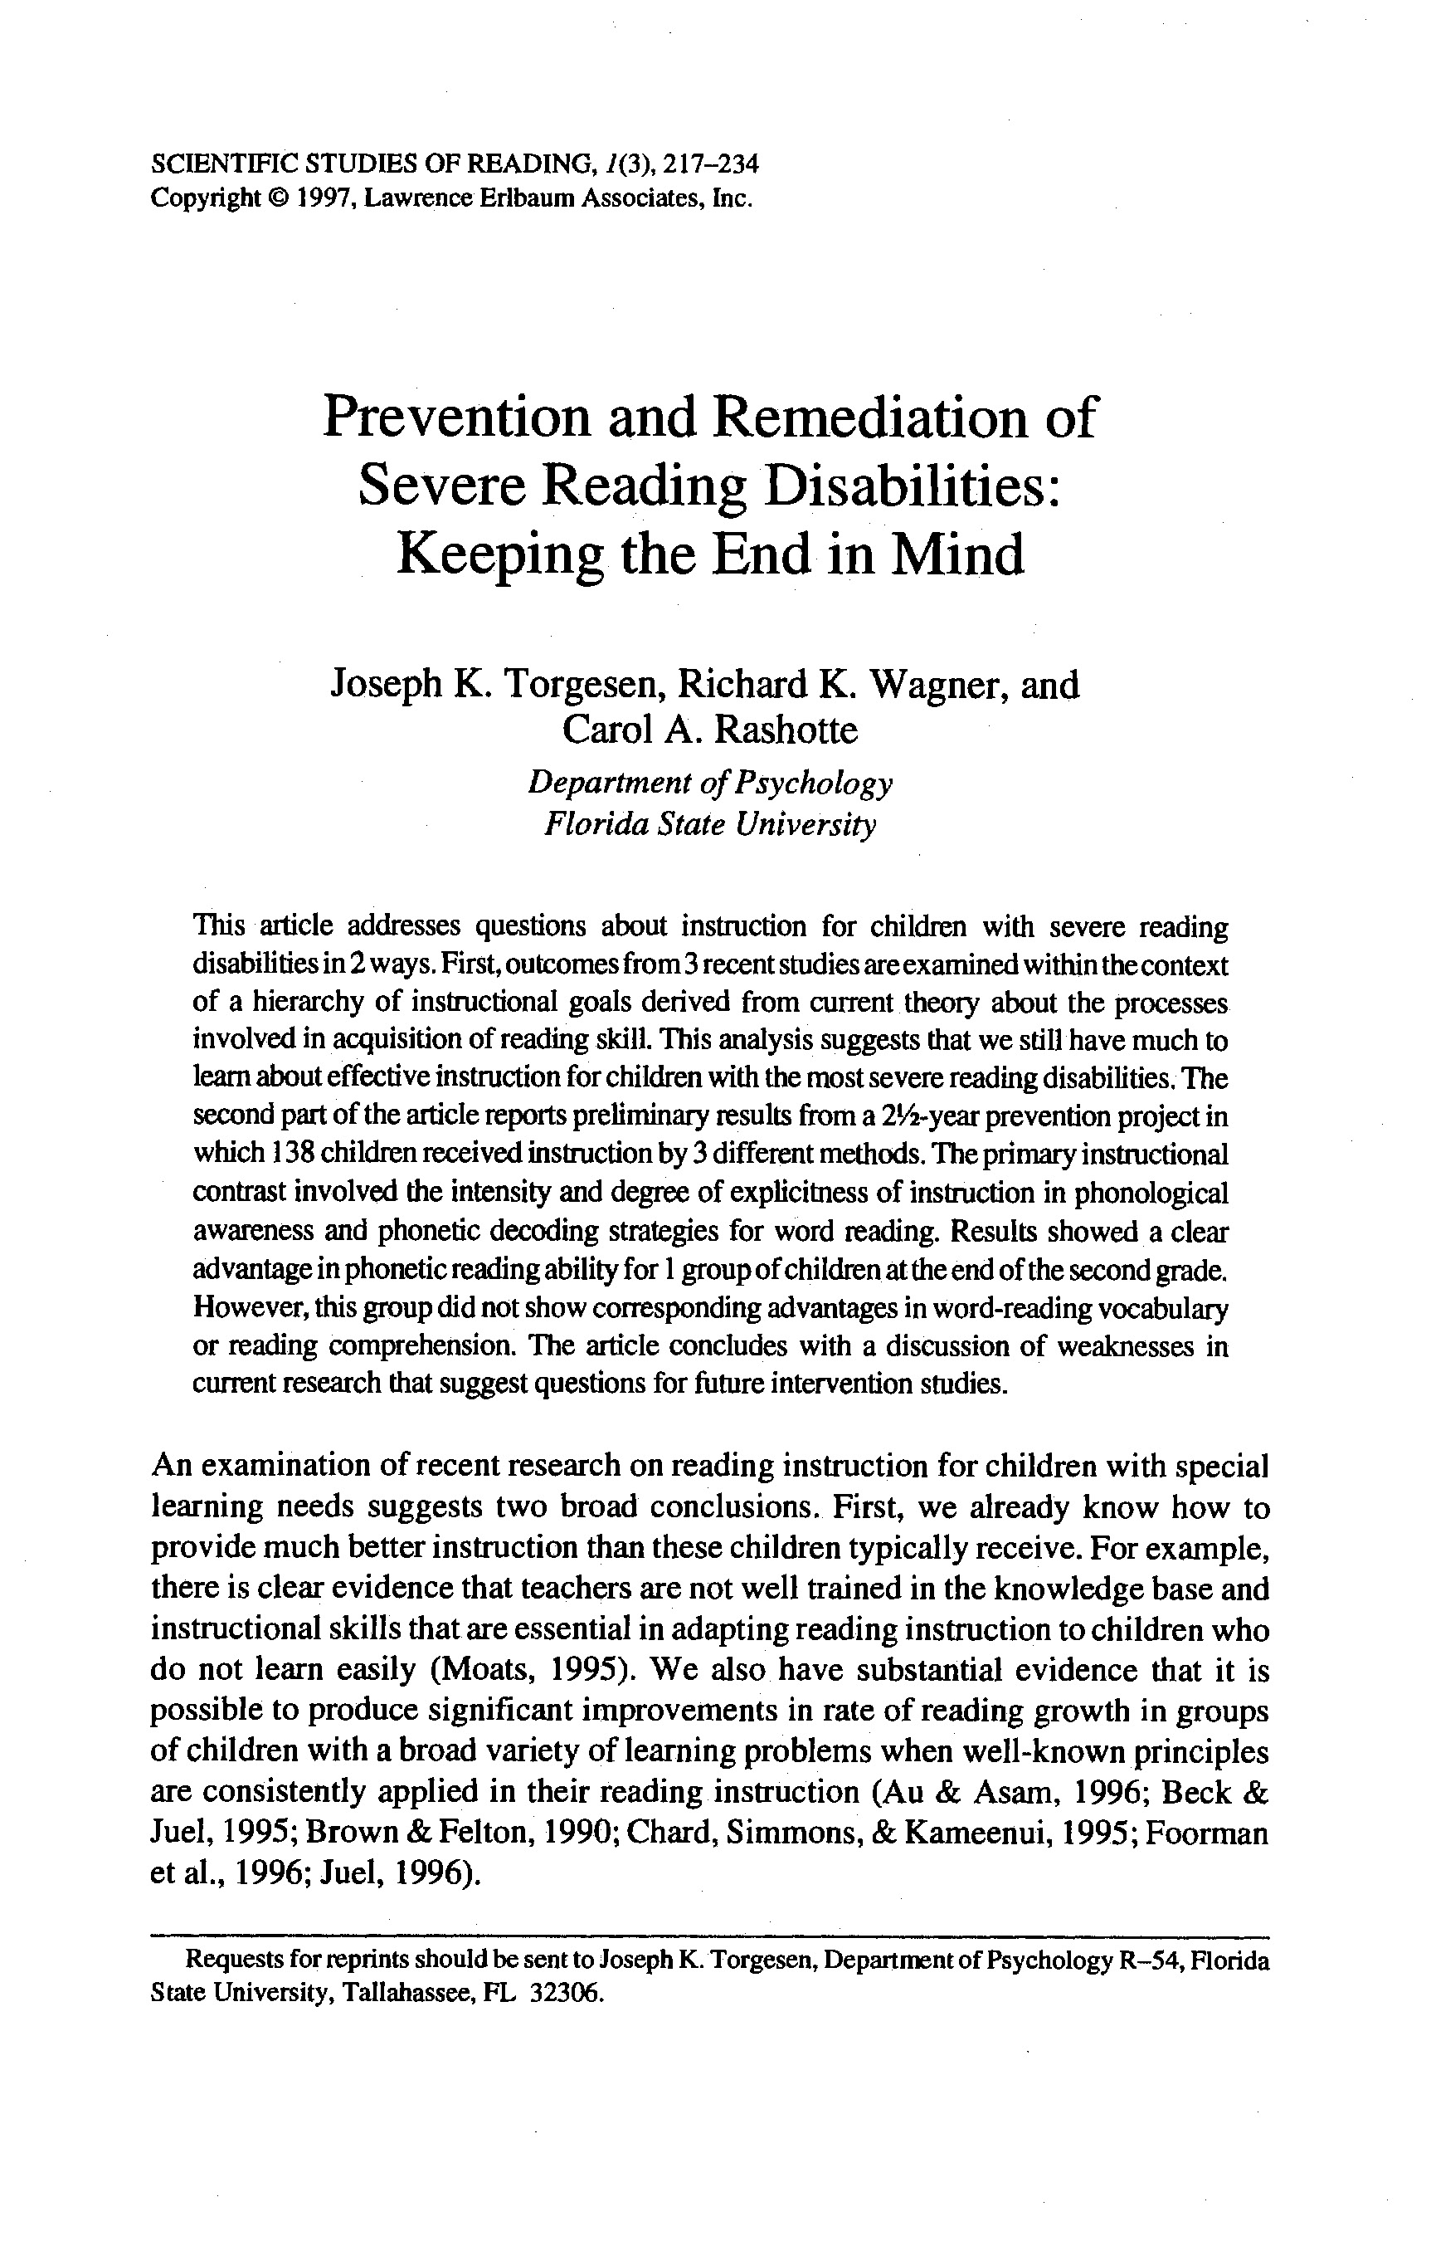
Prevention of Developmental Dyslexia
Preventing Reading Failure in Young Children with Phonological Processing Disabilities: Group and Individual Responses to Instruction
Joseph K. Torgesen
Richard K. Wagner
Carol Rashotte
Elaine Rose
Patricia Lindamood
Tim Conway
Cyndi Garvan
(1999). Journal of Educational Psychology 91, 579-593.
*NICHD, National Center for Learning Disabilities, Donald D. Hammill Foundation

Slide 33
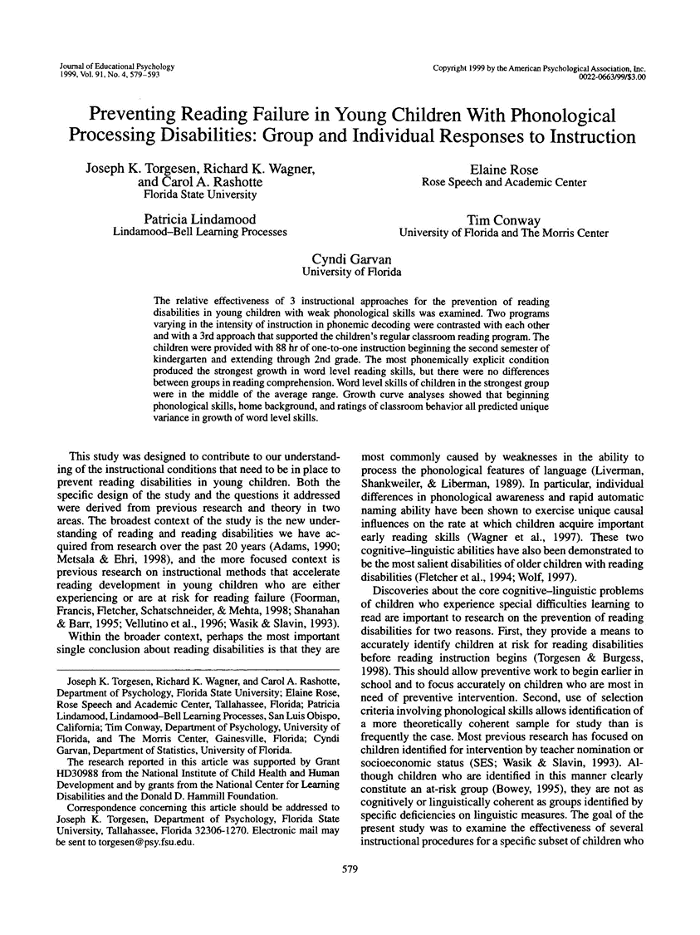

Slide 34
Different Promotion Rates: Dyslexia Prevention Study
“Bottom up Neurodevelopmental Multisensory” vs “Top-Down Phonics”
Groups
No Treatment Control
Regular Classroom Support
Explicit Phonics
Currently NOW! Foundations for Speech, Language, Reading and Spelling ®
(PASP)
Notes:
Why is it important to establish a “team” approach? Why distinguish skill vs. I.Q.?
The hierarchical process develops by establishing feeling (fingers behind back, wiggle… how do you know? –Not happy, sad, bored)
And a TEAM effort to develop SKILLS not increase IQ

Slide 35
Preventing Dyslexia: % at least 1 S.D. BELOW their peers [ <85 ]
Percent
Groups
No Treatment Control
Regular Classroom Support
Explicit Phonics
Currently NOW! Foundations for Speech, Language, Reading and Spelling ®
Woodcock Reading Mastery Test- Revised
(Torgesen et al, 1999)

Slide 36
Preventing Dyslexia: % at least 1 S.D. ABOVE their peers [ > 115 ]
Percent
Groups
No Treatment Control
Regular Classroom Support
Explicit Phonics
Currently NOW! Foundations for Speech, Language, Reading and Spelling ®
Woodcock Reading Mastery Test- Revised
(Torgesen et al, 1999)

Slide 37
Different referral rates for Special Education
*p<.01
Torgesen et al, 1999

Slide 38
PREVENTION OF POOR READING SKILLS
in Kindergarteners at High-Risk for Dyslexia**
Improved Reading Accuracy & Reading Fluency after NOW! Foundations Program®!
100
90
Average Range
STANDARD SCORE
WORD READING:
80
Accuracy
Rate
70
2nd GRADE
(after intervention ended)
4th GRADE
(2-years after intervention ended)
**Before intervention, the average score on pre-literacy skills was <15th percentile in Kindergarten (Torgesen, et al, 2003) www.NOWprograms.com NOW! Foundations for Speech, Language, Reading and Spelling®!
!current version of treatment program

Slide 39
Prevention of Dyslexia?
“…the PASP treatment [currently NOW! Foundations program], as delivered in this study, was [only] relatively ineffective in normalizing the phonetic reading skills of approximately 2.4% of children in the total population from which our treatment sample was selected.”
How many classroom teachers would be disappointed if only 97.6% of their students were reading in the “average” range or above?
(Torgesen, Wagner & Rashotte, 1997; Torgesen, et al., 1999)

Slide 41
GROWTH IN PHONEMIC DECODING from
8-WEEK INTERVENTION & FOLLOW-UP
100
NOW! FoundationsTM
Program
90
Standard Score
80
70
60
Before
Intervention
Test score
After
Intervention
Test score
1 Year
After
Intervention
2 Years
After
Intervention
Torgesen, et al., in AJ Fawcett (Ed), 2001; N=30, 8-10 year olds; 40% staffed out ESE by year 1 follow-up
www.NOWprograms.com

Slide 42
Immediate and Long Lasting Improvement
(Decoding + Comprehension)
40% Staff OUT of ESE SpecEd – no more IEP
After Intervention Test Score
95
Normal Range of Performance
90
Start of 8-Week Intensive Intervention [NOW! FoundationsTM program]
Standard Score
85
80
75
16 Months
Spec. Ed Class
Initial
Test score
Before
Intervention
Test score
1 Year
After
Intervention
2 years
After
Intervention
Torgesen, et al., 2001 N=30, 8-10 year olds; 40% staffed out of ESE by year 1 follow-up
www.NOWprograms.com

Slide 43
www.EinsteinSchool.us
Founded 1999
In USA, 1st FREE “evidence-based” Charter School for Dyslexia/LD
Grades 2-8
110-120 students
ALL have LD, Dyslexia, Language Disorders, etc….
NO TUITION – FREE SCHOOL

Slide 44


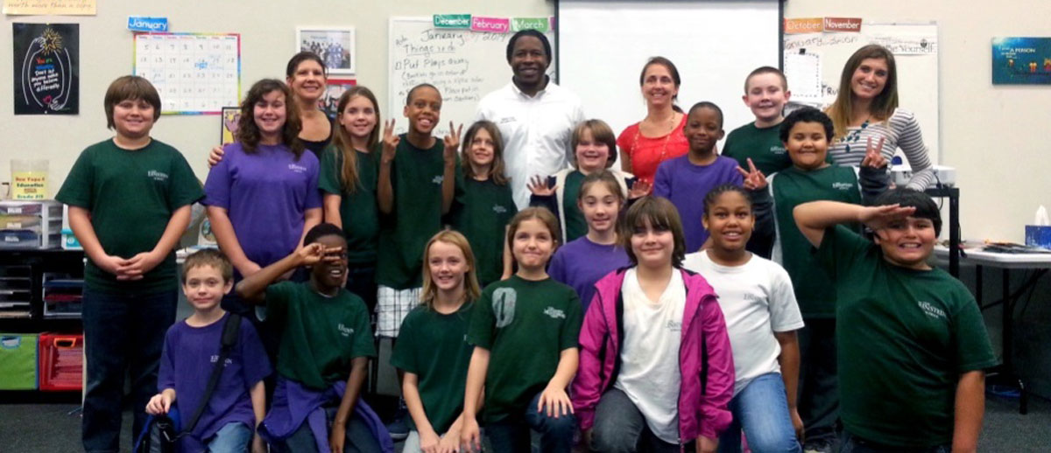

Slide 45
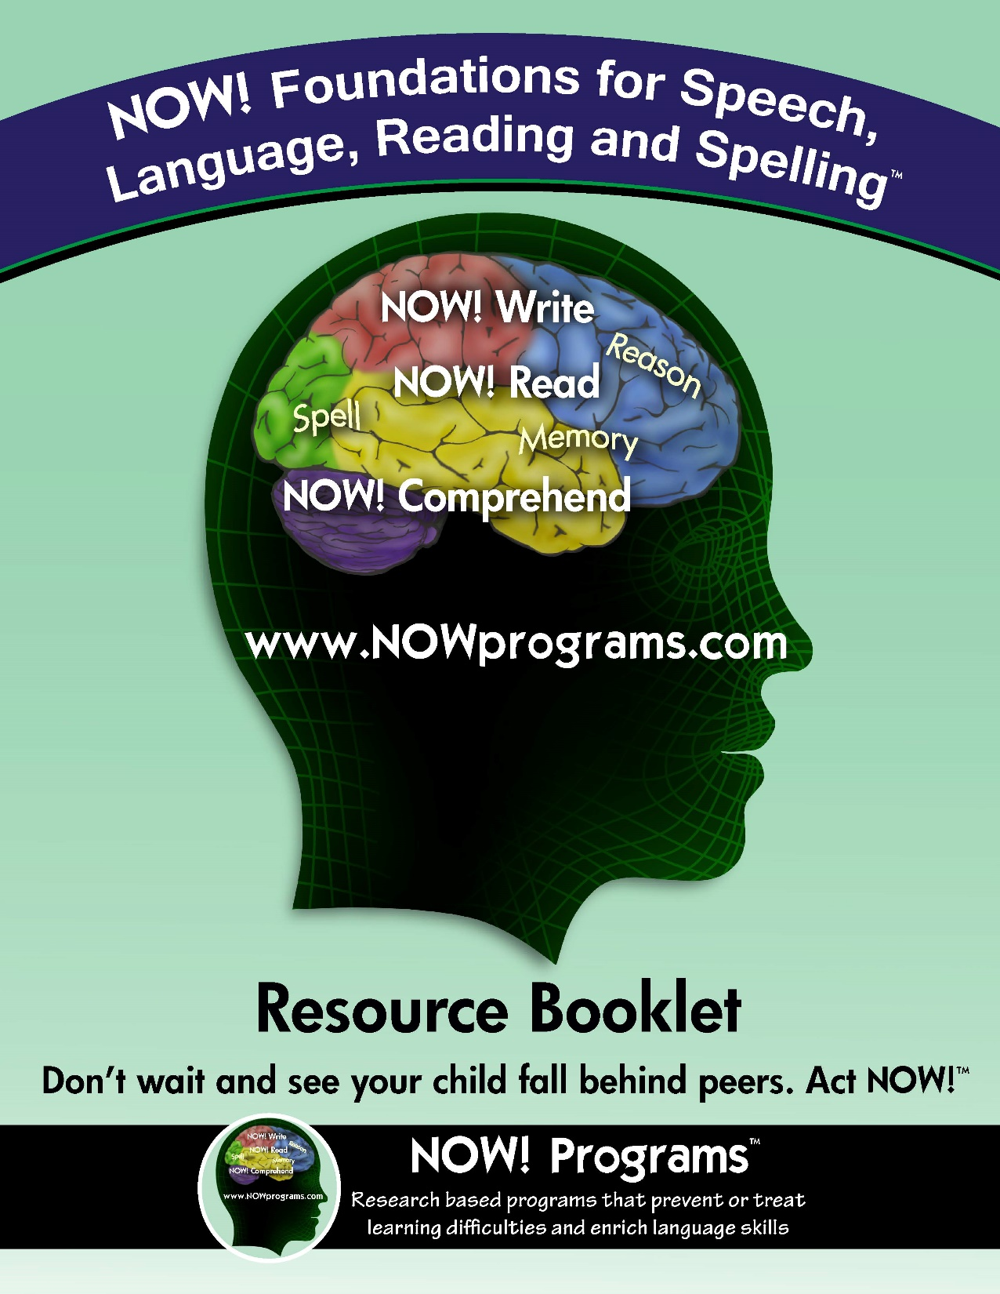
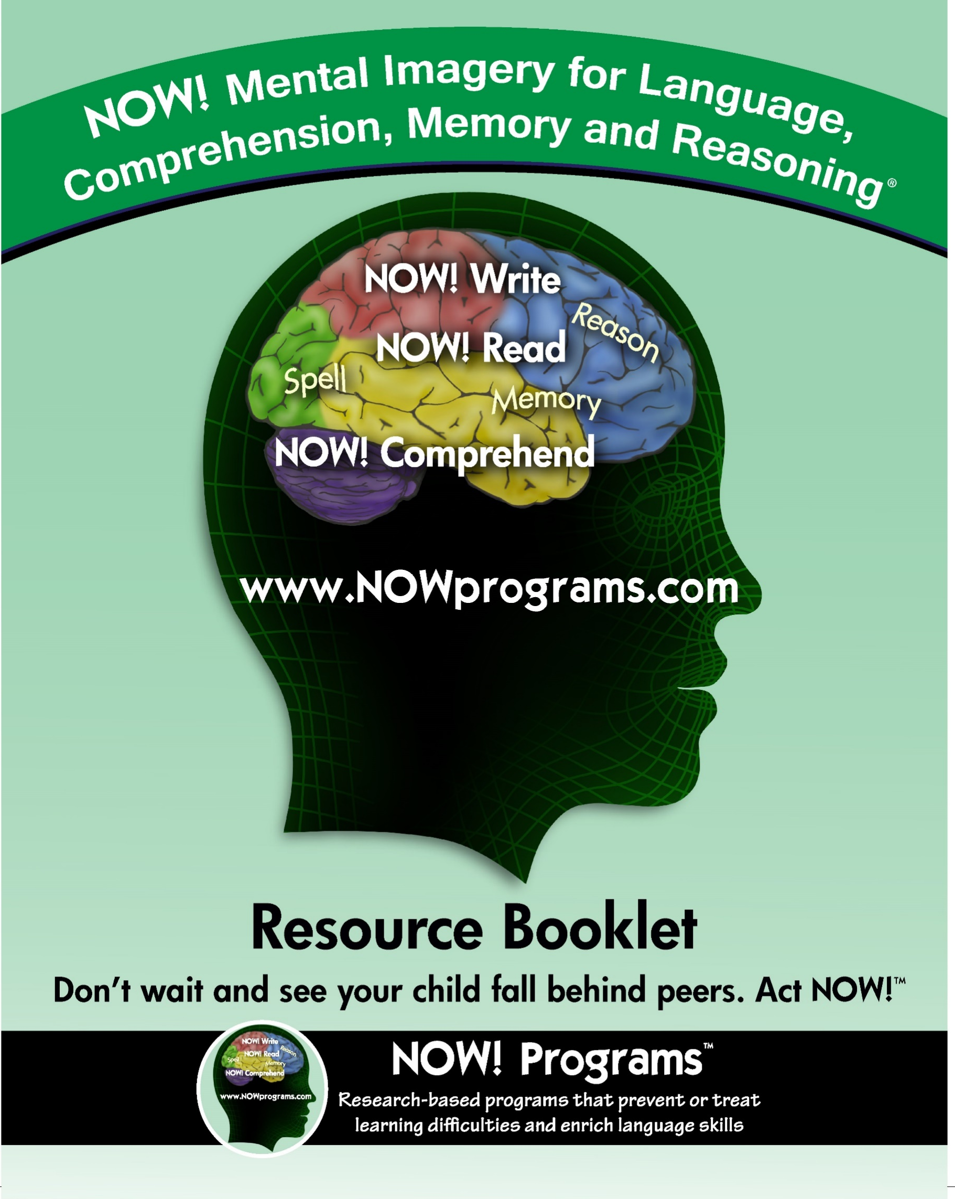

Slide 46


Slide 47
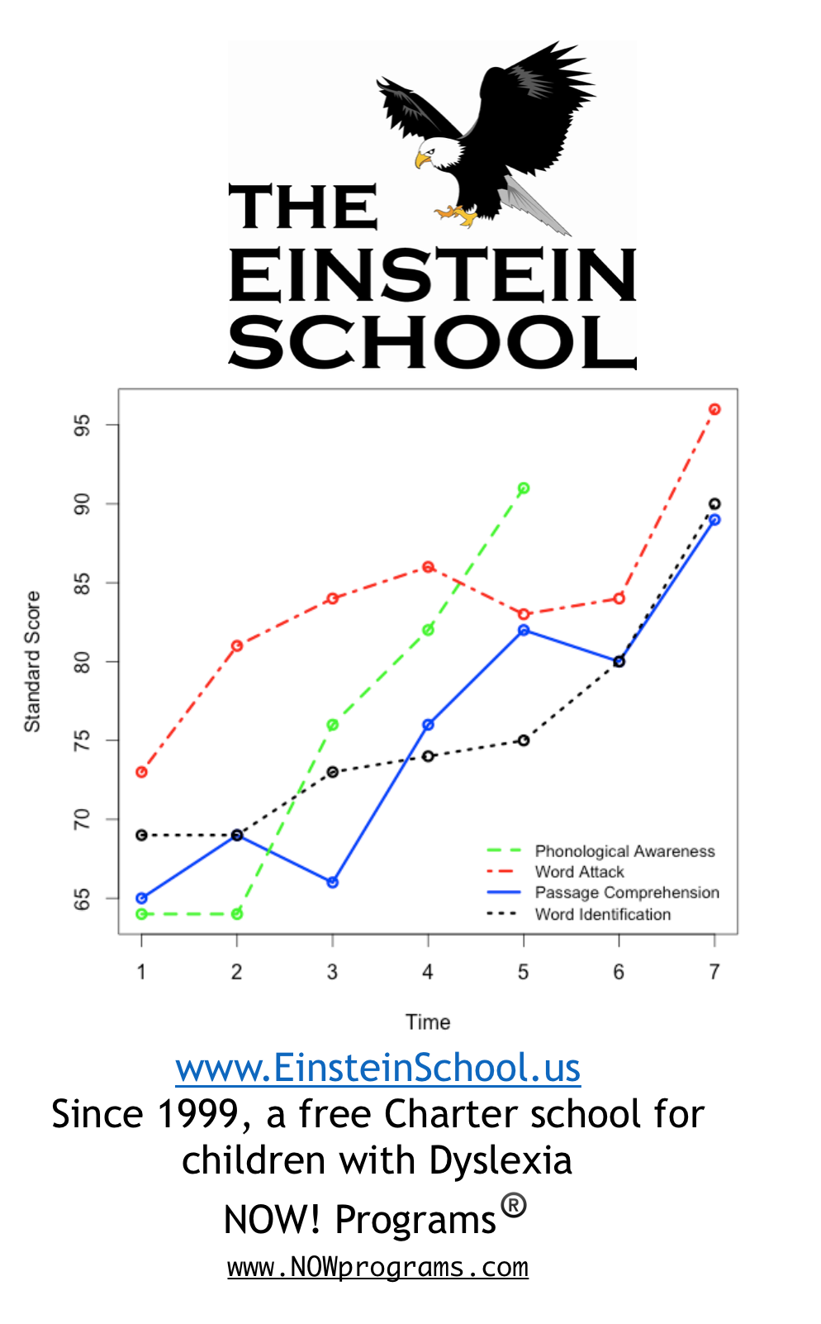
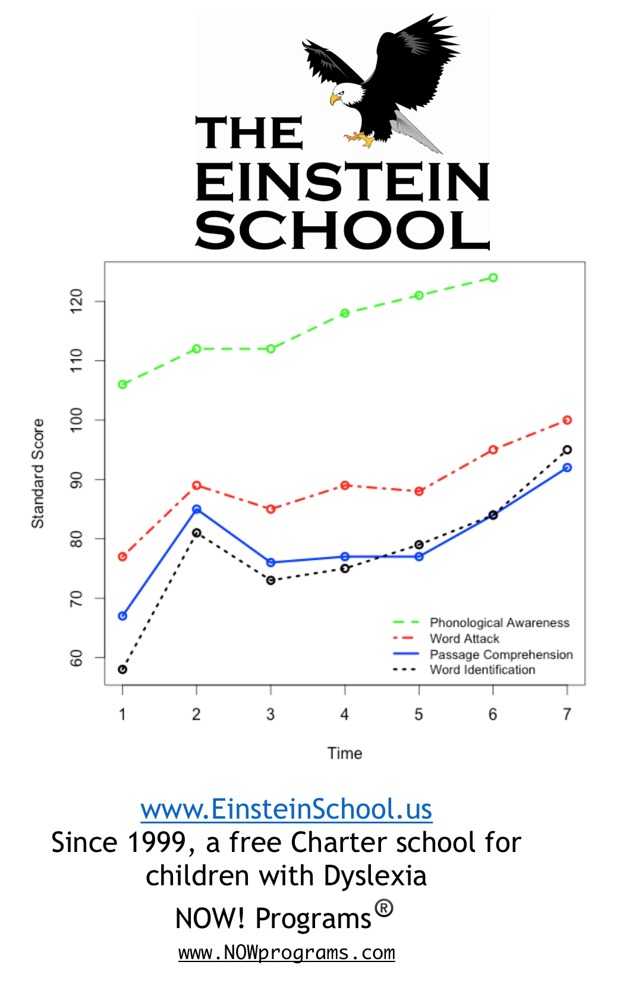

Slide 48
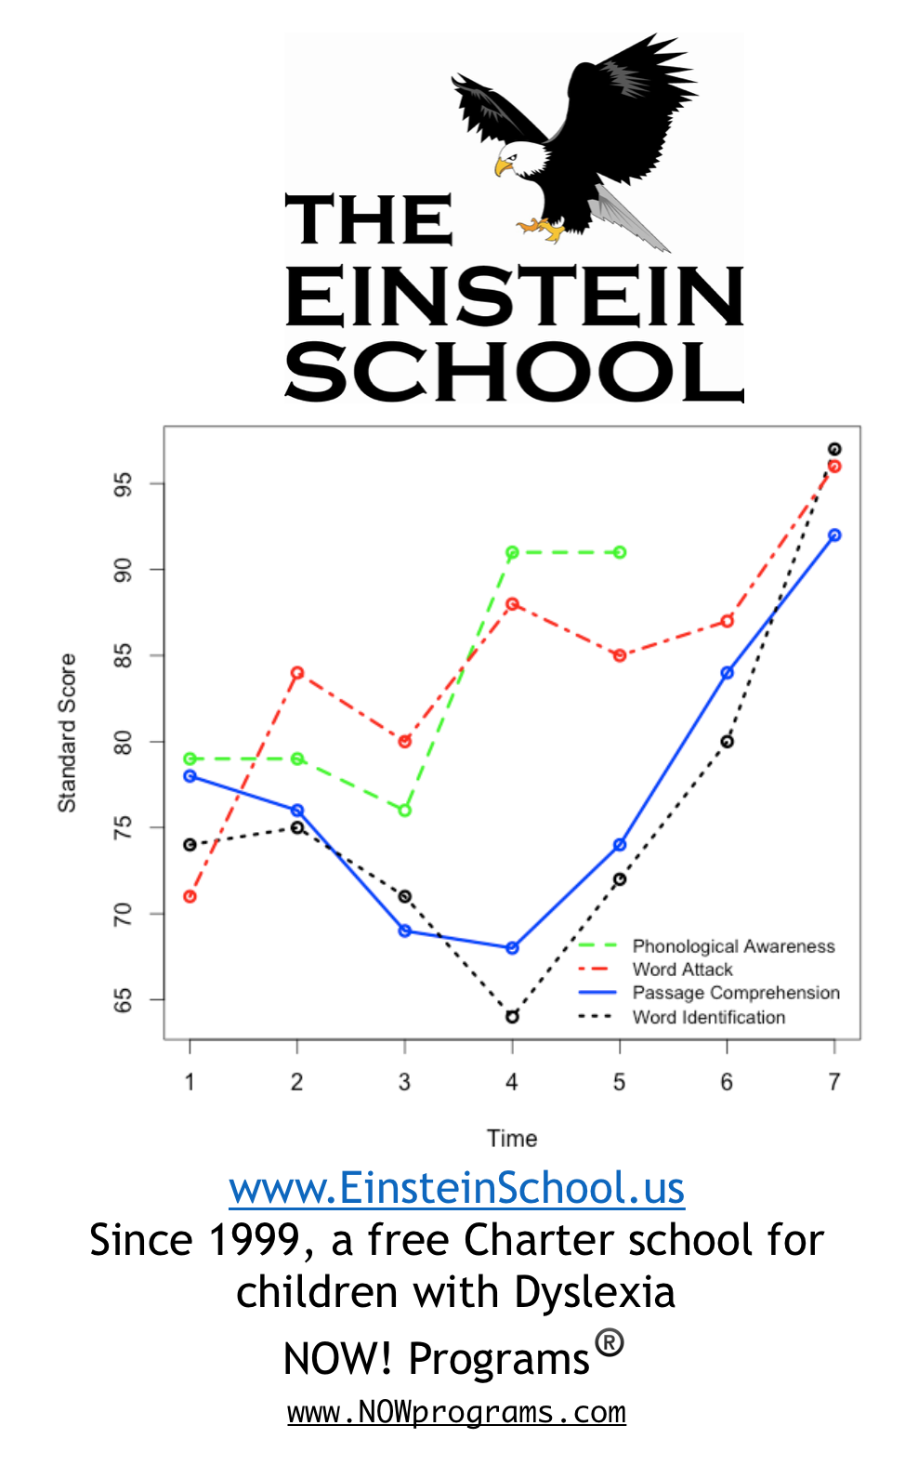
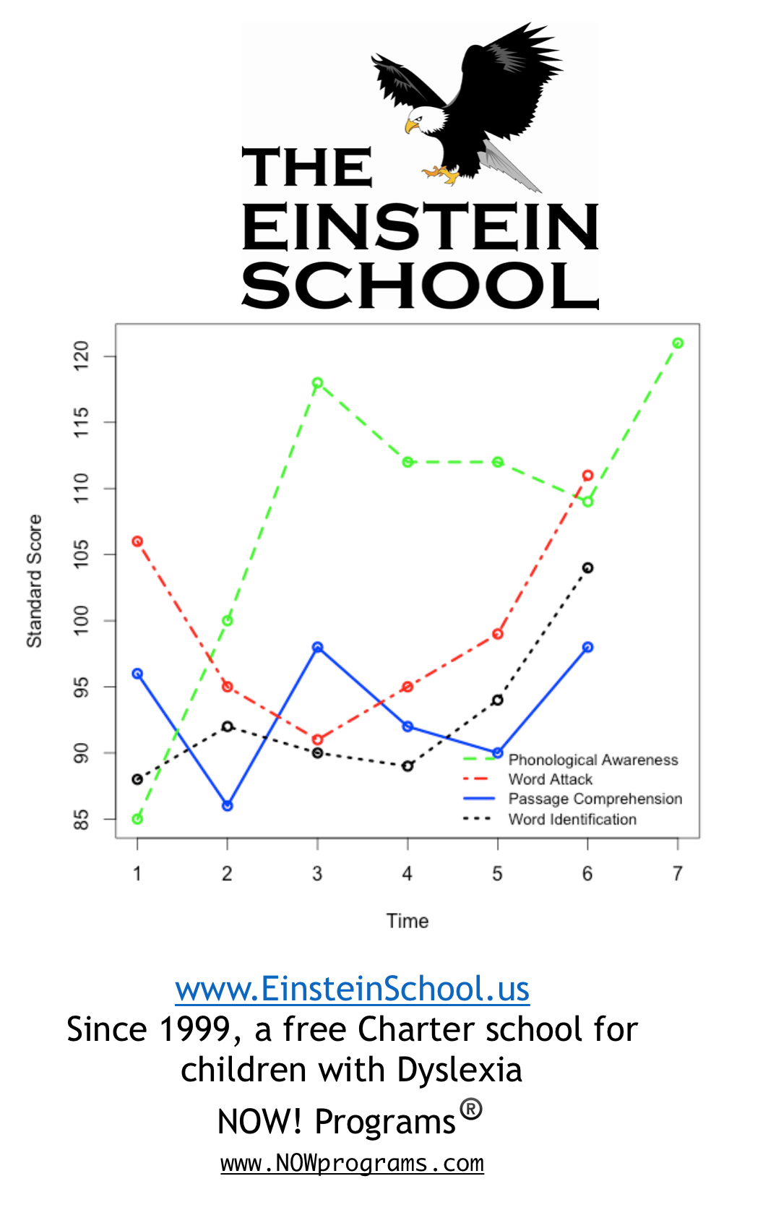

Slide 49
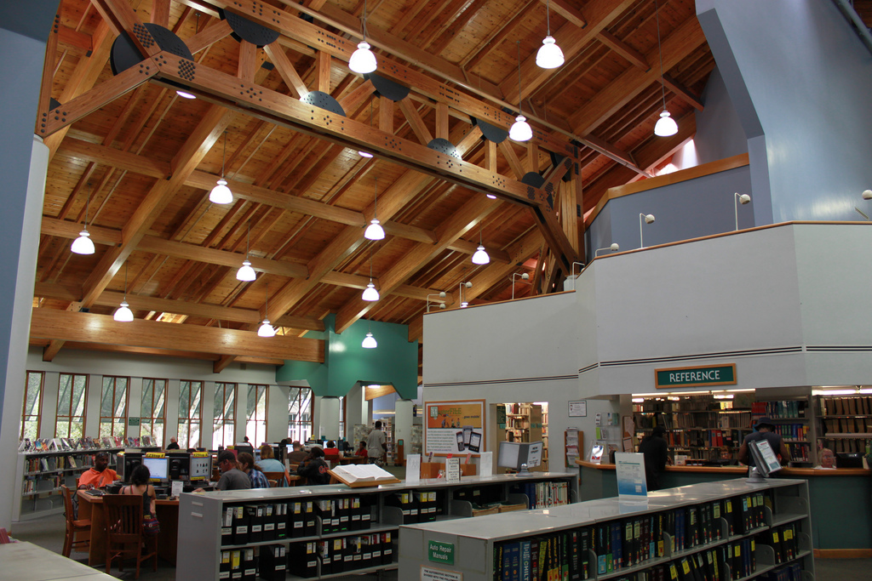
Alachua County Library – Adult Literacy Services Program

Slide 50
Adult Literacy Services: A community-based model
13 tutors
Serving 17 adult learners who are functionally illiterate
  Making large gains in skills,
  building community bonds,
  empowering adults of all ages and abilities,

Slide 51
Alachua County Library Adult Literacy Services
Why are community literacy programs important?
- 100 hours in Adult Ed = annual income increased by $10,000
- 60+ year old woman
- planned to end her life if she could not learn to read,
- did not want to burden her children – so far, she reports
“This is the best year of my life!”

Slide 52
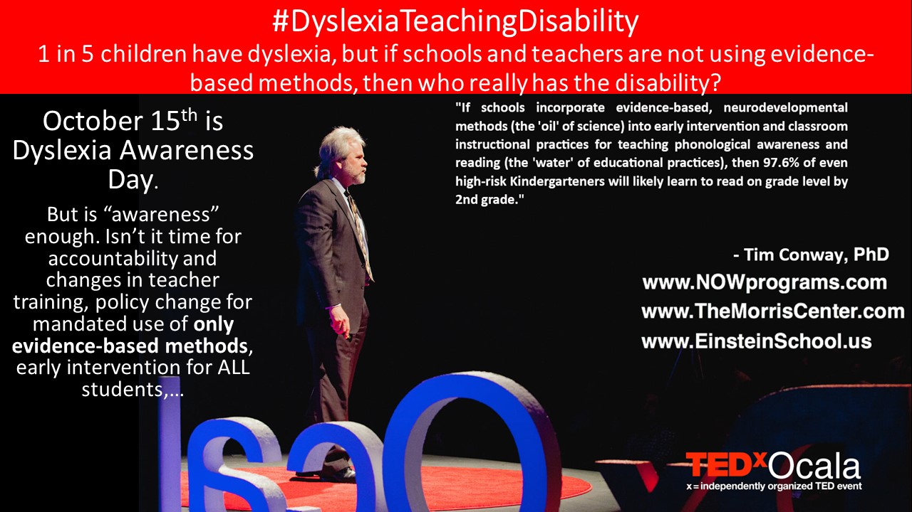

Slide 53
Thank you for your interest and questions www.EinsteinSchool.us www.NOWprograms.com www.TheMorrisCenter.com www.ACLib.us/literacy email: TWC@NOWprograms.com
TEDx Talk:
“How to Mix Oil & Water, so Nearly Everyone Learns to Read”

