Slide 1


Scientific Facts vs Myths in Dyslexia:
Neuropsych Profiles Strengths & Weaknesses:
Neurodevelopmental Multisensory Instruction
Tim Conway, Ph.D.
The Morris Center
The Morris Centre Trinidad and Tobago
The Einstein School
University of Florida
Jacksonville University
Neuro-development of Words – NOW! ®
IDA Conference 2016

Slide 2
Background
Professional Training – Clinical Neuropsychology research/training in pediatric, adult & geriatric; developmental disorders and acquired disorders, & neurorehabilitation models of intervention.
Types of work – Dyslexia Prevention/Early Intervention, Remedial Intervention (all ages), Post-Stroke Alexia Neurorehabilitation & fMRI
Venue/Business - Educational centers, Medical Clinics, Public Charter School, online Educational Technology Company, College/University Student Support programs, State Mental Hospital’s school

Slide 3
Background (continued)
Personal – Why at the age of 19 did I choose to focus on neuropsychological research on assessment and intervention of dyslexia/ADHD?
5-years old & brother 7-years old
Dad of ADHD/Dyslexic Kids
Dyslexia runs in my family
  I could have had reading disabilities myself except for early early early intervention.

Slide 4
Clinical Neuropsychology
Clinical Neuropsychology is the study of the relationship between behavior, emotion, and cognition on the one hand, and brain function on the other. A specialty in professional psychology that applies principles of assessment and intervention based upon the scientific study of human behavior, as it relates to normal and abnormal functioning of the central nervous system. The specialty is dedicated to enhancing the understanding of brain‐behavior relationships and the application of such knowledge to human problems. Competence in clinical neuropsychology requires the ability to integrate neuropsychological [assessment] findings with neurologic and other medical data, psychosocial and other behavioral data, and knowledge in the neurosciences, and interpret these findings with an appreciation of social, cultural and ethical issues.

Slide 5

Neuropsychology “Umbrella”
Sensory / Motor / Visual
Speech / Language
Attention / Executive Functioning
Memory
Achievement
Social / Emotional

Slide 6

Science of the Brain & Behavior!

Slide 7
Caliber of Scientific Evidence
How do you know if something is likely to work before you “buy” and “try it”?

Slide 8
Different Caliber/Quality of Evidence
Evidence-based
  A specific program is studied via
  Competitive Grant Funded/Peer-reviewed Research
  Peer-reviewed Research Publication (well-respected)
Research-based
  Program was not specifically tested/studied
  uses features from others’ research
  Zero studies published in peer-reviewed journals
Consensus-based
  “Popular program”; no research about its methods, but others say it works and are buying it.
Anecdotal
  no better than hearsay; a story that gets spread.

Slide 9
6 year-old gets held back in 1st grade
End of the year report from principal and teacher
  NO prior reports of difficulties meeting school’s goals
Recommend retention because child is “not yet ready for 2nd grade”, “needs more time to mature”
Why retention?
  Poor reading skills
Parent asks what will be done differently next year if grade repeated?
  Same curriculum, but she’ll be older and ready to learn more.
  Also, asks, what does research say about outcomes from retention?
  SILENCE across the table, but parent encouraged to “trust us. We have been educators for 25 years”

Slide 10
What Caliber of Evidence did School Offer?
Evidence-based?
Research-based?
Consensus-based?
Anecdotal?
Parent’s response?
  No retention
  Specialized Evidence-based Intervention
  Returned in Grade 2 to same school
  Top reading group within a few months of school

Slide 11
Why Did this Girl Need Specialized Instruction?
Something different about how her brain was processing information and that impacted how efficiently or inefficiently she was learning.

Slide 12
How Does the Brain Typically Develop these Language, Phonological & Reading Skills?
Is the brain “hard-wired” for Language and Speech development?
Is the brain “hard-wired” for Reading?
No, the brain is developed through
“experience-based plasticity”

Slide 13
Sensory Inputs Foster Development
Thalamus
  Deep middle part of the brain
  Way-station of inputs and outputs of sensory information from all 8 sensory systems.

Slide 14
Sensory Inputs that Support the Development of Speech, Language, Literacy and Auditory Working Memory

Slide 15
What Do Children Learn First….?
Spoken Language Skills
or
Written Language Skills
(reading and spelling)?

Slide 16
At what age do children begin to learn the speech sounds of their native language?
Do children hear words first or say words first?
Does Speech Perception develop before Speech Production or vice versa?

Slide 17
UNIVERSAL SPEECH PERCEPTION: 0-6 MONTHS
SENSORY LEARNING
STATISTICAL LEARNING (DISTRIBUTIONAL FREQUENCIES)
LANGUAGE-SPECIFIC PERCEPTION FOR VOWELS
INFANTS DISCRIMINATE PHONETIC CONTRASTS OF ALL LANGUAGES
Perception
Production
0
1
2
3
4
5
6
Time (months)
INFANTS PRODUCE NON-SPEECH SOUNDS
INFANTS PRODUCE
VOWEL-LIKE SOUNDS
UNIVERSAL SPEECH PRODUCTION: 0-6 MONTHS
(Kuhl, 2004)
Notes:
Use to reiterate the importance of the phonological system and how it lays foundation for future language development. Ability to perceive sounds as different from one another and to appreciate phonotactic patterns
(e.g. Statistical learning –distribution: babies learn phonotactic patterns (rules that govern the sequences of phonemes that can be used to compose words) by 9 months. In other words, they are able to discriminate between phonetic sequences that occur frequently (e.g. /st/) from those that do not occur frequently (e.g. /zb/ -note that this permissible in English) or at all.
Statistical learning transitional probabilities – being sensitive to the sequential probabilities between adjacent syllables (e.g. consider phrase “pretty baby” the probability that “ty” will follow “pre” is higher than the probability that “bay” will follow “ty”). Babies can discover that “pretty” is a potential word even before understanding it’s meaning)

Slide 18
UNIVERSAL SPEECH PERCEPTION: 6-12 MONTHS
Sensory Learning
Language-specific speech perception
RECOGNITION OF LANGUAGE-SPECIFIC SOUND PRODUCTION
LANGUAGE-SPECIFIC PERCEPTION FOR VOWELS
DETECTION OF TYPICAL STRESS PATTERNS IN WORDS
STATISTICAL LEARNING (DISTRIBUTIONAL FREQUENCIES)
INCREASE IN NATIVE-LANGUAGE CONSONANT PERCEPTION
STATISTICAL LEARNING (TRANSITIONAL PROBABILITIES)
DECLINE IN FOREIGN-LANGUAGE CONSONANT PERCEPTION
PERCEPTION
PRODUCTION
6
7
8
9
10
11
12
TIME (MONTHS)
FIRST WORDS PRODUCTION
CANONICAL BABBLING
LANGUAGE SPECIFIC SPEECH PRODUCTION
Sensory-Motor Learning
Language Specific Speech Production
(Kuhl, 2004)
Notes:
Babbling –baby’s way of playing with sound to help integrate the phoneme with sensory-motor learning to create a phonemic map.

Slide 19
Contrast Aids Perception:
- reasoning by comparison, learning statistical probabilities via experience/practice, and sensory & motor inputs seem to be key elements of the development of Speech and Language skills.

Slide 20
What Sensory Systems help a Baby’s Brain Learn or Develop Speech & Language Skills?
Notes:
General notes:
Neuro-developmental models
Define evidence-based support of a program versus research-based support versus clinical experiential support – all promoting SLP’s delivery of Evidence-Based Practice (the focus of FLASHA/ASHA
Are there dyslexia subtypes that are research-based subtypes?

Slide 21


How do parents speak to babies?
“ball”

Slide 22
If a child is having trouble learning to say a word, how do we help them say it correctly?
Do we shout it LOUDER in their ear?
Do we say it slower?

Slide 23
Where do babies look when parents are speaking to them – face to face?

Slide 24
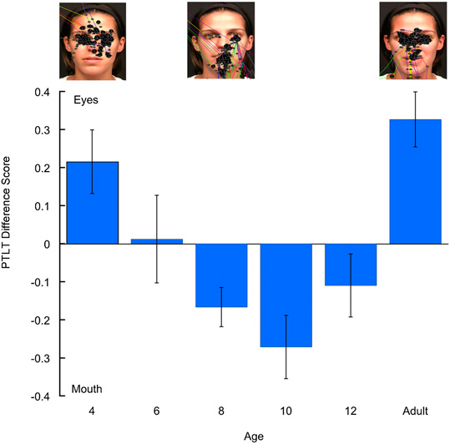
Infants’ visual fixation during speech perception – an example
Notes:
Fig. 1. PTLT difference scores as a function of age in response to the English monologue. Error bars represent SEMs. The screen shots above the graph are representative scan patterns of the talker’s face in a 4- and an 8-mo-old infant and in an adult (each black dot represents a single visual fixation).
ABSTRACT: The mechanisms underlying the acquisition of speech-production ability in human infancy are not well understood. We tracked 4–12-mo-old English-learning infants’ and adults’ eye gaze while
they watched and listened to a female reciting a monologue either in their native (English) or nonnative (Spanish) language. We found that infants shifted their attention from the eyes to the
mouth between 4 and 8 mo of age regardless of language and then began a shift back to the eyes at 12 mo in response to native but not nonnative speech. We posit that the first shift enables
infants to gain access to redundant audiovisual speech cues that enable them to learn their native speech forms and that the second shift reflects growing native-language expertise that frees
them to shift attention to the eyes to gain access to social cues. On this account, 12-mo-old infants do not shift attention to the eyes when exposed to nonnative speech because increasing native-
language expertise and perceptual narrowing make it more difficult to process nonnative speech and require them to continue to access redundant audiovisual cues. Overall, the current findings
demonstrate that the development of speech production capacity relies on changes in selective audiovisual attention and that this depends critically on early experience.

Slide 25
Speech Perception:
Do children learn their native language by ear, eye and/or mouth?
the “McGurk Effect”
(sample video)
Notes:
General notes:
Neuro-developmental models
Define evidence-based support of a program versus research-based support versus clinical experiential support – all promoting SLP’s delivery of Evidence-Based Practice (the focus of FLASHA/ASHA
Are there dyslexia subtypes that are research-based subtypes?

Slide 26
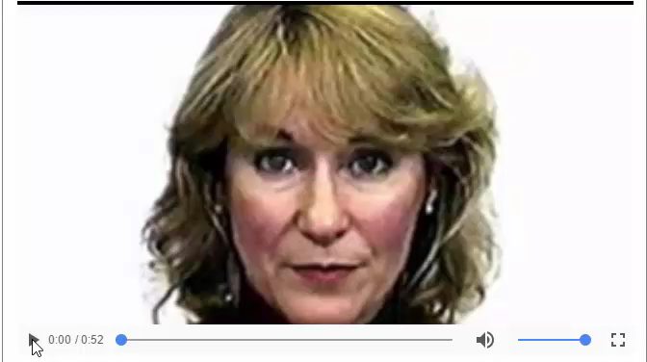
McGurk Effect –
Do we Hear by Ear, Eye or Both?

Slide 27
At what age is a child’s brain “tuned” to parents’ native language?
  At approximately 10 months of age the auditory cortex begins to specialize for a native language
  (Kuhl, 2004)
Notes:
General notes:
Neuro-developmental models
Define evidence-based support of a program versus research-based support versus clinical experiential support – all promoting SLP’s delivery of Evidence-Based Practice (the focus of FLASHA/ASHA
Are there dyslexia subtypes that are research-based subtypes?

Slide 28
EARLY NEURO-DEVELOPMENT of SPEECH
Babies integrate sensory and motor inputs from what senses?
    MOTOR - ORAL-FACIAL MOVEMENTS
    AUDITORY - SPEECH SOUNDS (Phonology)
    VISION (of oral-facial movements; own mouth if a mirror is available)
    SOCIAL–EMOTIONAL (Pragmatics)

Slide 29
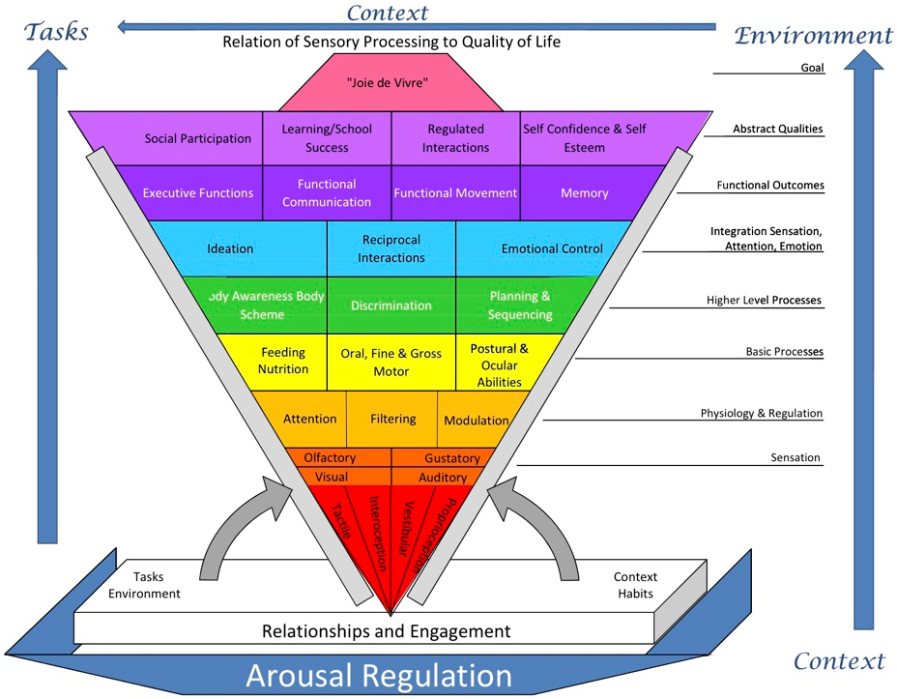
(Miller, 2011)
Notes:
It’s the sensory and cognitive experiences that drive “experience dependent” neural plasticity which helps the brain forms networks for developing skills and abilities.
Figure is from Miller’s handout @ SPD conference – her talk on 10/20/11.

Slide 30
NEURO-DEVELOPMENTAL MODEL OF PHONOLOGICAL AWARENESS AND READING

Slide 31
PHONOLOGY
(Alexander & Slinger, 2004)
(PERCEPTION & PRODUCTION)
EXECUTIVE FUNCTION / INTENTION
WORKING MEMORY (HOLD / MANIPULATE)
PROSODIC
(WORD LEVEL)
PHONEMIC
REPRESENTATION
ORAL MOTOR
SOMATOSENSORY
ACOUSTIC
VISUAL
ATTENTION / AROUSAL

Slide 32
Developmental Building Blocks for Language
(modified from Alexander & Heilman , 2006)
METALINGUISTICS
9 YEARS
WRITING
SPELLING
5 YEARS
READING
Expressive Language
SYNTAX
Receptive Language
18 MONTHS
(FORM)
9 MONTHS
SEMANTICS
(MEANING)
1 MONTH
PHONOLOGY
(FORM)
PRAGMATICS
(FUNCTION)
Notes:
Sensorimotor, phonology and language skills are developing immediately post-birth and should continue so for quite some time, if all the systems are working well together.

Slide 33
What Skills = Solid Foundation for Reading? Developmental “Language Building Blocks”
C O M P R E H E N S I O N
SYNTAX
R E A D I N G F L U E N C Y
SOUND OUT WORDS (phonology/decoding)
SIGHT WORDS
(Visual Memory)
SIGHT WORDS
(visual memory)
VOCABULARY
(semantic knowledge)
VOCABULARY
(Semantic Knowledge)
Notes:
Sensorimotor, phonology and language skills are developing immediately post-birth and continue so for quite some time. Phonology is a core system that develops from oral language from birth. Oral language is the primary mechanism for development of phonological processing UNTIL formal instruction in the English alphabet begins around age 4-5 years (younger in some regions/countries and older in others).

Slide 34
NEURAL ORGANIZATION & ACTIVITY: PHONOLOGICAL AWARENESS AND READING IN THE BRAIN

Slide 35
BRAIN ACTIVITY DURING READING
STRONG
ACTIVITY
PATTERN
weak activity
pattern
“SIGNATURE” DYSLEXIC BRAIN (Shaywitz, 2003)
Simos, Fletcher, Bergman, et al 2002
Notes:
Prototypical comparison of dyslexic and non dyslexic MSI study. The activated areas are, from left to right in the lower right panel, the angular gyrus, Wernicke’s area, and superior temporal gyrus (heavily involved in phonology. Activate after initial sensory activation in occipital area (not depicted) and activation of secondary association area (basal temporal- in yellow) and the simultaneous activation of red, representing a neural network supporting word rec- difference is obvious- in the language hemisphere in the normal reader and the nonlanguage hem in the poor reader

Slide 36
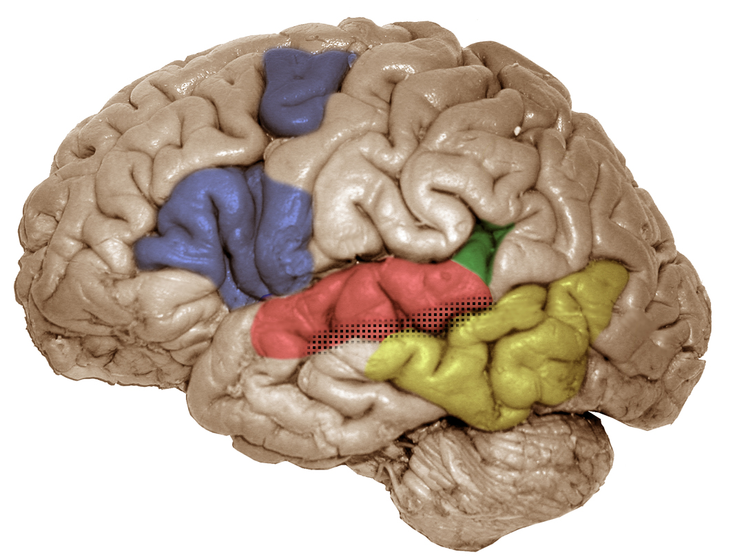
FUNCTIONAL BRAIN REGIONS
pIFG/dPM (left)
articulatory-based
speech codes
Area Spt (left)
auditory-motor interface
STG (bilateral)
acoustic-phonetic
speech codes
STS phoneme
representations
pMTG (left)
sound-meaning interface
HICKOK & POEPPEL (2000, 2004)

Slide 37
Education should change Brain Connections & Wiring, aka “Synapses”
At what age in your life do your neurons lose the ability to make new connections (synapses) or new wiring (networks)?
Can neural networks make new connections even after documented brain injury?

Slide 38
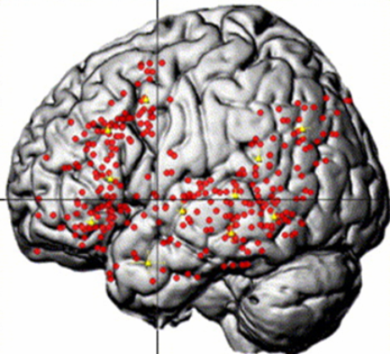
SEMANTIC activity
VIGNEAU et al., 2006

Slide 39
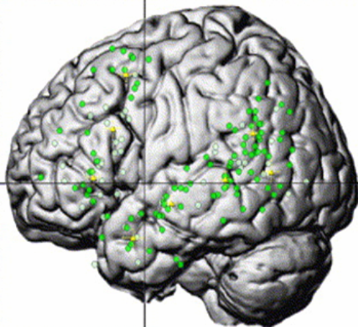
SENTENCE/SYNTACTIC Activity
VIGNEAU et al., 2006

Slide 40
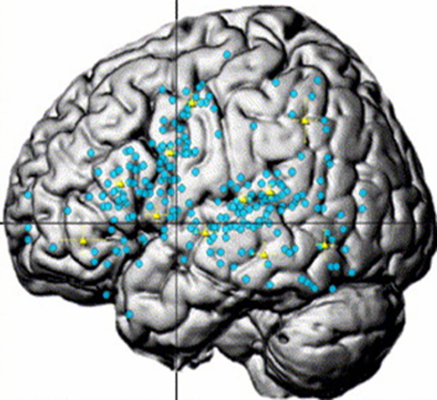
PHONOLOGICAL activity
VIGNEAU et al., 2006

Slide 41
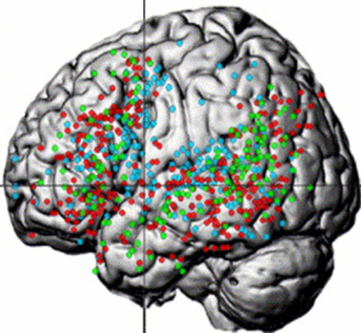
UNIQUE and OVERLAPPING NETWORKS
SENTENCE/SYNTACTIC, SEMANTIC, PHONOLOGICAL
(VIGNEAU et al., 2006)

Slide 42
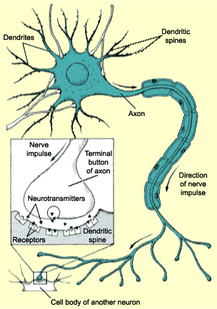
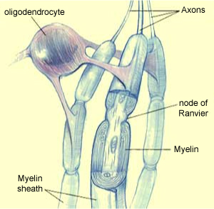
NEURONS
– follow a developmental journey
www.thebrain.mcgill.ca

Slide 43
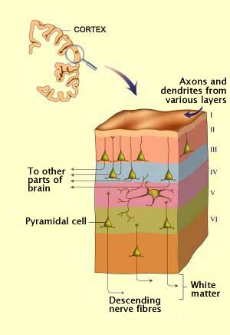
A journey forms specific brain layers
www.thebrain.mcgill.ca

Slide 44
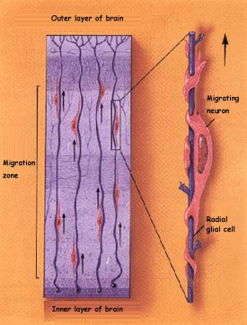
Maybe neuronal migration goes awry in developmental dyslexia?
NEURONAL MIGRATION (journey)
X
www.thebrain.mcgill.ca
Notes:
All 100 billion neurons have to migrate to their target destination in the cortex, but some do not migrate to the proper regions or layers of the brain. This leaves the brain with less efficient wiring, meaning that it will take more intensive, more frequent and more explicit or concrete instruction to help rewire these areas or networks in the brain. So, where do these ectopias occur and which networks in the brain are they most likely to affect? Language, sensory and motor skills (speech and fine motor). So, from this knowledge of the less efficient wiring and brain regions/networks models of what skills need to be working together to develop these networks for phonological processing and reading are developed. These models look like the following:

Slide 45
Fact or Myth about Dyslexia?
Dyslexia is genetic and tends to run in families.
  It is hereditary and has been linked to 6-9 different genes that may contribute to the development of dyslexia.

Slide 46
Dyslexia
Dyslexia is a genetic, neurobiological learning difficulty and in severe degrees it may include visual, language, sensory, motor, behavioral, and attention difficulties too.
However, many common beliefs are myths, not supported by research data.
Importantly, research on both the prevention and the remediation of the phonological and decoding deficits common to dyslexia shows robust success for improving skills in children and for adults.

Slide 47
What is Dyslexia?
Definition:
  Difficulty with words (dys = difficulty; lex = words)
  Difficulty in learning to read despite adequate intelligence, educational opportunities and cannot be due to an impairment in a primary sensory system (e.g. blindness).
  Can affect other language skills besides reading, i.e. spelling, speech, language expression and language comprehension.

Slide 48
Fact or Myth about Dyslexia?
Dyslexia is not very common?
  Current estimates are nearly 20% of children have dyslexia.
  That’s a prevalence of 1 out of every 5 children
  Among those diagnosed with a learning disability, 80% of these children have a specific learning disability in reading.

Slide 49
Fact or Myth about Dyslexia?
Individuals with Dyslexia see words backwards
  Child looks at the word WAS and says “saw”
  Does the child look at THE and say “eht” ?
    Why not?

Slide 50
Fact or Myth about Dyslexia?
Dyslexia is a visual problem that can be fixed with eye exercises?
  Eye training has not been shown to improve decoding skills in children with dyslexia (2009).
    AMERICAN ACADEMY OF PEDIATRICS
    AMERICAN ACADEMY OF OPHTHALMOLOGY
    AMERICAN ASSOCIATION FOR PEDIATRIC OPHTHALMOLOGY AND STRABISMUS
    AMERICAN ASSOCIATION OF CERTIFIED ORTHOPTISTS

Slide 51
Fact or Myth about Dyslexia?
Dyslexia is a developmental lag and if we just retain or hold a child back one year then reading will “click”, because the child will have matured and caught up to his/her peers.
  Retention does not produce better reading skills in children with dyslexia
  Another year of the same educational methods – yields the same results it did the first time – POOR.
  Matching children with and without dyslexia for total reading experience, stills shows that the children with dyslexia are making more errors when reading.

Slide 52
DYS = trouble LEXIA = words
Dyslexia is…
Neurologic in origin – genetic
Lifelong – but environment may alter course
Reading comprehension > word reading skills
Dyslexia may include accompanying challenges
  ADHD 20-70% (sample bias)
  Behavioral problems
  Sensory motor difficulty
  = More challenging to remediate

Slide 53
GROWTH IN “PHONICS” ABILITY OF CHILDREN WHO BEGIN FIRST GRADE IN THE BOTTOM 20%ile IN PHONEME AWARENESS AND LETTER KNOWLEDGE
6
5.9
5
Average
Low PA
4
Low
Ave. PA
READING GRADE LEVEL
3
2.3
2
1
K
1
2
3
4
5
GRADE LEVEL CORRESPONDING TO AGE
(Torgesen & Mathes, 2000)
`

Slide 54
GROWTH IN WORD READING ABILITY OF CHILDREN WHO BEGIN FIRST GRADE IN THE BOTTOM 20%ile IN PHONEME AWARENESS AND LETTER KNOWLEDGE (Torgesen & Mathes, 2000)
5.7
Low PA
5
Average
Low
4
Ave. PA
READING GRADE LEVEL
3.5
3
2
1
K
1 2 3 4 5
GRADE LEVEL CORRESPONDING TO AGE

Slide 55
GROWTH IN READING COMPREHENSION OF CHILDREN WHO BEGIN FIRST GRADE IN THE BOTTOM 20%ile IN PHONEME AWARENESS AND LETTER KNOWLEDGE (Torgesen & Mathes, 2000)
6.9
6
Average
Low
5
4
3.4
READING GRADE LEVEL
3
2
SAME VERBAL ABILITY – VERY DIFFERENT READING COMPREHENSION
1
Low PA
K
1
2
3
4
5
GRADE LEVEL CORRESPONDING TO AGE

Slide 56
THE EFFECTS OF WEAKNESSES IN ORAL LANGUAGE
ON READING GROWTH
(Hirsch, 1996)
16
15
14
13
12
11
10
9
8
7
6
5
High Oral Language in Kindergarten
Reading Age Level
5.2 years gap
Low Oral Language in Kindergarten
5 6 7 8 9 10 11 12 13 14 15 16
Chronological Age

Slide 57
Oral Language Difficulties in Dyslexia
(ALL SYMPTOMS DO NOT OCCUR WITH EVERYONE)
(Alexander & Conway, 2006)
ORAL LANGUAGE
CHALLENGES
LISTENING
SPEAKING
Phonological Awareness
Word Finding
Multi-syllable Words
Auditory Memory
(word sequences, phone numbers,
remembering directions)
Sequencing Ideas
Foreign Language
Foreign Language

Slide 58
Fact or Myth about Dyslexia?
If he/she would just “apply” him/herself and try harder, then they would learn more and be better at reading.
  Most children with learning difficulties have wanted to learn to read and have tried much harder than their peers – again and again – but with poor results.
    When an individual’s effort consistently produces a poor outcome, then sooner or later the individual’s effort will decrease or cease.

Slide 59
Fact or Myth about Dyslexia?
Dyslexia occurs more often in boys than in girls.
  The Connecticut Longitudinal Study showed that this belief was due to a referral bias.
    Boys more commonly act up when they cannot read and are their reading difficulties are more likely to be noticed
    Girls tend to withdrawal and hope that no one notices that they cannot read, so their reading difficulties are less likely to be noticed.

Slide 60
Fact or Myth about Dyslexia?
Individuals with Dyslexia have a brain that just “works differently” or “learns differently” than others who do not have dyslexia?
  Every healthy individual’s brain (without brain injury) has the same sensory inputs
    Visual
    Auditory
    Touch
    Taste
    Smell
    [OT’s note: Proprioception & Vestibular]

Slide 61
Effective Treatment Changes Brain Activity/Networks
- In Developmental Dyslexia
Pre-Treatment S-3
Pre-Treatment S-4
right
left
right
left
After Treatment S-3
After Treatment S-4
Treatment = Increased activity in left hemisphere
Decreased activity in right hemisphere
(Simos, et al., 2002)
Notes:
I ask audience why this happened or who did it- instruction, teacher- brain has to learn that words are part of the language system- instruction is needed, whether by parents or a teacher or some other adult; the human brain is not specialized for reading, as the specialization only occurs in response to environmental intervention/educational experience.

Slide 62
NEUROBIOLOGICAL MODEL OF DYSLEXIA

Slide 63
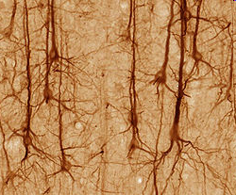
Notes:
Ultimately – everything I’m talking about today comes down to this – the neurons in a human brain and their response to the environment.

Slide 64
Neurons - How the Brain Works
How many neurons In the brain?
  ~ 100 Billion
How many connections exist in the neural networks formed in the brain?
  ~ 100 Trillion
How many “connections” from one neuron?
  ~ 40,000
The brain is specifically designed for learning and behaviors. It is ready and willing to create neural networks.
Learning to drive?
Driving to Daytona, FL…..

Slide 65
NEURONAL MIGRATION
Four “Dyslexia Susceptibility Genes”
(Galaburda, et al., 2006)
Galaburda, 2006

Slide 66
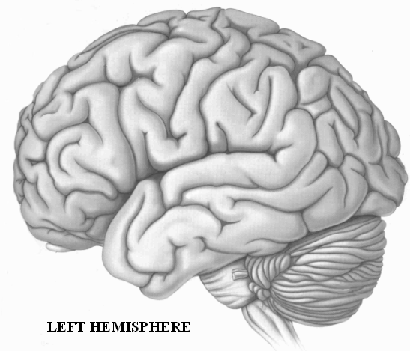
“OUT OF LINE NEURONS” ( ECTOPIAS )
FRONT
BACK

Slide 67
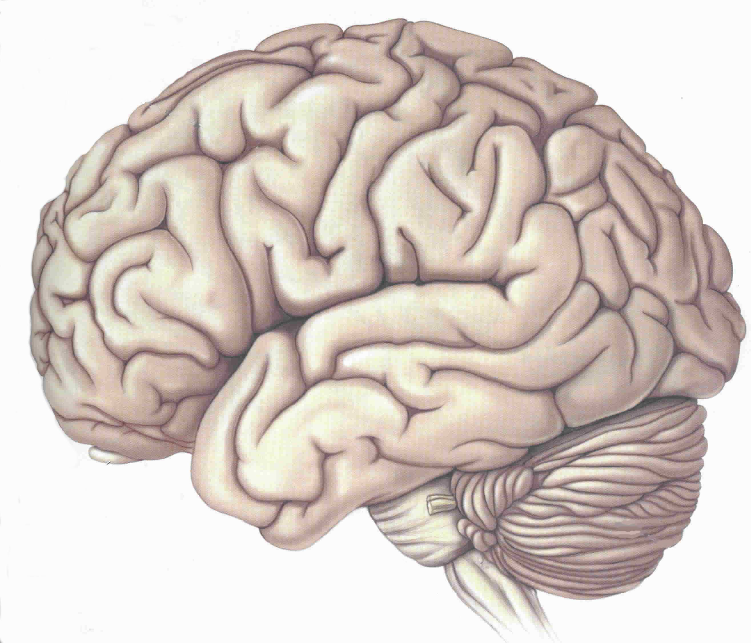
TYPICAL LANGUAGE AREAS
VISUAL-LANGUAGE
ASSOCIATION AREA
VISUAL /
VERBAL
AREA
SPEECH
PRODUCTION
AREA
AUDITORY
PROCESSING
AREA
LEFT HEMISPHERE

Slide 68
TYPICAL READING AREAS
WORD ANALYSIS
WORD ANALYSIS
AUTOMATIC
(SIGHT WORD)
LEFT HEMISPHERE

Slide 69
Microneurodysgenesis and Genetic Dyslexia
  Areas in the left side of the brain that are most likely to be affected:
    Broca's area/inferior frontal gyrus controlling articulation and word analysis
    Parieto-temporal area controlling word analysis
    Occipito-temporal area controlling the rapid, automatic fluent identification of words

Slide 70
(RAMUS, 2006)
Biology
Cognition
Behavior

Slide 71
Fact or Myth about Dyslexia?
Is dyslexia caused by weak phonological processing skills?
  FACT:
    This weakness is evident in speaking skills well before it appears in difficulties with reading/spelling skills.
      Poor rhyming words
      Trouble learning the letters of the alphabet (name and/or sound)
      Persistently mispronounces words even when given the correct pronunciation, e.g. says
  FACT:
    Over 88% of individual with dyslexia have phonological processing difficulties (Shaywitz, 2003)

Slide 72
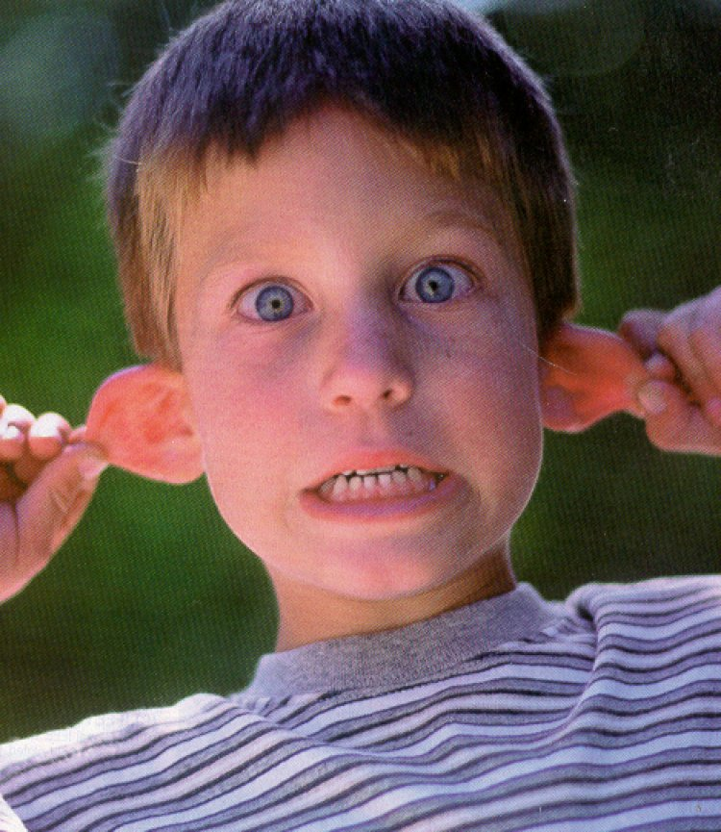
WHAT IS PHONOLOGICAL AWARENESS?

Slide 73
EXPERIENCING PHONOLOGICAL AWARENESS
In Reading…. GLESP
In Spelling… THROUG
In Speech… PACIFIC vs SPECIFIC

Slide 74
PHONOLOGICAL AWARENESS
THE ABILITY TO IDENTIFY, THINK ABOUT, AND
MANIPULATE THE INDIVIDUAL SOUNDS
(PHONEMES) IN WORDS
THE IMPLICATION OF A GROWING ABILITY TO
IDENTIFY INDIVIDUAL SOUNDS IN WORDS.
Torgesen, www.fcrr.org

Slide 75
Fact or Myth about Dyslexia?
Individuals with dyslexia may have trouble learning a foreign language?
  If someone struggles to learn the phonology (speech sounds) of their first language, might they also struggle to learn the phonology (speech sounds) of a 2nd language?
  YES, individuals with dyslexia commonly report having trouble learning a foreign language, including speaking, reading and/or writing in another language.

Slide 76
Fact or Myth about Dyslexia?
Dyslexia is a “gift” and makes you different from others who don’t have it – embrace your trouble with dyslexia.
  If there was no way to change the primary difficulties of dyslexia, then “accepting and embracing it” might be the best choice IF it was the only option.
  However, when given an opportunity to make reading significantly easier, few people with dyslexia usually chose to keep the difficulty.

Slide 77
Fact or Myth about Dyslexia?
Individuals who have dyslexia commonly have other difficulties or disorders too?
  For example,
  ADHD (20-70% will have ADHD with Dyslexia)
  Sensory processing disorder
  Behavioral/emotional difficulties
  Language impairment

Slide 78
Fact or Myth about Dyslexia?
Because individuals with dyslexia have trouble reading, will they most likely have difficulty with reading comprehension too?
  Many individuals with dyslexia have adequate vocabulary knowledge and can infer or reason to compensate for their reading difficulty. Thus, their performance on standardized testing of comprehension skills may be grade levels higher than their performance on standardized tests of reading skills.

Slide 79
Written Language Difficulties in Dyslexia
(ALL SYMPTOMS DO NOT OCCUR WITH EVERYONE)
(Alexander & Conway, 2006)
WRITTEN LANGUAGE CHALLENGES
READING
SPELLING & WRITING
Mechanics
Comprehension
Mechanics
Expressing Ideas
Speed
Speed

Slide 80
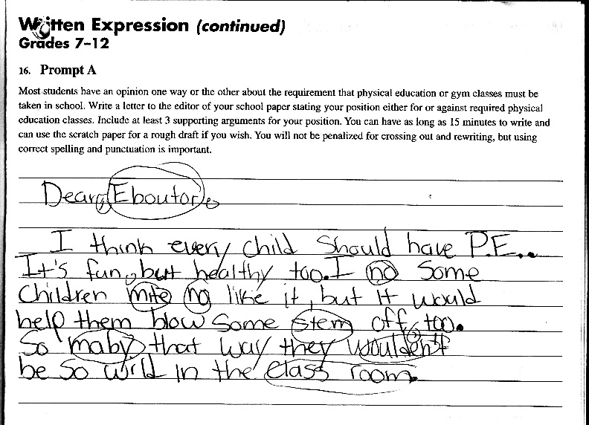
Written Expression Skills Before Treatment

Slide 81
What Develops First, Speaking or Reading & Writing Skills?
Spoken language
Does this same developmental progression happen in languages besides English?

Slide 82
Fact or Myth about Dyslexia?
Phonological processing does not develop until children are taught to read?

Slide 83
Fact or Myth about Dyslexia?
Dyslexia’s Reading Difficulties can be prevented.

Slide 84
What Develops First, Speaking or Reading & Writing Skills?
If speech and spoken language develops first and phonological processing deficits are identifiable in speaking skills, then why do most educational interventions begin instruction with written language tasks, like reading and spelling?
Could intervention begin with speech and spoken language skills first?

Slide 85
What is a Systematic Program of Dyslexia Research?
Striving for evidence-based data, before implementing an intervention program.

Slide 86
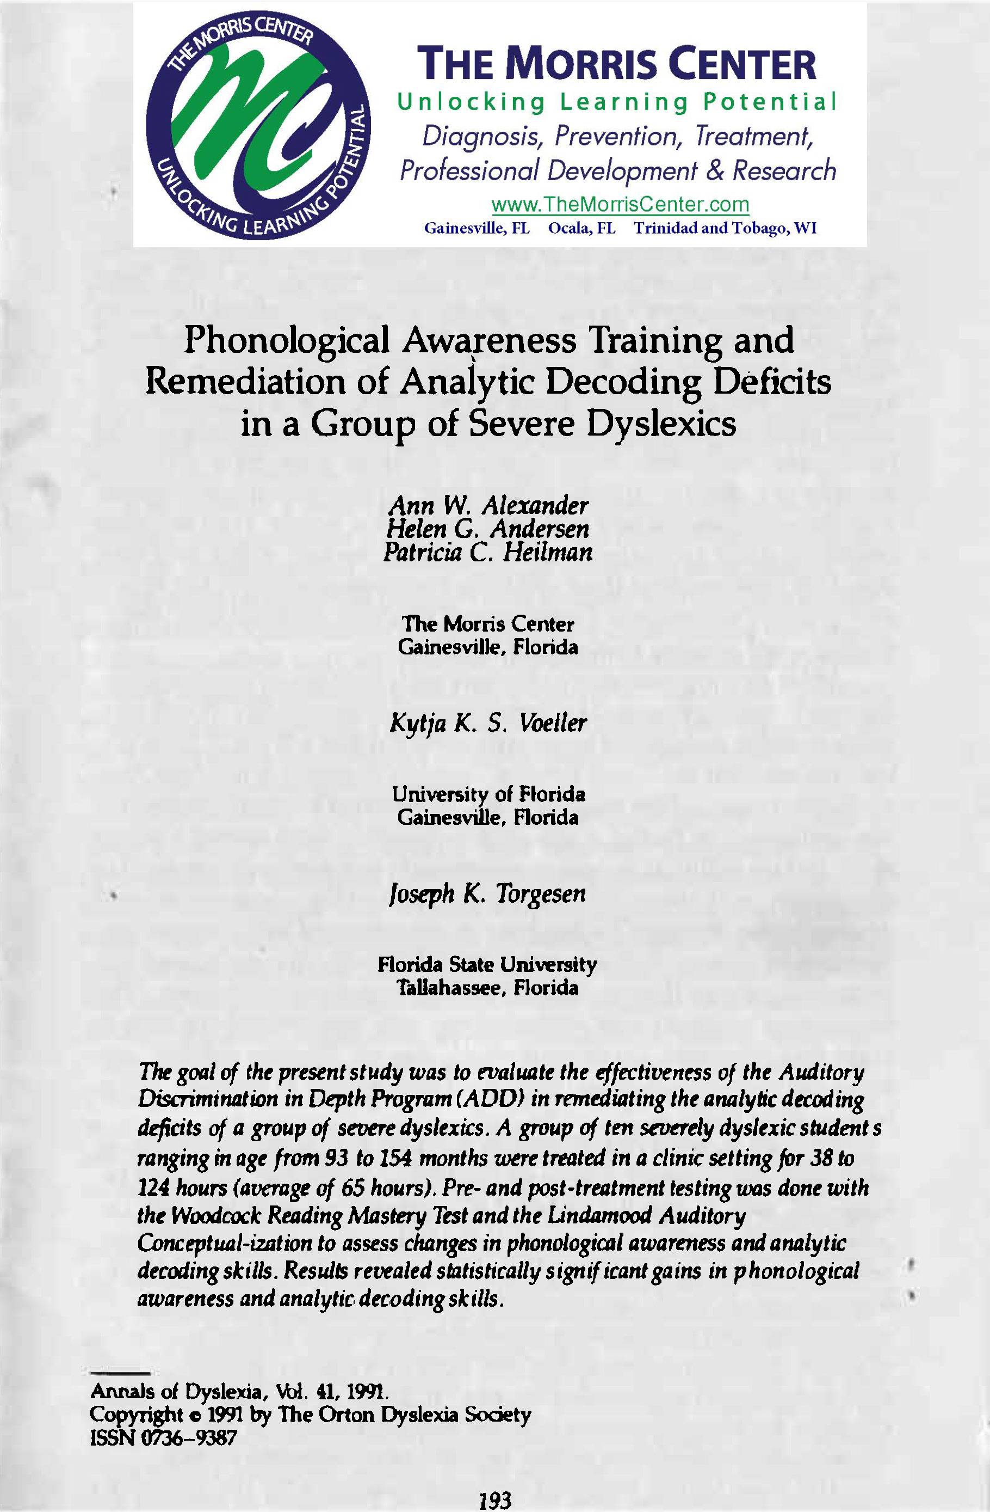

Slide 88
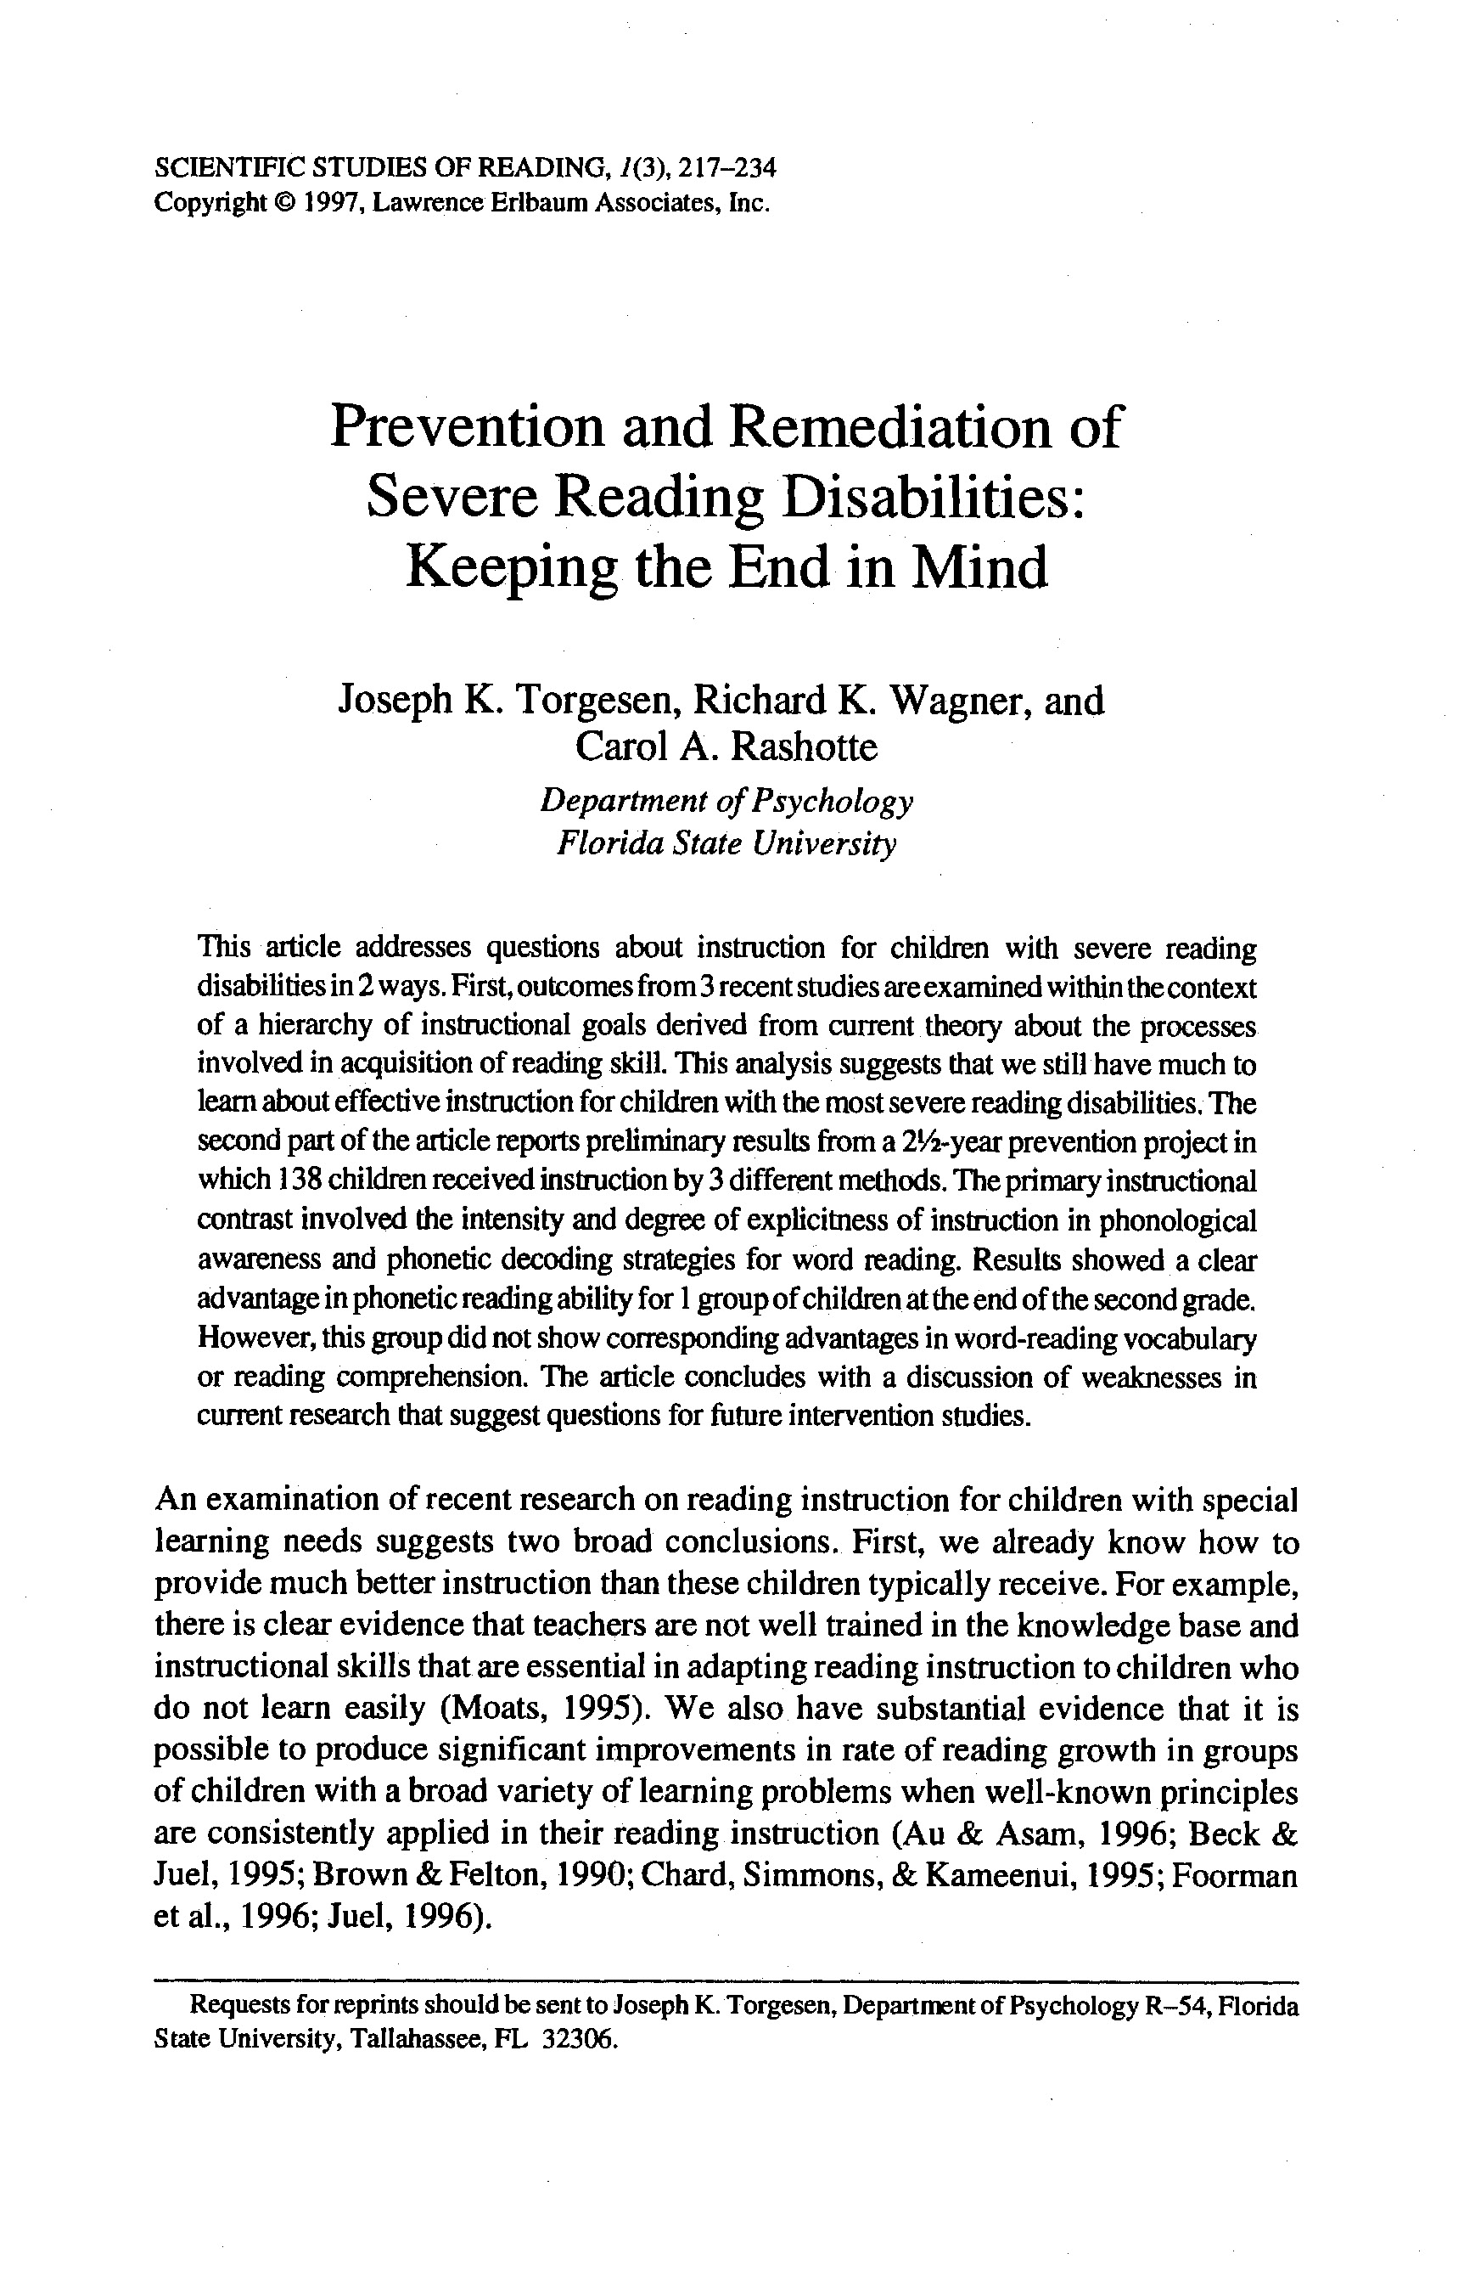
Prevention of Developmental Dyslexia
Preventing Reading Failure in Young Children with Phonological Processing Disabilities: Group and Individual Responses to Instruction
Joseph K. Torgesen
Richard K. Wagner
Carol Rashotte
Elaine Rose
Patricia Lindamood
Tim Conway
Cyndi Garvan
(1999). Journal of Educational Psychology 91, 579-593.
*NICHD, National Center for Learning Disabilities, Donald D. Hammill Foundation

Slide 89
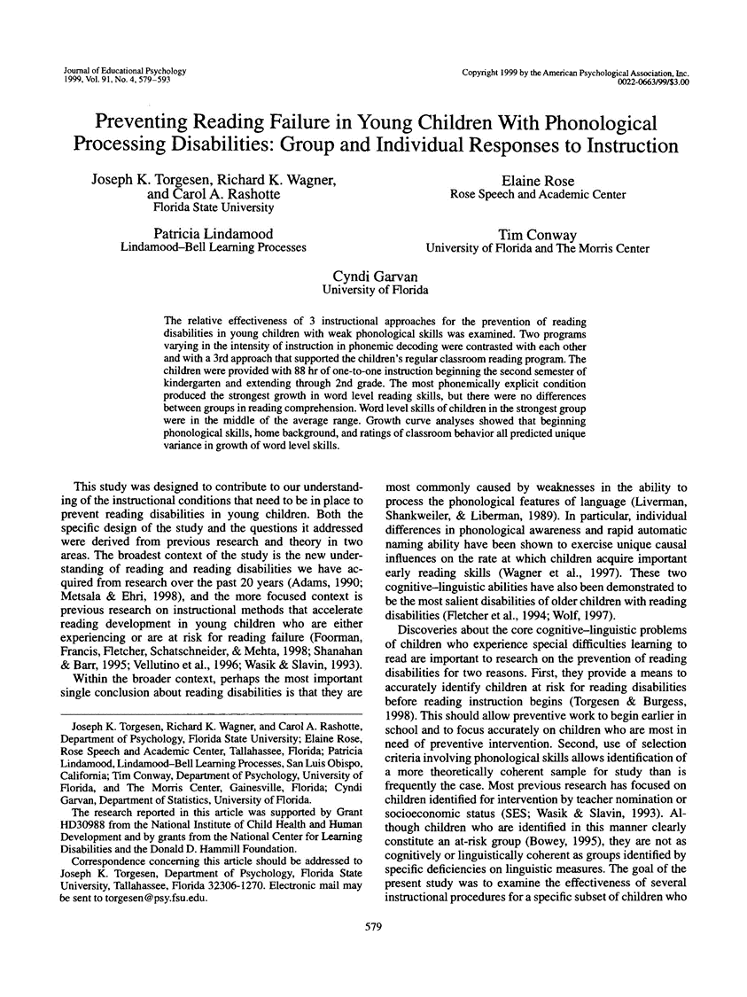

Slide 90
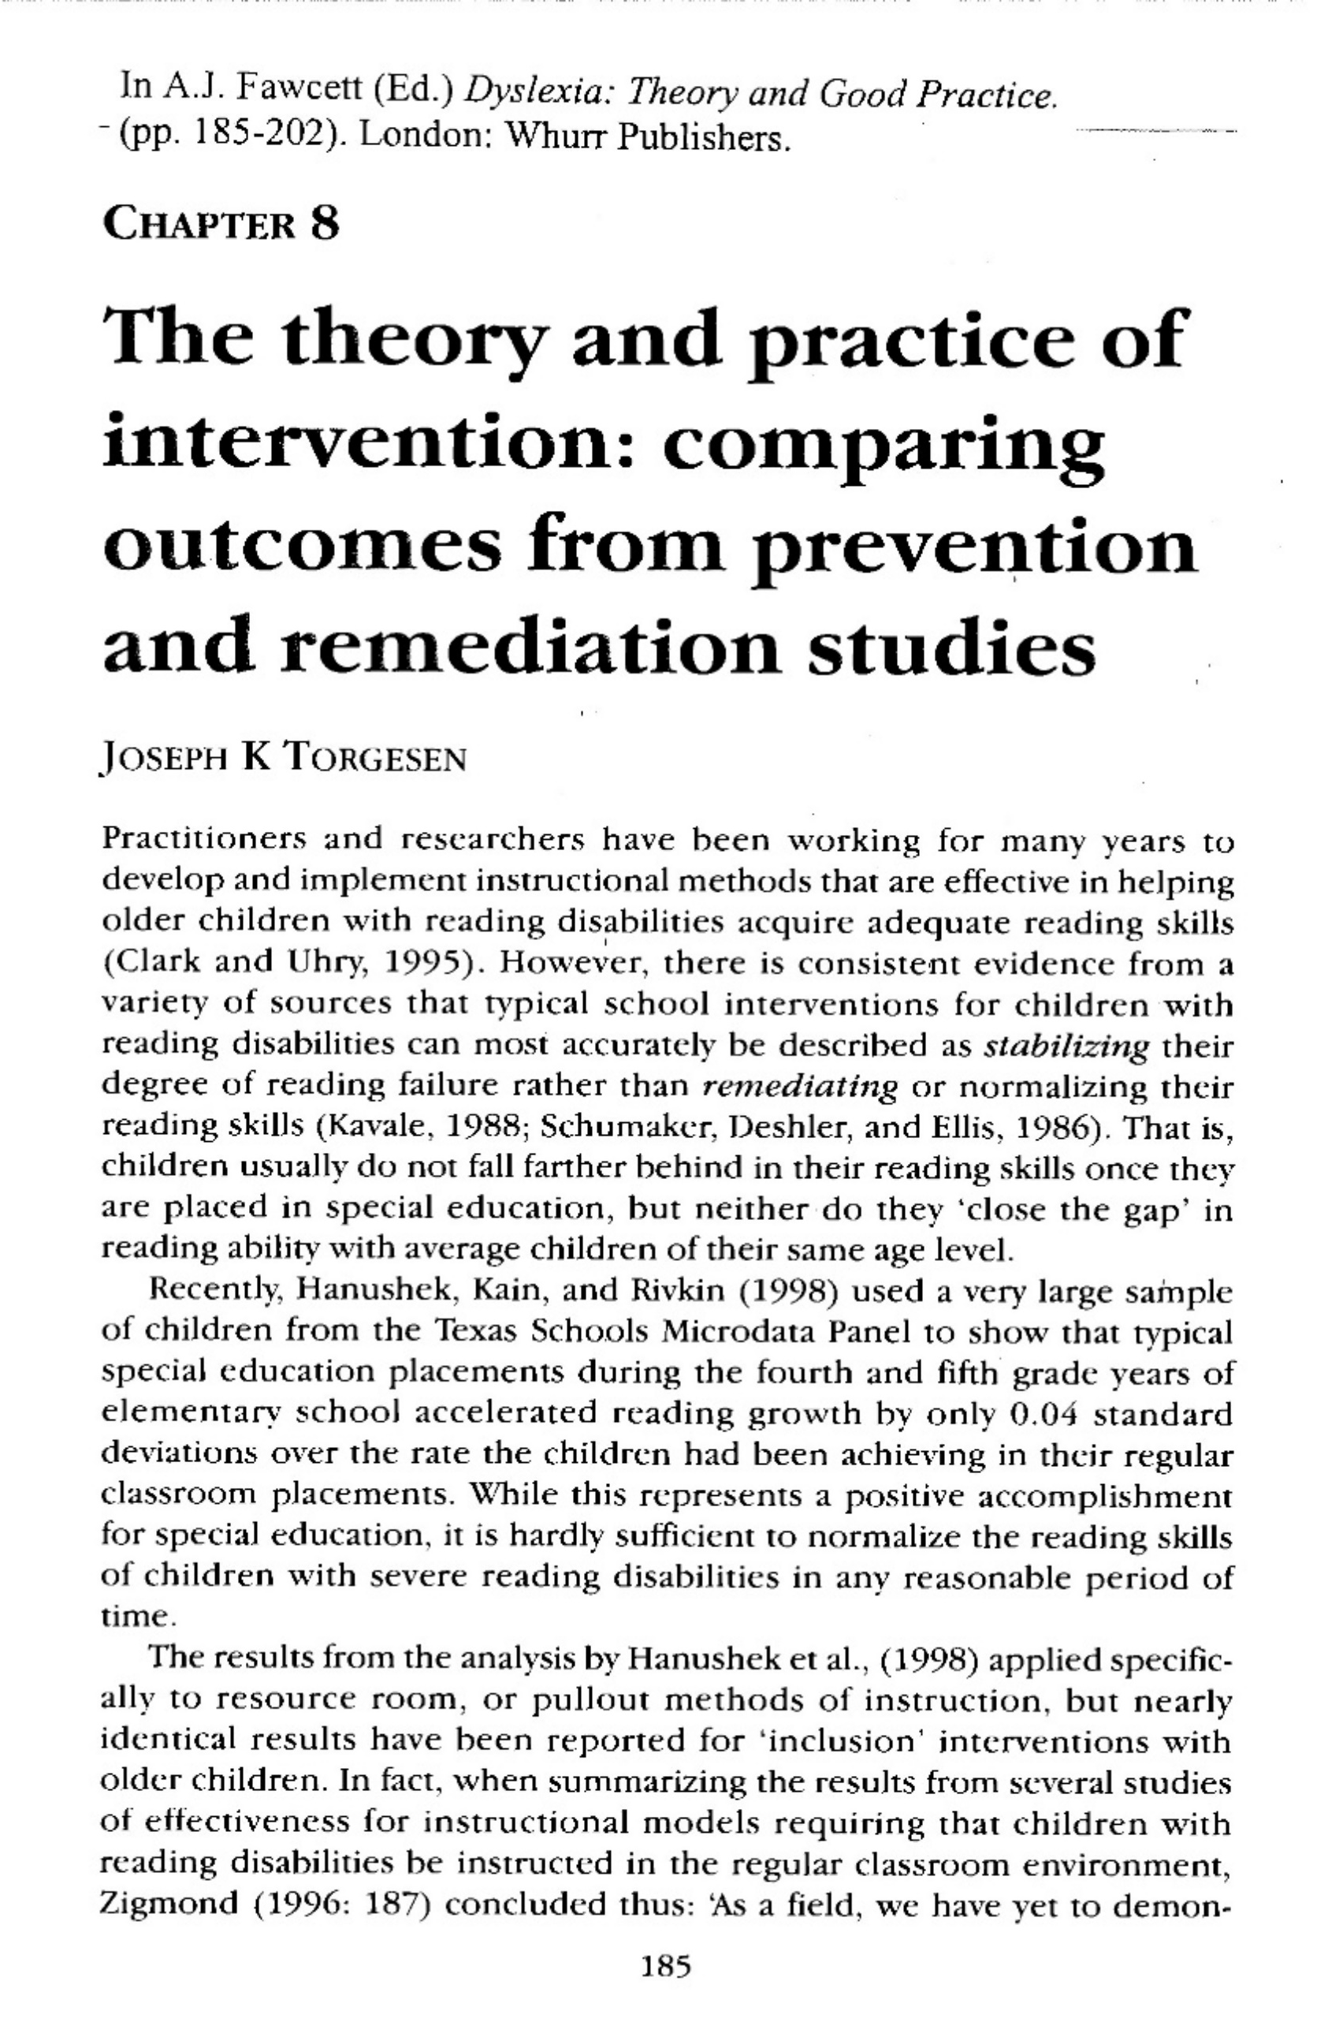
(2001)

Slide 91
Different Retention Rates:
Dyslexia Prevention Study
“Bottom-Up” vs “Top-Down”
NTC (NO TREATMENT CONTROL)
RCS (SUPPORT OF CLASSROOM TEACHING)
EP (TRADITIONAL EXPLICIT PHONICS)
NOW! Foundations program (MULTISENSORY, “BOTTOM UP”)
(PASP)*
*uses a more explicit, concrete, multisensory approach to train phonological awareness
(Torgesen et al, 1999)
Notes:
Why is it important to establish a “team” approach? Why distinguish skill vs. I.Q.?
The hierarchical process develops by establishing feeling (fingers behind back, wiggle… how do you know? –Not happy, sad, bored)
And a TEAM effort to develop SKILLS not increase IQ

Slide 92
Different Promotion Rates:
Dyslexia Prevention Study
“Bottom-Up” vs “Top-Down”
(PASP)
Notes:
Why is it important to establish a “team” approach? Why distinguish skill vs. I.Q.?
The hierarchical process develops by establishing feeling (fingers behind back, wiggle… how do you know? –Not happy, sad, bored)
And a TEAM effort to develop SKILLS not increase IQ

Slide 93
Preventing Dyslexia: After Treatment - Percent of children performing at least 1 S.D. BELOW their peers [ <85 ]
(Torgesen et al, 1999)
Percent
Groups
No Treatment Control
Regular Classroom Support
Explicit Phonics
Currently NOW! Foundations for Speech, Language, Reading and Spelling ®
Woodcock Reading Mastery Test- Revised (WRMT-R)

Slide 94
Preventing Dyslexia: After Treatment - Percent of children performing at least 1 S.D. ABOVE their peers [ > 100 ]
(Torgesen et al, 1999)
Percent
Groups
No Treatment Control
Regular Classroom Support
Explicit Phonics
Currently NOW! Foundations for Speech, Language, Reading and Spelling ®
Woodcock Reading Mastery Test- Revised (WRMT-R)

Slide 95
Different referral rates for Special Education
*p<.01
Torgesen et al, 1999

Slide 96
PREVENTION OF POOR READING SKILLS
in Kindergarteners at High-Risk for Dyslexia**
Improved Reading Accuracy & Reading Fluency after NOW! Foundations Program®!
100
!current version of treatment program
90
Average Range
STANDARD SCORE
WORD READING:
80
Accuracy
Rate
70
2nd GRADE
(after intervention ended)
4th GRADE
(2-years after intervention ended)
**Before intervention, the average score on pre-literacy skills was <15th percentile in Kindergarten (Torgesen, et al, 2003) www.NOWprograms.com NOW! Foundations for Speech, Language, Reading and Spelling®!

Slide 97
Prevention of Dyslexia?
“…the PASP treatment [currently NOW! Foundations program], as delivered in this study, was [only] relatively ineffective in normalizing the phonetic reading skills of approximately 2.4% of children in the total population [180] from which our treatment sample (the bottom 10%) [of ~1,500 children] was selected.”
How many classroom teachers would be disappointed if only 97.6% of their students were reading in the “average” range or above?
(Torgesen, Wagner & Rashotte, 1997; Torgesen, et al., 1999)

Slide 99
GROWTH IN PHONEMIC DECODING from
8-WEEK INTERVENTION & FOLLOW-UP
100
NOW! FoundationsTM
Program
90
Standard Score
80
70
60
Before
Intervention
Test score
After
Intervention
Test score
1 Year
After
Intervention
2 Years
After
Intervention
Torgesen, et al., in AJ Fawcett (Ed), 2001; N=30, 8-10 year olds; 40% staffed out ESE by year 1 follow-up
www.NOWprograms.com

Slide 100
Immediate and Long Lasting Improvement
(Decoding + Comprehension)
After Intervention Test Score
95
Normal Range of Performance
90
Start of 8-Week Intensive Intervention [NOW! FoundationsTM program]
Standard Score
85
80
75
16 Months
Spec. Ed Class
Initial
Test score
Before
Intervention
Test score
1 Year
After
Intervention
2 years
After
Intervention
Torgesen, et al., 2001 N=30, 8-10 year olds; 40% staffed out of ESE by year 1 follow-up
www.NOWprograms.com

Slide 101
The acquired reading disorders - Alexia
Alexia = an acquired reading disorder
(see B. Coslett Chapter in Clinical Neuropsychology, 4th Ed)
  Phonological Alexia
    misread pseudowords or novel real words.
  Deep Alexia
    Same as phonological, but with semantic paraphasias, e.g. says “duck” when reading the word swan.
  Surface Alexia
    misread sight words or words that can not be sounded out, e.g. yacht.
  Pure Alexia
    Word and nonword reading are very slow and reads by spelling out the word or nonword aloud, e.g. naming each letter in left-to-right sequence, AKA "letter-by-letter reading”

Slide 102
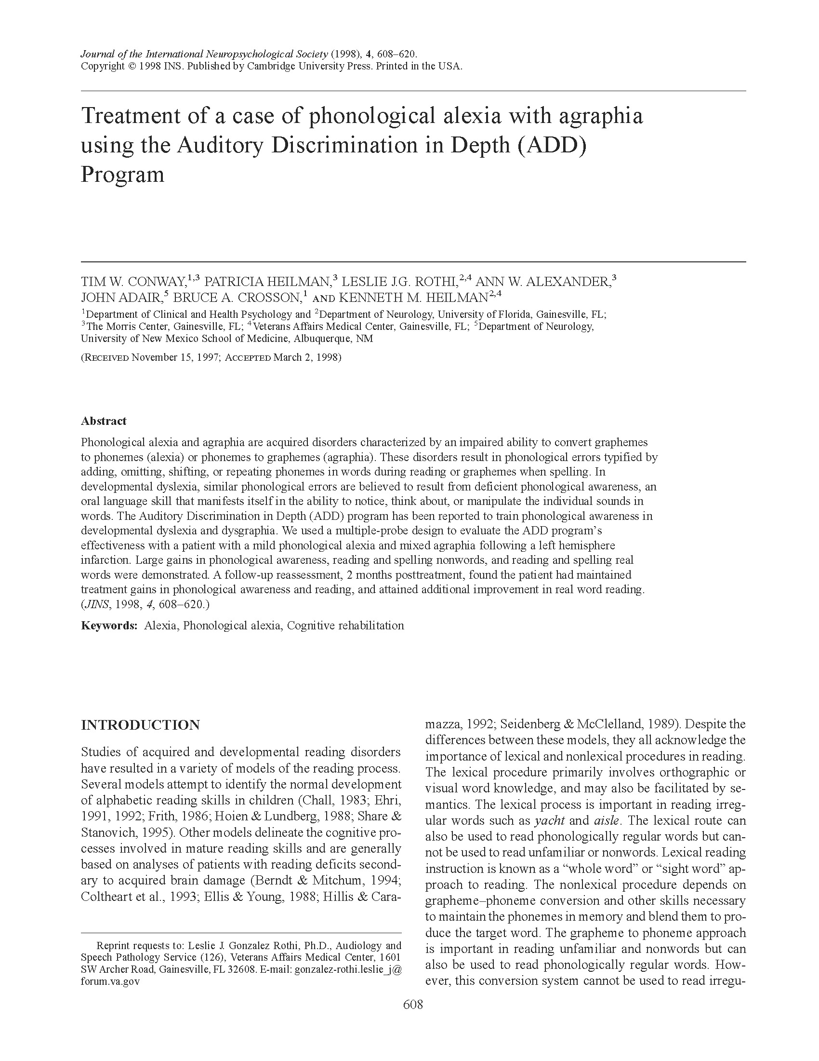

Slide 103
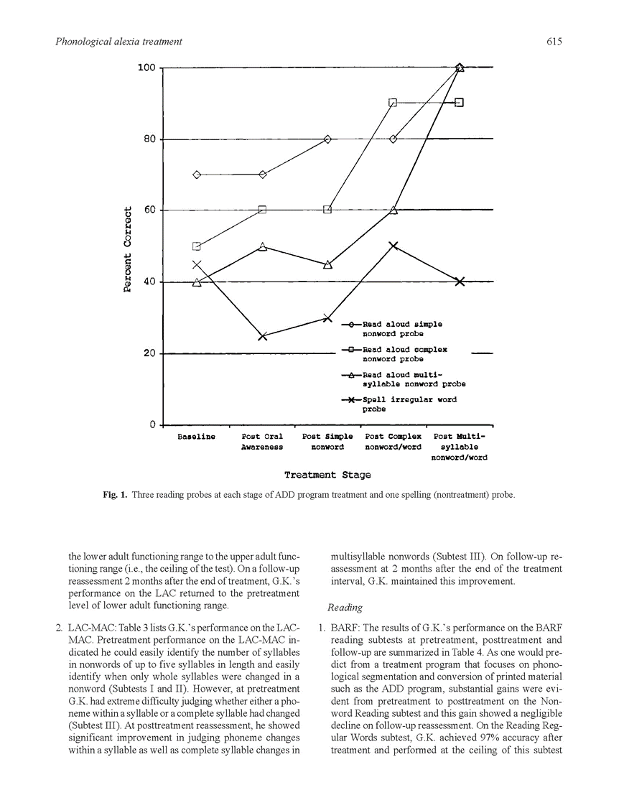

Slide 104
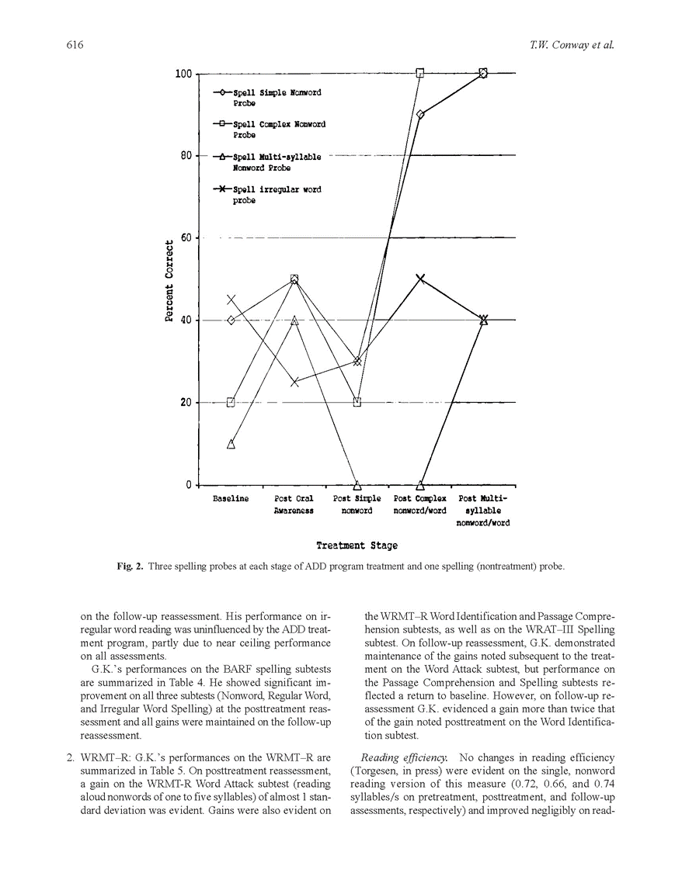

Slide 105
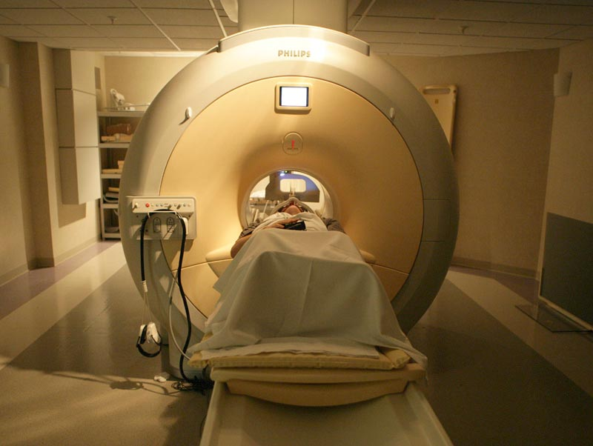
Functional MRI is done on the same machines on which clinical MRIs are done. However, in functional MRI, we measure blood oxygenation levels to determine what areas of the brain are active.

Slide 106
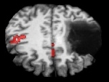
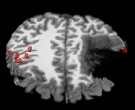
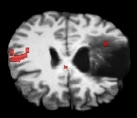
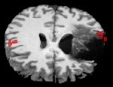
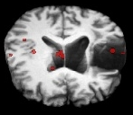
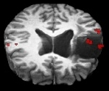
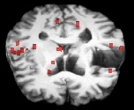
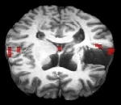
Pre-Treatment
Post-Treatment
We are interested in whether brain areas partially damaged by stroke can be re-activated during rehabilitation.
This appears possible in some patients, such as the one in these images.
Top
R
L
R
L
Back
Back
Bottom
Front
Front
(Chang, et al. 2006)

Slide 107
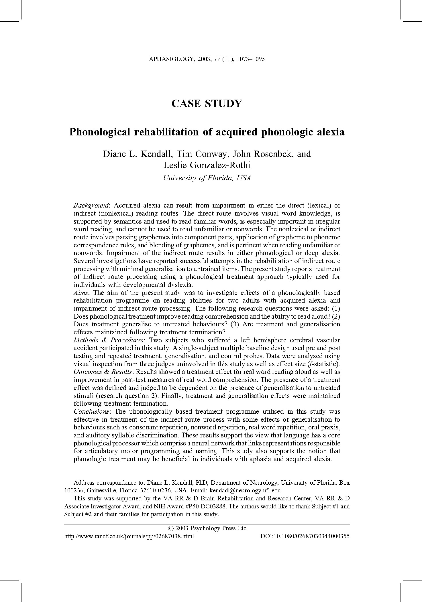

Slide 108
Thank you for your time, interest and questions
Tim Conway, Ph.D. twc@morriscenters.com
TEDx “How to Mix Oil & Water, so nearly everyone learns to read” www.TheMorrisCenter.com www.NOWprograms.com www.EinsteinSchool.us

Slide 109
Extra slides not used in presentation
TEDx Talk How to Mix Oil & Water so Nearly Everyone Learns to Read
  https://www.youtube.com/watch?v=M4LtozMLMNc
Professional Essays/Opinions posted on Linkedin
  https://www.linkedin.com/in/timconwayphdthemorriscenter
Twitter:
  @TheMorrisCenter
  @NOW_Programs
FB
  www.facebook.com/The.Morris.Center
  www.facebook.com/neurodevelopmentofwords
Academia.edu Repository of PDFs of Research
  https://florida.academia.edu/TimConway
Articles authored/co-authored by Dr. Conway
  https://scholar.google.com/citations?hl=en&user=K_5nHpcAAAAJ

Slide 110
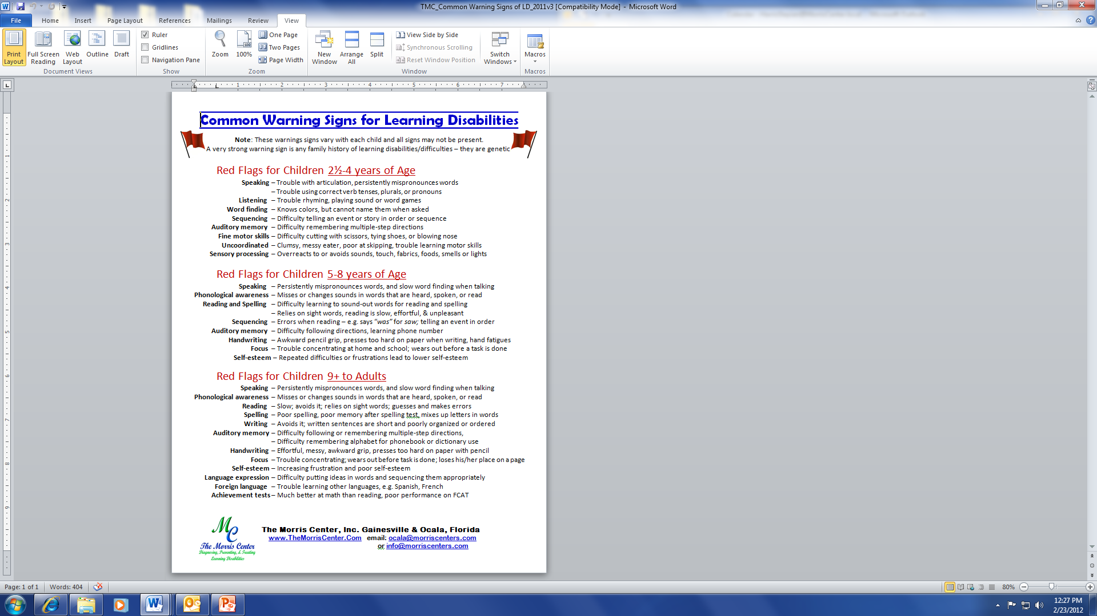

Notes:
These are “warnings signs” or “red flags” that a child is at risk for developing learning difficulties. The “Wait and See” approach is a poor choice and is not in the child’s best interest – according to scientific studies. If a child has these difficulties/warning signs/red flags, then early action is the scientifically supported approach. The “new science” says to engage these children in activities that have been shown in scientific studies to help PREVENT them from developing learning difficulties. As in primary care medicine, PREVENTION provides the best outcomes for the child.

Slide 111
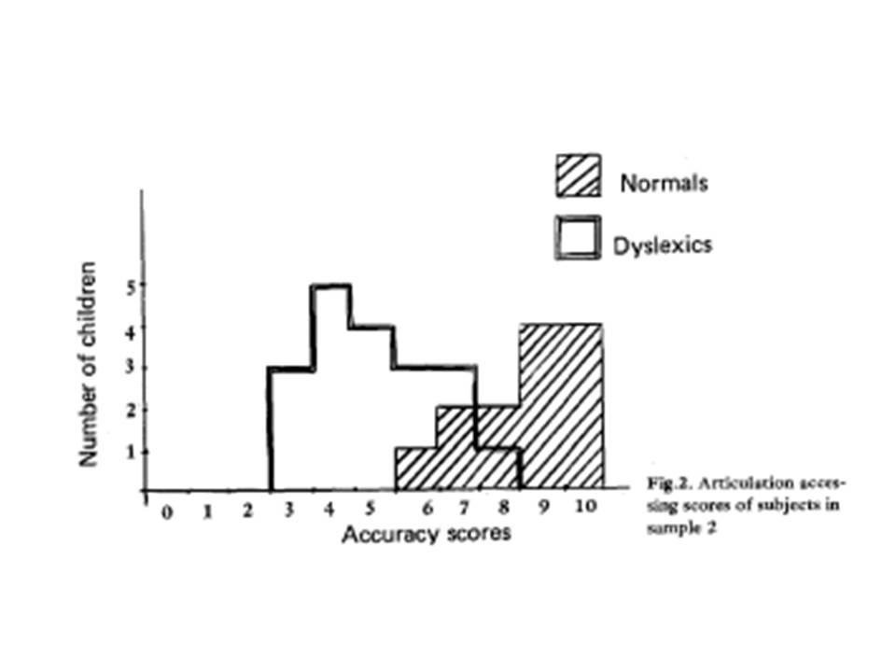
Visual, Auditory & Oral sensory systems – Are they working together in dyslexia?
Articulation Accessing scores of subjects in sample 2
Montgomery, 1981
Notes:
Discuss - Montgomery & Developmental Dyslexia oral awareness deficits
Abstract:
15 dyslexic and 19 normal readers of the same reading age (8 yrs) but of different CA (10 and 8 yrs) were given an articulation accessing and a phoneme segmentation task. For the former task, Ss had to indicate which of several schematic drawings corresponded to the position of their tongue, teeth, and lips for a given phoneme. Results show that the dyslexic Ss experienced great difficulty with this task, although they were equal to the normal Ss on a simple phoneme segmentation task. Results were replicated with 2 further samples of 19 dyslexic and 15 normal Ss. It is hypothesized that awareness of articulation processes is an important factor in explanations of dyslexia. (17 ref) (PsycINFO Database Record (c) 2010 APA, all rights reserved)

Slide 112
READING
(Alexander & Slinger, 2004)
DYSLEXIA
(PERCEPTION & PRODUCTION)
EXECUTIVE FUNCTION / INTENTION
SEMANTIC/
LEXICAL
PHONICS RULES
WORKING MEMORY (HOLD / MANIPULATE)
SYNTACTIC
ORTHOGRAPHIC
ARTICULATORY
PHONOLOGIC
PROSODIC
MORPHO-SYNTACTIC
ATTENTION / AROUSAL

