Slide 1

Is It Too Late Or Can Developmental Phonological Dyslexia Be Successfully Treated In Adults?
Tim Conway, Ph.D.
The Morris Center, Inc.
University of Florida
Gainesville, Florida
Presentation at the
Florida Association of Speech Language Pathologists and Audiologists May, 2010

Slide 2
Is It Too Late Or Can Developmental Phonological Dyslexia Be Successfully Treated In Adults?
Abstract:
Children with developmental phonological dyslexia typically grow up to become adults with phonological dyslexia. However, recent treatment studies report successful prevention and treatment of dyslexia in children. This raises the question of whether or not it is too late to help adults with dyslexia improve their phonological processing, phonological decoding, functional reading and language skills. We present a theoretical model of assessment and treatment of dyslexia that relies on an transdisciplinary team approach. Case studies of adults who have completed this approach are presented to highlight that successful remediation may be possible for many adults. Limitations of this model and approach as well as future directions are also discussed.
Three Learning Outcomes:
1. The participants will describe how a transdisciplinary team may guide assessment and treatment of phonological dyslexia.
2. The participants will identify a minimum of 3 disciplines that may collaborate on a transdisciplinary team.
3. The participants will be able to explain evidence that some adults are able to improve their phonological dyslexia following a transdisciplinary treatment.
4. Participants will understand how evidence from this transdisciplinary model of assessment and treatment may impact the future direction of phonological treatment.

Slide 3
WHAT DYSLEXIA IS NOT
DYSLEXIA…
.. is NOT A VISUAL PROBLEM
.. is NOT A LACK OF INTELLIGENCE
.. is NOT DUE TO LACK OF EFFORT
.. is NOT A DEVELOPMENTAL LAG
.. is NOT UNCOMMON: 5–17.5 % OF POPULATION
.. is NOT RESPONSIVE TO STANDARD READING
INSTRUCTION

Slide 4
DYS = TROUBLE LEXIA = WORDS
DYSLEXIA IS…
NEUROLOGIC IN ORIGIN – GENETIC
LIFELONG – ENVIRONMENT MAY ALTER COURSE
CORE DEFICIT=PHONOLOGICAL AWARENESS (LANGUAGE)
READING COMPREHENSION > WORD READING SKILLS
DYSLEXIA MAY INCLUDE ACCOMPANYING CHALLENGES
  ADHD (50-70%)
  BEHAVIORAL PROBLEMS
  SENSORY MOTOR DIFFICULTY
  = MORE CHALLENGING TO REMEDIATE
Notes:
IDA.NICHHD - GETTING A CLEARER PICTURE, ZOOMING IN – INCREASED UNDERSTANDING

Slide 5

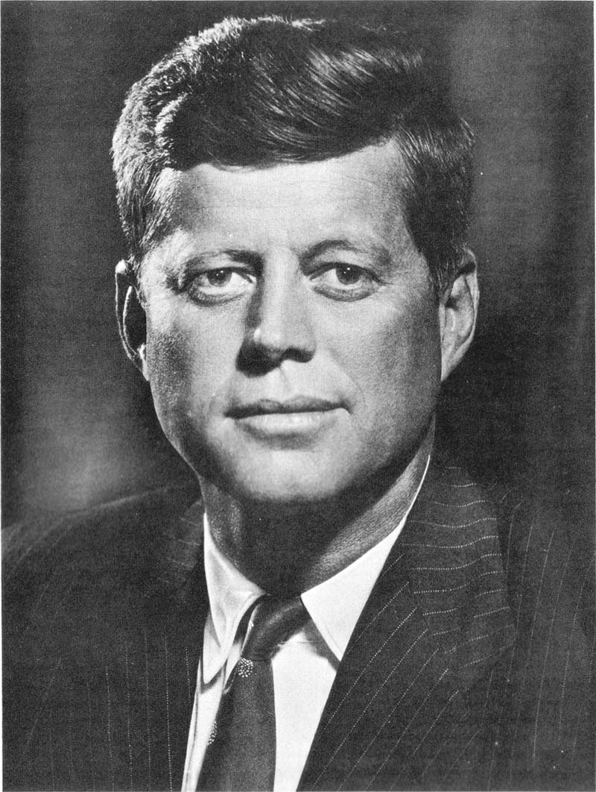

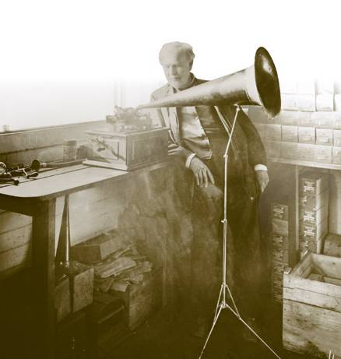

THE PICTURE OF DYSLEXIA
(ALL STENGTHS DO NOT OCCUR FOR EVERYONE)
(Alexander & Conway, 2007)
STRENGTHS
LEADERSHIP SKILLS
THINKING “OUT OF THE BOX”
CHURCHILL
THOMAS EDISON
JFK
TED TURNER
POLITICAL
&
MILITARY
PATTON
BUSINESS
SCIENTISTS &
INVENTORS

Slide 6




THE PICTURE OF DYSLEXIA
(ALL STENGTHS DO NOT OCCUR FOR EVERYONE)
(Alexander & Conway, 2007)
STRENGTHS
CREATIVITY
WRITERS
ARTISTS
MUSICIANS
ACTORS/DIRECTORS
H.C. ANDERSEN
Da VINCI
MOZART
SPEILBERG / FORD

Slide 7
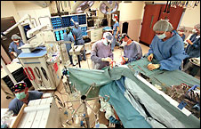

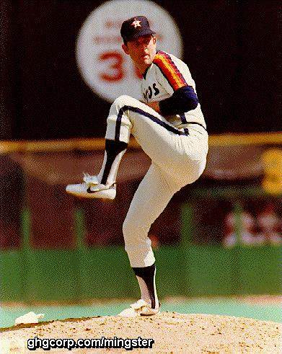
THE PICTURE OF DYSLEXIA
(ALL STENGTHS DO NOT OCCUR FOR EVERYONE)
(Alexander & Conway, 2007)
STRENGTHS
VISUOSPATIAL / MOTOR SKILLS
SURGEONS
ATHLETES
NEUROSURGERY
MUHAMMAD ALI
NOLAN RYAN

Slide 8
THE PICTURE OF DYSLEXIA
(ALL SYMPTOMS DO NOT OCCUR WITH EVERYONE)
(Alexander & Conway, 2007)
ORAL LANGUAGE
CHALLENGES
LISTENING
SPEAKING
Phonological Awareness
Word Finding
Multi-syllable Words
Auditory Memory
(word sequences, phone numbers,
remembering directions)
Sequencing Ideas
Foreign Language
Foreign Language

Slide 9
THE PICTURE OF DYSLEXIA
(ALL SYMPTOMS DO NOT OCCUR WITH EVERYONE)
(Alexander & Conway, 2007)
WRITTEN LANGUAGE CHALLENGES
READING
SPELLING & WRITING
Mechanics
Comprehension
Mechanics
Expressing Ideas
Speed
Speed

Slide 10
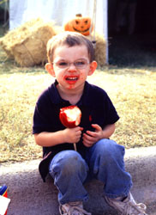
THE PICTURE OF DYSLEXIA
(ALL SYMPTOMS DO NOT OCCUR WITH EVERYONE)
(Alexander & Conway, 2007)
ACCOMPANYING SENSORIMOTOR CHALLENGES
Messy Eating
Oral Motor
Writing/knots
Fingers
Lose Place
Words Swim
Eyes
Tired
Left/Right
Spatial Awareness
Up/Down

Slide 11
Sensorimotor Pyramid
Cognition
Academic
Learning
ADL’s Behavior
Perceptual-
Motor
Auditory Visuospatial Focus
Language Perception Attention
Eye-Hand Ocular-Motor Postural
Coord Control Adjustment
Sensory-
Motor
Body Scheme Reflex Maturity Screen Input
Postural Security Bilateral Awareness Motor Planning
Sensory
Olfactory Visual Auditory Gustatory
Tactile Vestibular Proprioception
Central Nervous System
Notes:
Viewing a sensori-motor “pyramid” highlights the contributions these systems may play in supporting Academic Functions. Ultimately, the “body functions” play a role in the operation of the “academic functions”

Slide 12

THE PICTURE OF DYSLEXIA
(ALL SYMPTOMS DO NOT OCCUR WITH EVERYONE)
(Alexander & Conway, 2007)
ACCOMPANYING CHALLENGES (BEHAVIORAL)
Attention & Executive Function
Anxiety
Brain / Behavior
Disorders
OCD
Oppositional
Behavior
Depression
Parents with similar challenges

Slide 13
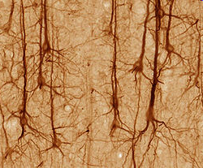
Notes:
Ultimately, the “picture” of dyslexia comes down to the neurons. What’s happening now or happened in the past with the neurons, can be the driving force behind the particular picture of a specific child or adult with developmental dyslexia.

Slide 14
“CHANGES IN SYNAPSES?”
AT WHAT AGE DO NEURONS LOSE THE ABILITY TO MAKE NEW CONNECTIONS (SYNAPSES) WITH OTHER NEURONS?

Slide 15
NEURONS - How the Brain Works
How Many Neurons In The Brain?
  ~ 100 Billion
How Many Connections Exist in the Neural Networks Formed in the Brain?
  ~ 100 Trillion
How Many “Connections” for a Single Neuron?
  ~ 40,000

Slide 16
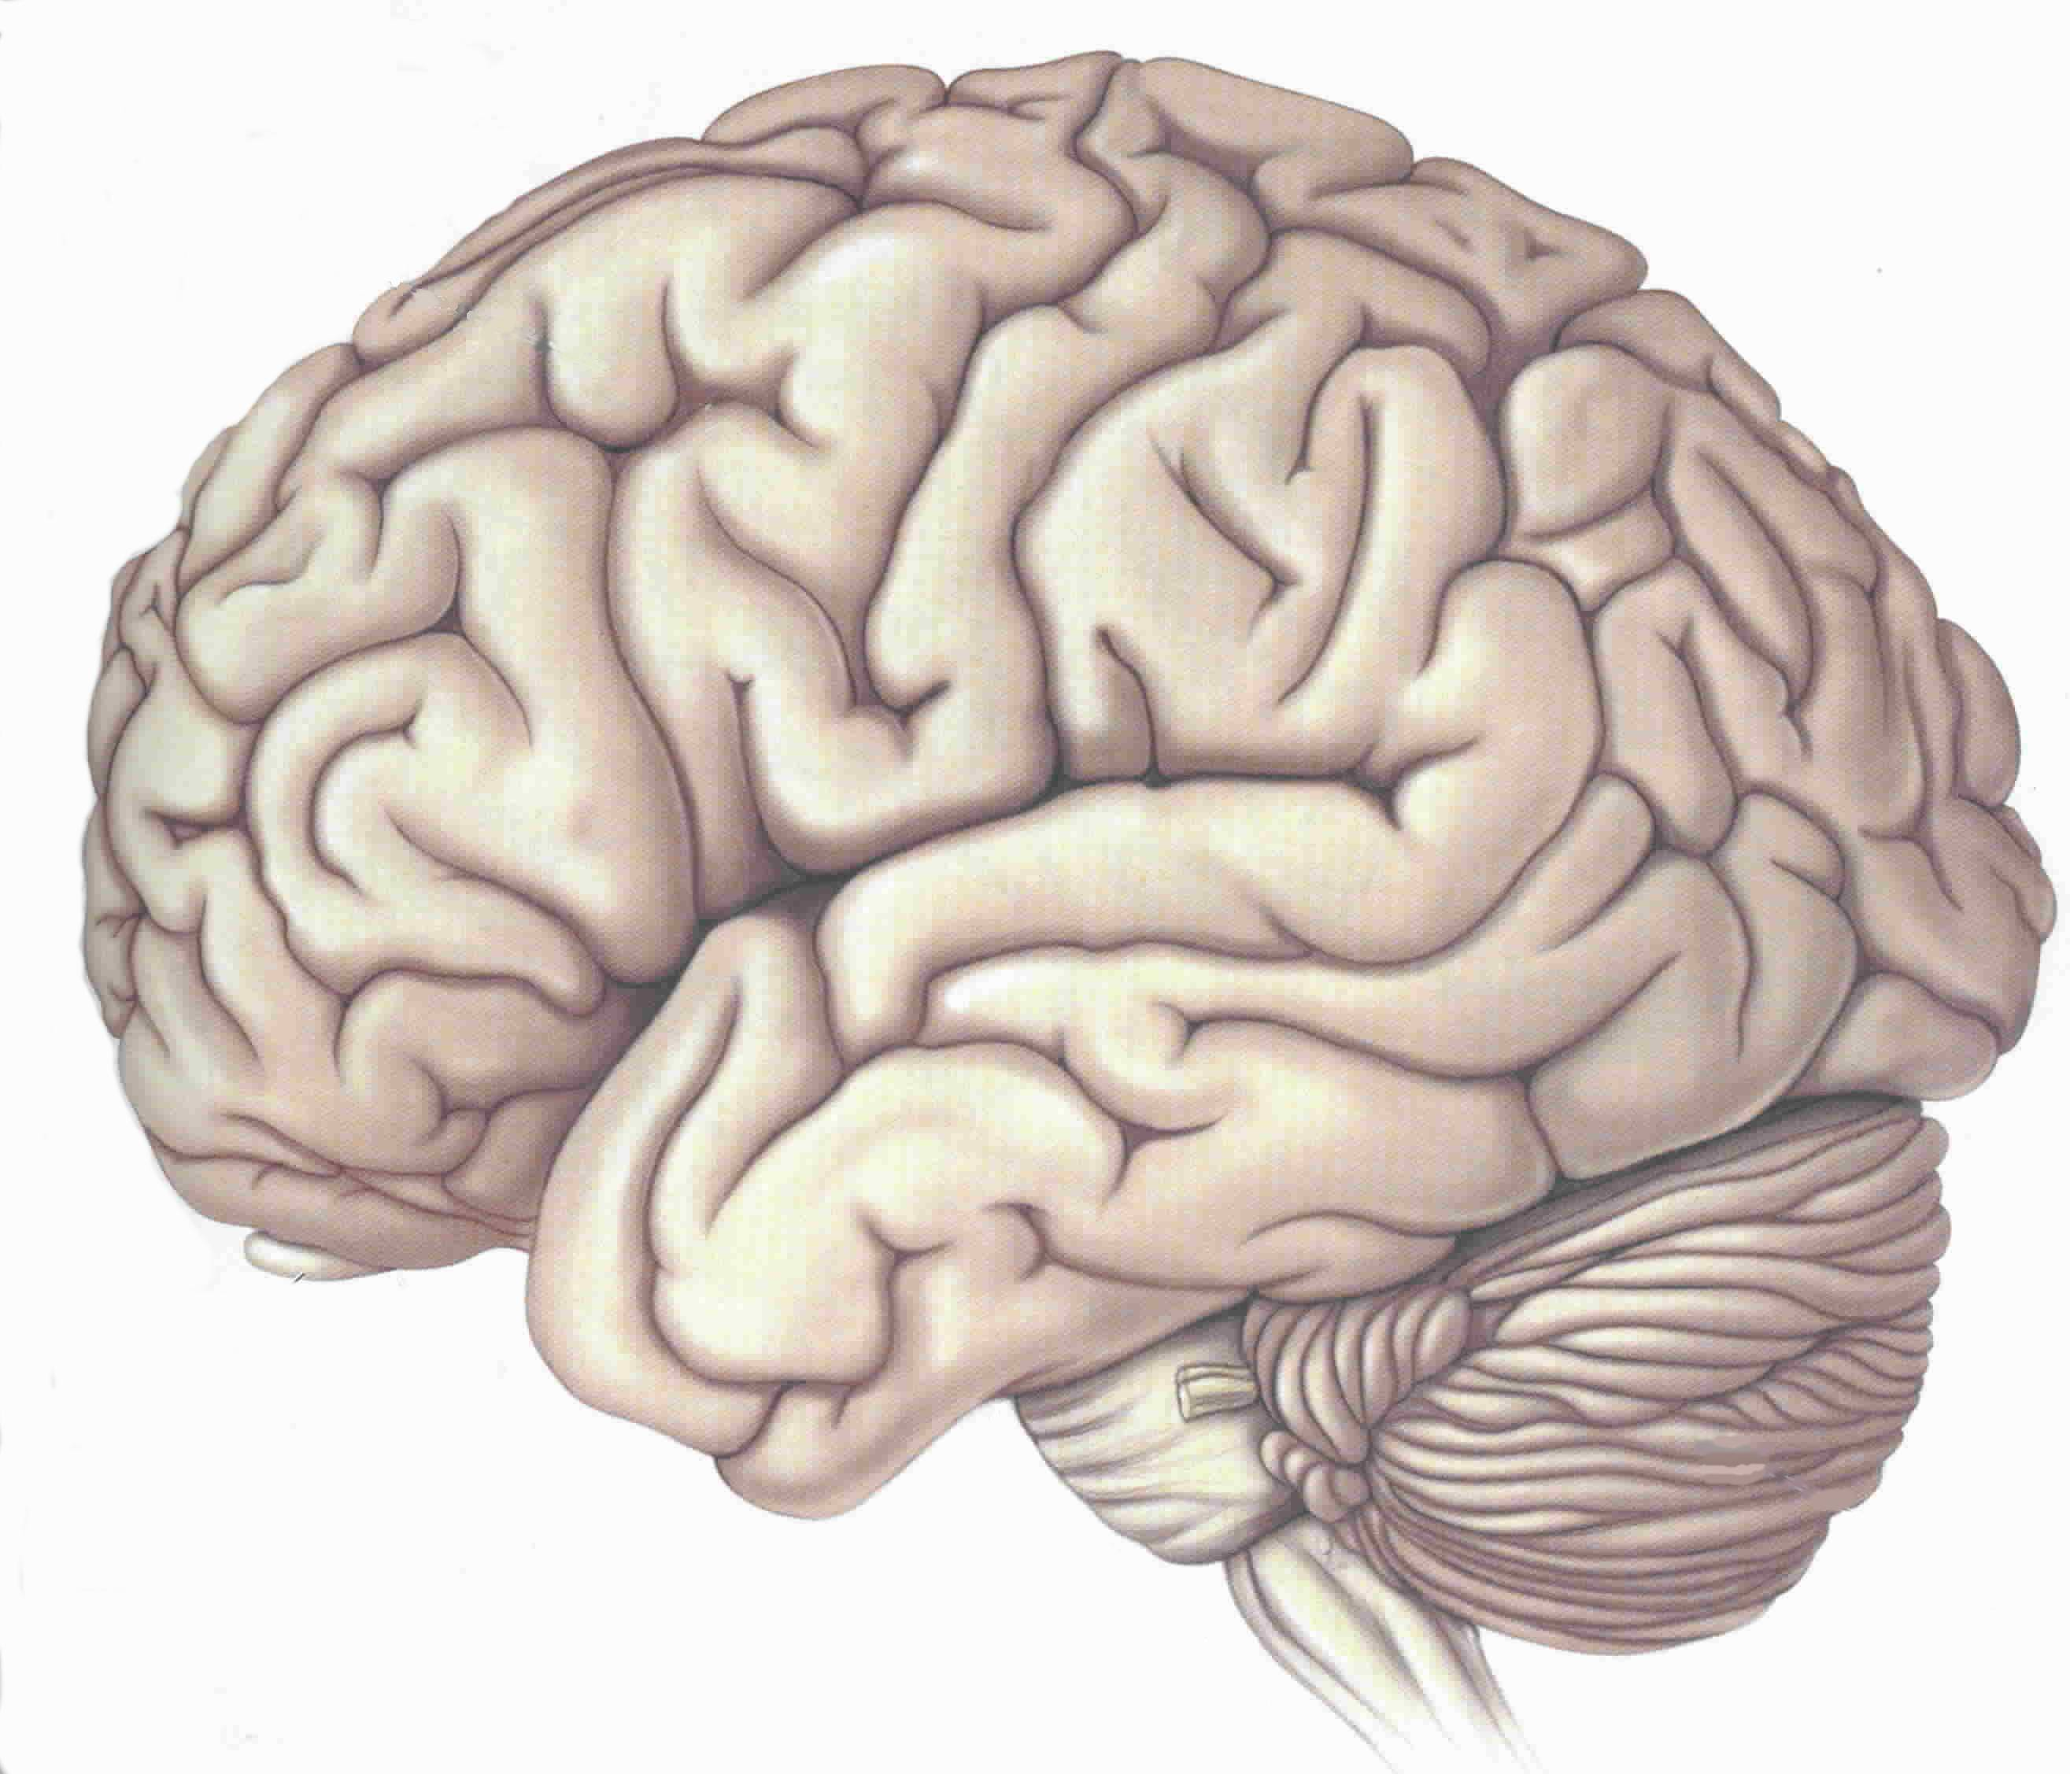
TYPICAL LANGUAGE AREAS
VISUAL-LANGUAGE
ASSOCIATION AREA
VISUAL /
VERBAL
AREA
SPEECH
PRODUCTION
AREA
AUDITORY
PROCESSING
AREA
LEFT HEMISPHERE

Slide 17
TYPICAL READING AREAS
WORD ANALYSIS
WORD ANALYSIS
AUTOMATIC
(SIGHT WORD)
LEFT HEMISPHERE

Slide 18
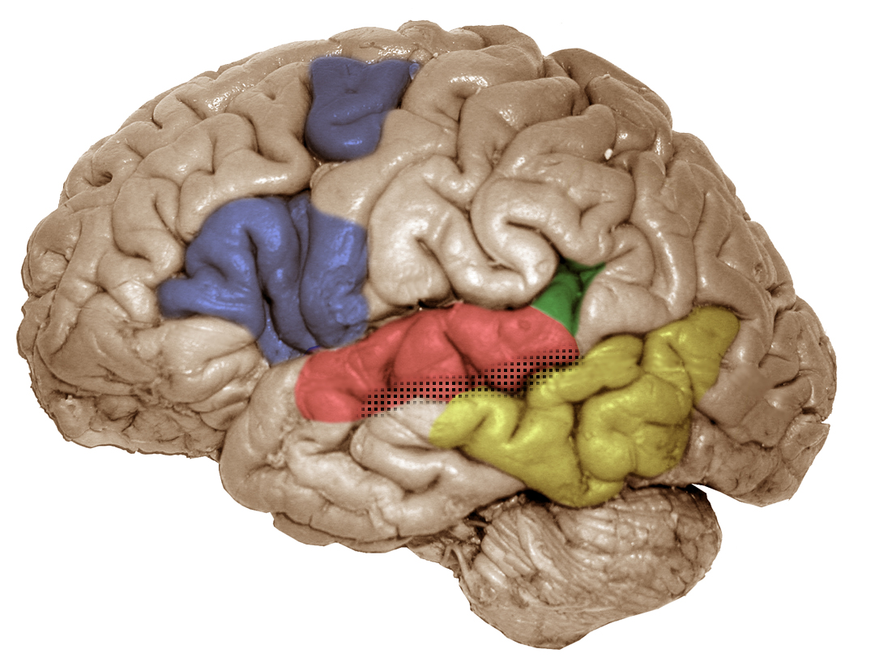
pIFG/dPM (left)
articulatory-based
speech codes
Area Spt (left)
auditory-motor interface
STG (bilateral)
acoustic-phonetic
speech codes
STS phoneme
representations
pMTG (left)
sound-meaning interface
Hickok & Poeppel (2000), Trends in Cognitive Sciences
Hickok & Poeppel (2004), Cognition

Slide 19
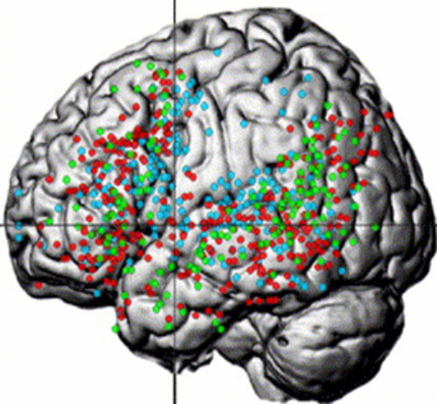
UNIQUE AND OVERLAPPING NETWORKS
SENTENCE/SYNTACTIC, SEMANTIC, PHONOLOGICAL
VIGNEAU et al., 2006

Slide 20
Developmental Building Blocks for Language
9 YEARS
METALINGUISTICS
WRITING
SPELLING
5 YEAR S
READING
SYNTAX
18 MONTHS
(FORM)
SEMANTICS
9 MONTHS
(MEANING)
PHONOLOGY
(FORM)
PRAGMATICS
(FUNCTION)
1 MONTH
Notes:
Sensorimotor, phonology and language skills are developing immediately post-birth and continue so for quite some time.

Slide 21
Is There a Neurobiological Basis to Dyslexia?

Slide 22
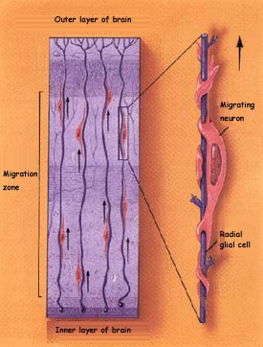
NEURAL MIGRATION
GONE AWRY IN DEVELOPMENTAL DYSLEXIA
NEURONAL MIGRATION
X
www.thebrain.mcgill.ca

Slide 23
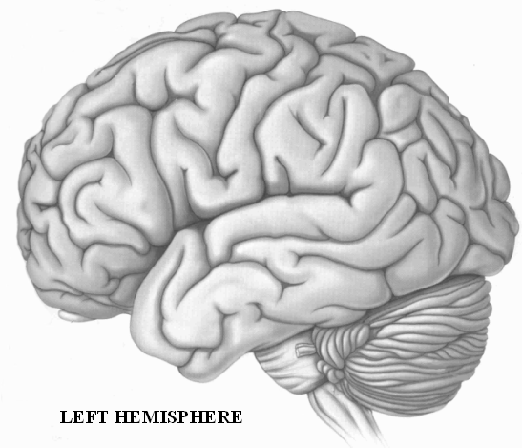
“OUT OF LINE NEURONS” (ECTOPIAS)
FRONT
BACK

Slide 24
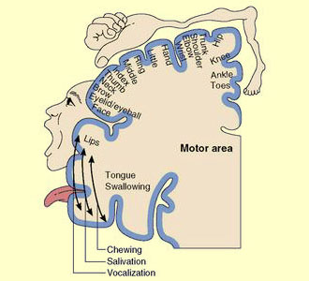

Slide 25
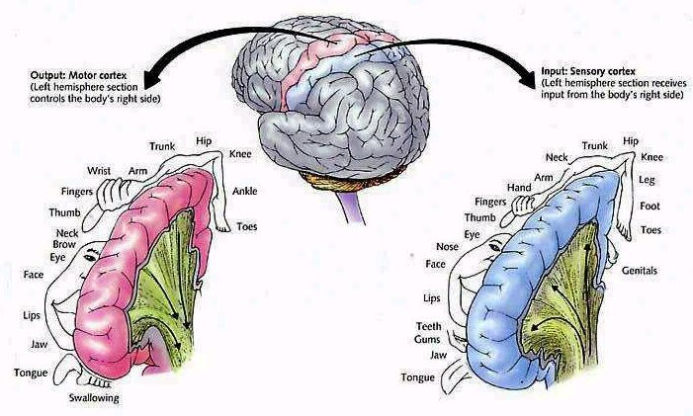

Slide 26
NEURONAL MIGRATION
(GALABURDA, LOTURCO, RAMUS, FITCH & ROSEN, 2006)
Galaburda, 2006

Slide 27
From Genes to Behavior in Developmental Dyslexia.
Galaburda AM, LoTurco J, Ramus F, Fitch RH, Rosen GD.
Nat Neurosci. 2006 Oct;9(10):1213-7.
Department of Neurology, Division of Behavioral Neurology, Harvard Medical School, Beth Israel Deaconess Medical Center, 330 Brookline Avenue, Boston, Massachusetts 02215, USA.
All four genes thus far linked to developmental dyslexia participate in brain development, and abnormalities in brain development are increasingly reported in dyslexia. Comparable abnormalities induced in young rodent brains cause auditory and cognitive deficits, underscoring the potential relevance of these brain changes to dyslexia. Our perspective on dyslexia is that some of the brain changes cause phonological processing abnormalities as well as auditory processing abnormalities; the latter, we speculate, resolve in a proportion of individuals during development, but contribute early on to the phonological disorder in dyslexia. Thus, we propose a tentative pathway between a genetic effect, developmental brain changes, and perceptual and cognitive deficits associated with dyslexia.

Slide 28
BRAIN ACTIVITY DURING READING
STRONG
ACTIVITY
PATTERN
weak activation
pattern
“SIGNATURE” DYSLEXIC BRAIN
Simos, et al 2002
Notes:
Prototypical comparison of dyslexic and non dyslexic MSI study. The activated areas are, from left to right in the lower right panel, the angular gyrus, Wernicke’s area, and superior temporal gyrus (heavily involved in phonology. Activate after initial sensory activation in occipital area (not depicted) and activation of secondary association area (basal temporal- in yellow) and the simultaneous activation of red, representing a neural network supporting word rec- difference is obvious- in the language hemisphere in the normal reader and the nonlanguage hem in the poor reader

Slide 29
TREATMENT CHANGES the BRAIN’S ACTIVITY
Decreased activity in right hemisphere
Treatment = Increased activity in left hemisphere
(Simos et al 2002)
Notes:
I ask audience why this happened or who did it- instruction, teacher- brain has to learn that words are part of the language system- instruction is needed, whether by parents or a teacher or some other adult- brain not specialized for reading without environmental intervention

Slide 30
Biology
(RAMUS, 2004)
Cognition
Behavior
Notes:
Strong evidence that there are neuronal influences on body functions (cognition) and academic functions (behavior). So, where does Occupational Therapy fit in with all of this?

Slide 31
(Alexander, 2006)

Slide 32
PHONOLOGY
(Alexander, 2006)
(PERCEPTION & PRODUCTION)
EXECUTIVE FUNCTION / INTENTION
WORKING MEMORY
HOLD / MANIPULATE
PROSODIC
(WORD LEVEL)
PHONEMIC
REPRESENTATION
ORAL MOTOR
SOMATOSENSORY
ACOUSTIC
VISUAL
ATTENTION / AROUSAL
Notes:
Breaking phonology into it component parts helps highlight the critical sensori-motor skills that are core to language development. Explain stoplight model

Slide 33
THEORETICAL
DEVELOPMENTAL DYSLEXIA: A MOTOR-ARTICULATORY FEEDBACK HYPOTHESIS
(HEILMAN, VOELLER, ALEXANDER, 1996)
  “The inability to associate the position of their articulators with speech sounds may impair the development of phonological awareness and the ability to convert graphemes to phonemes. Unawareness of their articulators may be related to programming or feedback deficits.”

Slide 34
Transdisciplinary Team for
Assessment & Treatment
Disciplines:
  Neuropsychology
  Psychiatry
  Nursing/Nurse Practitioner/Developmental Pediatrics
  Clinical Psychology
  Occupational Therapy
  Speech-Language Pathology
  Education

Slide 35
Transdisciplinary Team
Disciplines on the team
  Pediatrician/Psychiatrist
  Nursing/Nurse Practitioner
  Psychologist/Neuropsychologist
  Occupational Therapist
  Speech-Language Pathologist
  Teacher/Special Education

Slide 36
Transdisciplinary Team Assessment
Two Phase Assessment
  Phase I:
  Screening & a Broad Neurodevelopmental Evaluation
  Phase II:
  Assessment of Specific Abilities
  - Identify an Individual Profile of Strengths & Weaknesses (for diagnostic and treatment planning purposes)

Slide 37
Transdisciplinary Team Assessment
Phase I Evaluation (broad screening)
  Neurodevelopmental evaluation (Nurse Practitioner)
    Medical and Developmental History & Exam
    Screening of all sensory & cognitive systems including sensorimotor, learning & memory, attention, speech/language,
    vision, motor planning and cognition
    Nutrition, sleep, behavior, allergies, genetic history, other concerns…
  Psychological evaluation (Psych or Psychiatry)
    Diagnostic interview – psychosocial, educational, behavior, & family history

Slide 38
Transdisciplinary Team Assessment
Phase II – identify an individual strengths and weakness:
  Attention/Intention
  Intelligence/Cognition
  Oral Language
  Memory
  Sensorimotor
  Written Language
  Mathematics
  Behavioral Observations

Slide 39
Transdisciplinary Treatment Program
Key treatment features are based on neuroscience and behavioral treatment research findings
  Intensity (# of hours per day)
  Frequency (# of days per week)
  Specificity (clarity of treatment program)
Selective post-treatment assessment with standardized tests to document treatment gains
Ongoing data collection of program effects for program self-evaluation

Slide 40
Transdisciplinary Treatment Program
Treatment Targets Within and Across Disciplines
Speech-Language Therapy
  Targets improving foundational language skills that may cause the learning difficulty, e.g. phonological processing/decoding
Occupational Therapy
  Targets sensory and motor skills that may contribute to learning difficulties, e.g. sensory defensiveness, visual processing/perception, etc.
Psychiatric/Medical
  Medication and behavioral management of attention, mood or behavior disorders.
Psychological Treatment
  Client - developing adaptive coping skills for academic and life stressors
  Parent - better behavior management, conflict resolution training, etc…
  Client & Parent/Spouse (separately or combined) - developing adaptive family or marital functioning, relative to learning and other difficulties.

Slide 41
Case Study
High school student
History of dyslexia since elementary school
Parent is a school teacher
Years of school-based academic intervention and specialized tutoring at franchised centers…
Starting athlete with scholarship potential, but he has body function and academic deficits in…

Slide 42
Case Study - Assessment Findings
Deficits in:
  Attention
    ADHD-Inattentive
  Language
    Phonological
    Reading
    Writing
    Spelling
    Written comprehension
    Expression.
  Sensorimotor
    Visual vigilance
    Visual tracking
    Vestibular
    Visual perceptual
    “Low Registration” on Sensory Profile
    Poor balance with eyes closed
    Poor supine flexion.

Slide 43
Case Study: Transdisciplinary Treatments
Psychology:
  Individual therapy
  Therapy with mother
Speech-Language:
  Phonological Awareness (LiPS Program®)
  Mental Imagery
  (Visualizing & Verbalizing®)
  Written Composition
  (Visual-Kinesthetic Sentence Structure).
OT
  Sensory modulation & processing - esp. vestibular
  Oculomotor skills
  Joint stability
  Visual perceptual skills
  Balance
  Movement perception
  Sequencing.

Slide 44
Case Study:
Transdisciplinary Treatment of Dyslexia
Treatment Schedule:
Daily
4-6 hours treatment per day
  ~1 hour of OT
  ~3-5 hours language
5 days per week
~12 weeks
Treatment Hours:
Phonological/Cognitive: ~150
(LiPS®)
Semantic/Memory (V/V®): ~50
Syntax/Cognitive (VKSS): ~50
Physical Medicine: ~45.

Slide 45
Sensorimotor Functions:
Visual-Motor Integration (VMI)
IQ=101
Standard score
Notes:
Motor – 75 to 89 Standard score (14 points of improvement; ~1SD)

Slide 46
Sensorimotor Functions:
Test of Visual Processing Skills-3
IQ=101
Scaled score

Slide 47
Language Functions:
Comprehensive Test of Phonological Processing (CTOPP)
Standard score

Slide 48
Improved Sensorimotor Functions
Sensory Processing – “Low registration” was improved with medication and arousal strategies for use at home and school.
Processing/ Modulation of Vestibular Information - R & L LE balance without vision = 4 and 7 secs, improved to 21 and 18 secs; impaired supine flexion improved to 90 seconds while counting (without holding shoulders); depressed post rotary nystagmus was improved
Oculomotor Skills - losing his place during reading and poor visual endurance (blinked excessively during visual tasks/testing), both visual tracking and endurance were improved and excessive blinking was markedly decreased
Visual Perception -TVPS=83 SS (below average) to TVPS=110 (high average)
Graphomotor Skills - VMI Motor Coordination = 75 SS improved to 89
Oral Motor Skills - improved oral-motor “feeling” or proprioception

Slide 49
Academic Functions:
WECHSLER INDIVIDUAL ACHIEVEMENT TEST (WIAT-II)
Standard score

Slide 50
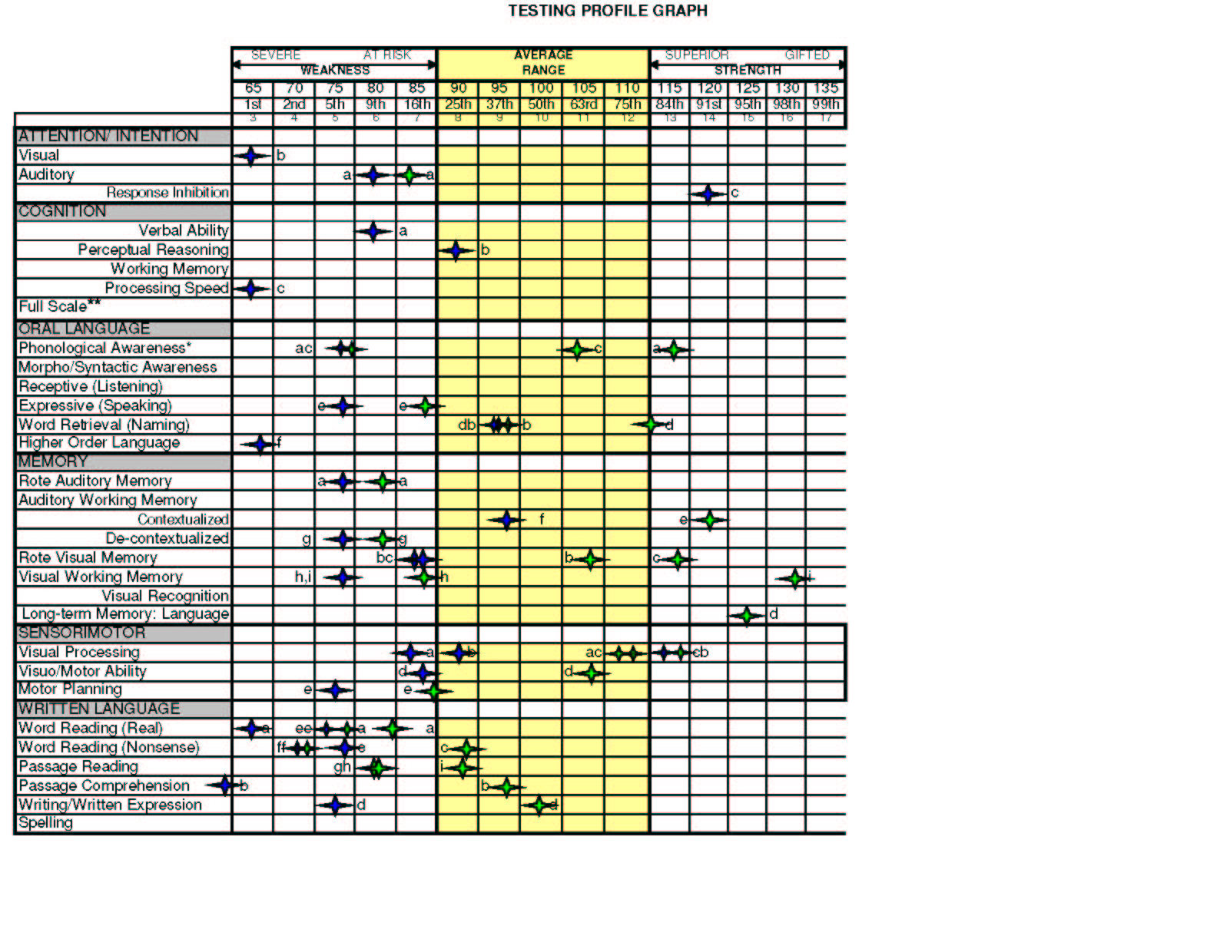
pre-treatment skills
post-treatment skills
Notes:
vz

Slide 51
Treatment Summary
Participant01 Demonstrated:
Improved Attention, Language, Sensorimotor and Academic (passed high school proficiency tests and will get a standard diploma)
Planning to enroll in Junior College and play sports on an athletic scholarship

Slide 52
Conclusions
Adults with language-based learning difficulties may be able to make significant improvements in areas of attention, sensorimotor, visual perceptual, language and academic functioning.
The multifaceted nature of the challenges for many adults with language-based learning difficulties may be best treated by a transdisciplinary team.
Large scale studies are needed to identify if there are pre-treatment cognitive/sensorimotor profiles that may be more responsive to these types of intervention.

Slide 53
Thank You
Questions or Comments?

